Slide 1
Reservoir Analysis for Deep Direct-Use
Feasibility Study
in East Texas
Joseph Batir, Maria Richards, and Harrison Schumann
Southern Methodist University Geothermal Laboratory
Jbatir@gmail.com
GRC Technical Talk, Monday October 15, 2018

Slide 2
Research Problems
A low temperature geothermal resource exists in the Texas/Louisiana Gulf Coast, most suitable for direct-use applications. How do we turn a low-grade heat resource into a high value economic product?
Can a turbine air inlet cooling system using the geothermal resource - through the application of an absorption chiller –increase the efficiency of the gas turbine system and do so economically?
Outline
Geologic Overview
Reservoir Properties Review
NGDS Data Review
New data
Results and Conclusions

Slide 3
Research Questions
What is the temperature and volume of the low-temperature geothermal resource in the vicinity of the Eastman Chemical Power Plant near Longview, Texas?
Is this an economically feasible geothermal resource for turbine air inlet cooling?
Analysis Methods
Literature review of previous work in the area
Examine National Geothermal Data System (NGDS) for thermal regime, regional tectonics, and reservoir properties
Examine Railroad Commision of Texas (RRC) data to supplement reservoir properties, reservoir production, and formation depths

Slide 4
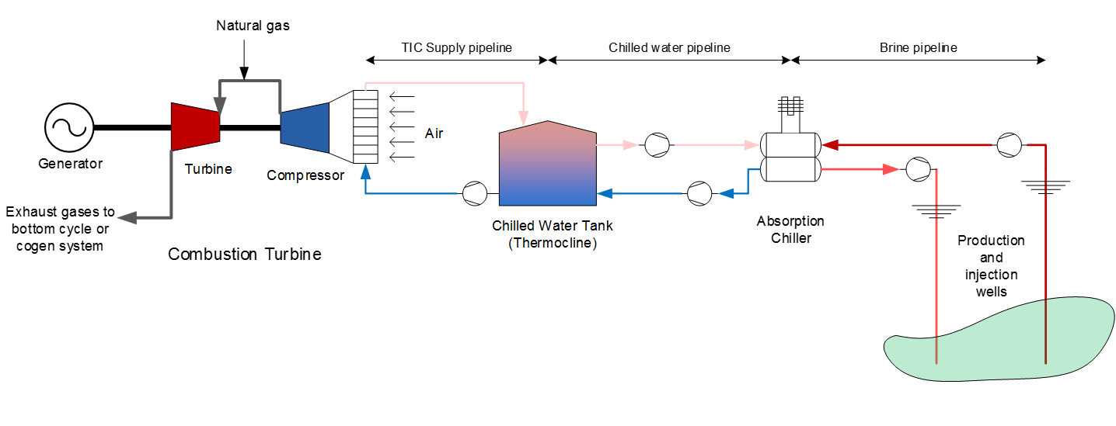
Application: Turbine Inlet Cooling (TIC)
Optimization variables:
Well location and depth
Formation temperature
Pipeline lengths
Tank volume
Chiller capacity
Chilled water dispatch to compressor inlet
Power market
Craig Turchi et al., Wednesday 2:40- 3:00 Industrial Uses

Slide 5
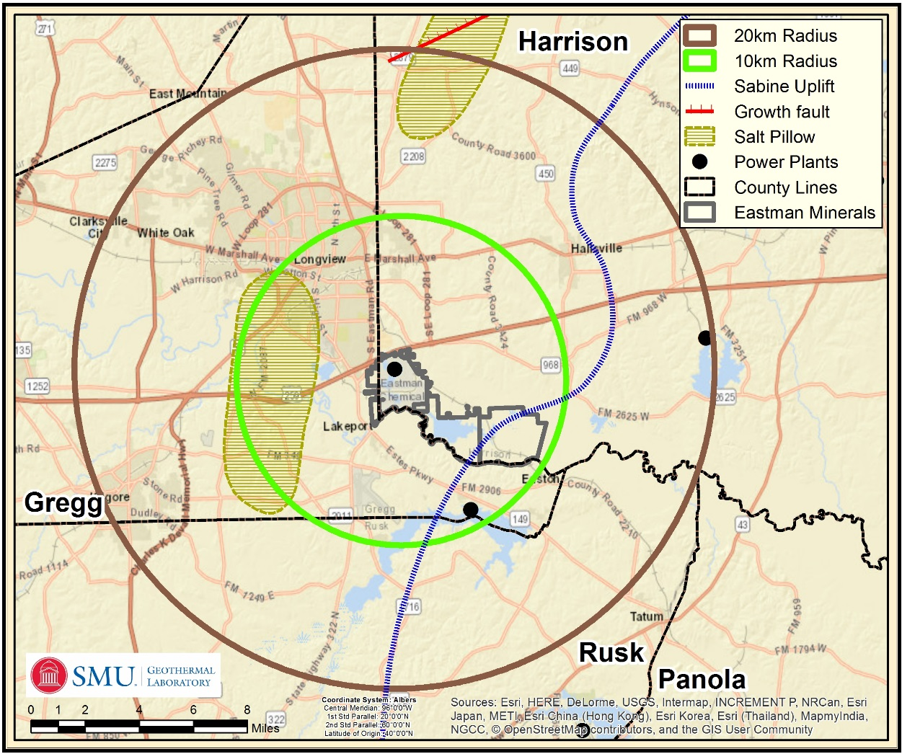
Study Area
Eastman Chemical Company
Southeast of Longview, Texas
Own mineral rights in plant area
235 MW Gas-turbine power plant
10 km radius circle – primary focus
20 km radius circle – geologic correlation

Slide 6
Regional Geology
East Texas
Western flank of the Sabine Uplift
Eastern flank of the East Texas salt basin
(modified after Hammes et al., 2011)

Slide 7
Area Tectonics
No major faults, growth fault to north
Salt Pillows to the west and north
Sabine Uplift to east
(Tectonic data from Ewing, 2001)

Slide 8
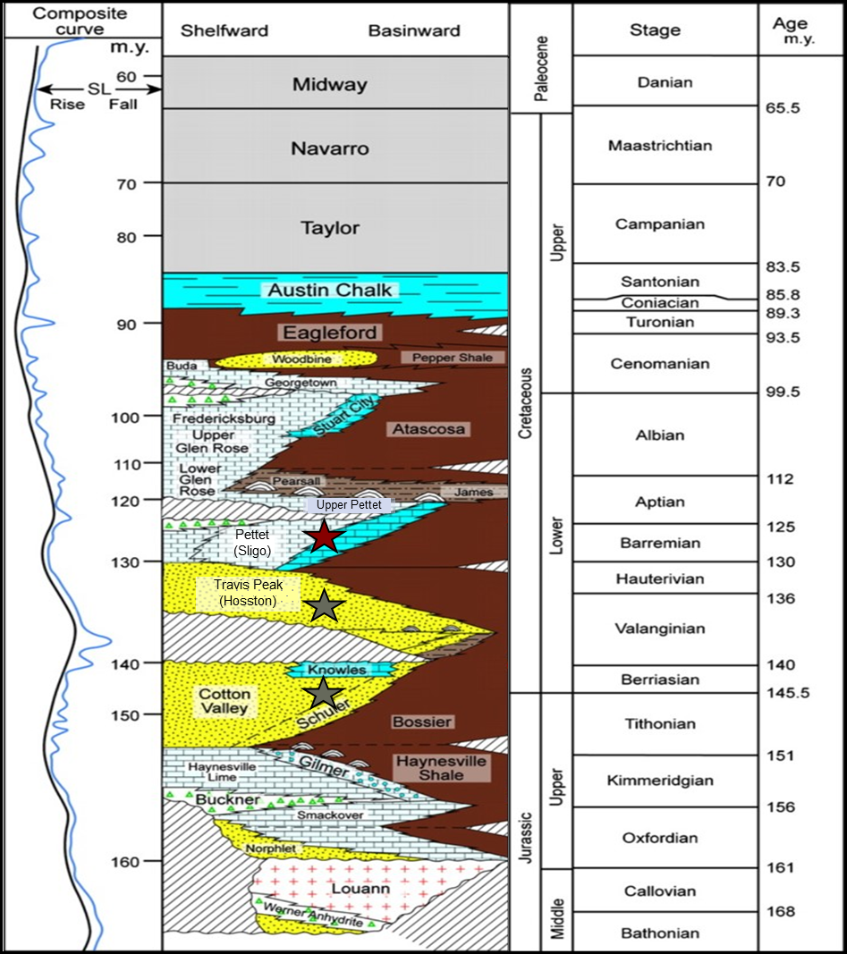
Stratigraphic Section
Primary target – Travis Peak Formation
Secondary targets – Cotton Valley (deeper); Pettett (shallower)
Study area is Shoreface to shallow marine
Reservoir quality can vary significantly
primary target
secondary target
(modified after Hammes et al., 2011)

Slide 9
Reservoir Hydraulic Properties
Field-scale published data sources for the parameters:
Average/Maximum/Minimum of
Porosity
Permeability
Reservoir thickness

Slide 10
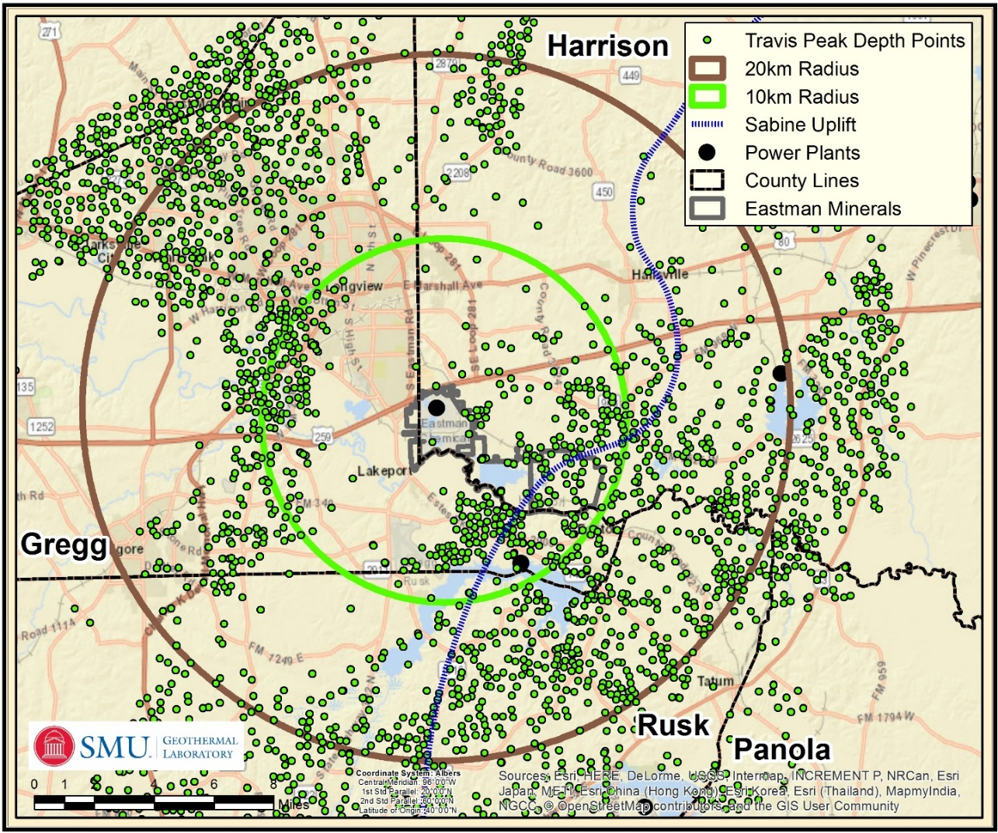
Well data
Texas RRC Public Data
Downloaded from Drillinginfo.com
1000's of wells available
Formation depth - used to calculate Formation thickness
Production/Injection interval
Production/Injection history
Well logs (.TIFF) for most wells

Slide 11
National Geothermal Data System
121 BHT derived heat flow from SMU node
Can increase heat flow resolution using available .TIFF well logs
No additional tectonic information
No additional reservoir properties information
Production and Injection data available – still to be incorporated

Slide 12
New Data

Slide 13
Thermal Data
121 original BHT derived heat flow sites
Now > 1400 sites within the 20 km radius
Pitman and Rowan (2012) thermal conductivity estimates used in heat flow calculation
Increased resolution
Improved total thermal heat in the reservoir

Slide 14
Results

Slide 15
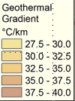
Regional Tectonics impact on thermal regime
No significant change in
Gradients
Formation tops

Slide 16
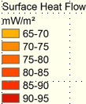
New Surface Heat Flow
Mineral Rights area consistent
Increased variability in 20 km

Slide 17
Reservoir Properties
* RFC = Reservoir Flow Capacity
**RPI = Reservoir Productivity Index, a value below 10 would require hydraulic stimulation
⁺ Thickness is an average based on the difference between formation tops/bottoms (MAX) and injection perforations (AVE) and hydrocarbon productivity zones (MIN).

Slide 18
Thermal Properties
Geologic Unit Name | 20 km Median Top (m) | 20 km Median Bottom (m) | Median Thickness (m) | Median Top Temperature (°C) | Median Bottom Temperature (°C) | Temperature Standard Dev. (°C) | Median Formation Gradient (°C/km)
Pettit Limestone | 2245 | 2319 | 74 | 99 | 101 | 7 | 27
Travis Peak Sandstone | 2319 | 2881 | 562 | 101 | 120 | 7 | 33.8
Cotton Valley Sandstone | 2881 | 3354 | 473 | 120 | 134 | 10 | 29.6
Minimum target formation temperature is 100 °C

Slide 19
Travis Peak Formation Top depth (2,000 m to 2,400 m) Well sites (green dots)

Slide 20
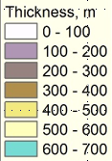
Travis Peak Formation Thickness
Consistent thickness under Mineral Rights
Thickness greater in 10 km radius to south and east

Slide 21
Travis Peak Heat Density
Mineral Rights area - average
SE and NW areas variable

Slide 22
Conclusions
Significant amounts of data are publicly available for geothermal reservoir analysis
National Geothermal Data System (NGDS), previous publications, and state organizations
Data are more easily accessible through proprietary data aggregation companies like Drillinginfo and IHS Energy
In East Texas, the Travis Peak Formation is a promising geothermal reservoir for direct use applications
The reservoir heat density varies from ~150 - 300 MJ/m³, which would have a significant impact on economic potential of the reservoir
NREL is working on economically viability of reservoir (See Craig Turchi talk on Wednesday afternoon)
Concerns - high salinity in the Texas formation fluids (~200,000 TDS)
Concerns - drilling cost for two production wells
Results presented here are applicable to several gas turbine power plant operators within our study area
The workflow and analysis methodology can be utilized in other prominent hydrocarbon producing basins to discover other deep direct use geothermal reservoirs

Slide 23
Thank you!
Sharon Fields and Cathy Chickering Pace of the SMU Geothermal Lab
Drillinginfo, ESRI, and IHS for educational software licenses
XTO Energy donated .LAS well logs
Collaborators: National Renewable Energy Lab (NREL) Eastman Chemical Company Turbine Air Systems (TAS)
This work was authored in part by the National Renewable Energy Laboratory, operated by Alliance for Sustainable Energy, LLC, for the U.S. Department of Energy (DOE) under Contract No. DE-AC36-08GO28308. Funding provided by U.S. Department of Energy Office of Energy Efficiency and Renewable Energy Geothermal Technologies Office under Contract No. DE-EE0001514. The views expressed in the article do not necessarily represent the views of the DOE or the U.S. Government. The U.S. Government retains and the publisher, by accepting the article for publication, acknowledges that the U.S. Government retains a nonexclusive, paid-up, irrevocable, worldwide license to publish or reproduce the published form of this work, or allow others to do so, for U.S. Government purposes.

