Slide 1
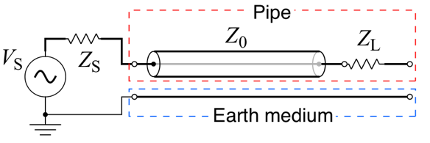
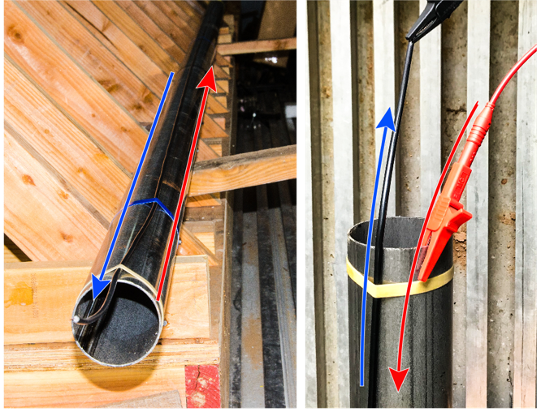
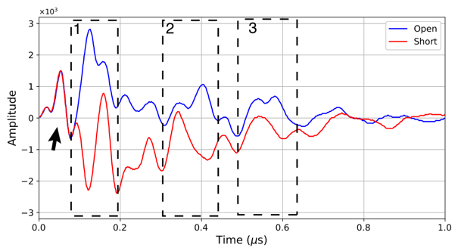
Physical modeling with low-carbon pipe: pipe in the air
6 m pipe
Using coaxial cable as return path in the air
1: Reflection from the end of the pipe

Slide 2
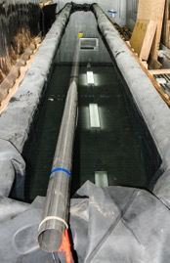
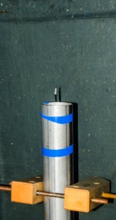
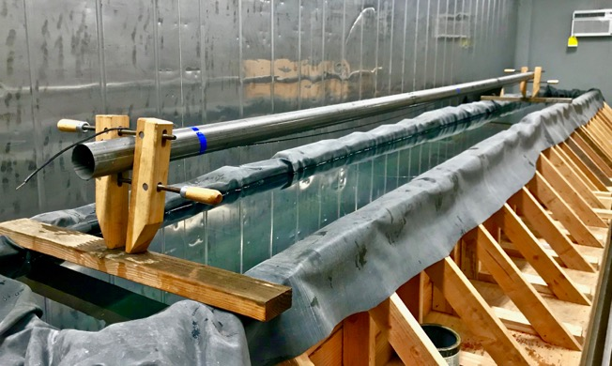
Physical modeling with low-carbon pipe: pipe in the water
One end in the water with open circuit termination
One end in the water with short circuit termination
Reflection from the end of the pipe

