Slide 1
Experiment 1 Injection and Production Thermistors
EGS Collab

Slide 2
Thermistor Design
Water infiltration through wire insulation/jacket is a likely failure mechanism for thermistor designs previously used in E1-I and E1-P.
To minimize water ingress, thermistor wiring is now fully encapsulated within stainless steel tubing.
E1-P Interval Thermistor
1/4in Tube
E1-P Bottom Thermistor
1/8in Tube
3/16in Tube
E1-P Interval Thermistor
1/8in Tube
3/16in Tube
Wire Splice
Epoxy
Thermistor Bead
Welded Tip
1/4in Tube
E1-P Bottom Thermistor

Slide 3
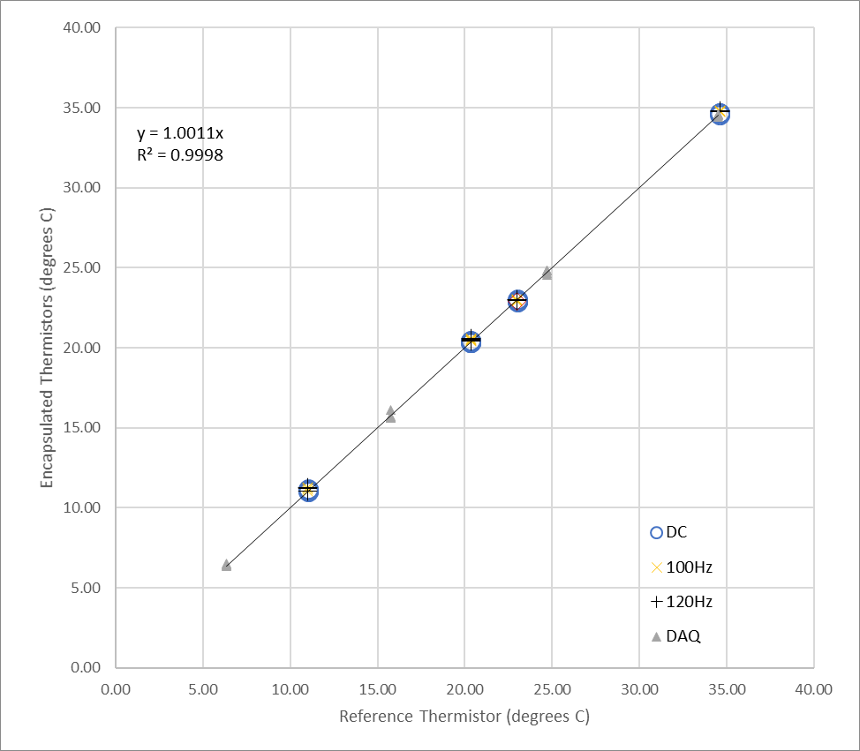
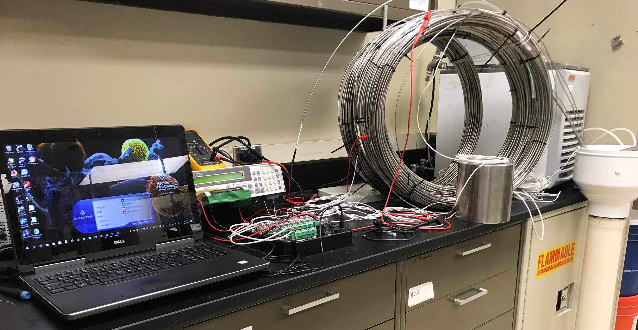
Laboratory Testing
Six encapsulated thermistor assemblies were built and tested in the lab using a recirculating temperature chamber.
Resistance/Impedance was measured using three systems: Agilent LCR, Fluke multimeter, and same DAQ used on the 4850 (Campbell Scientific CR6)
Stainless tubing was grounded to LCR and DAQ chassis.

Slide 4
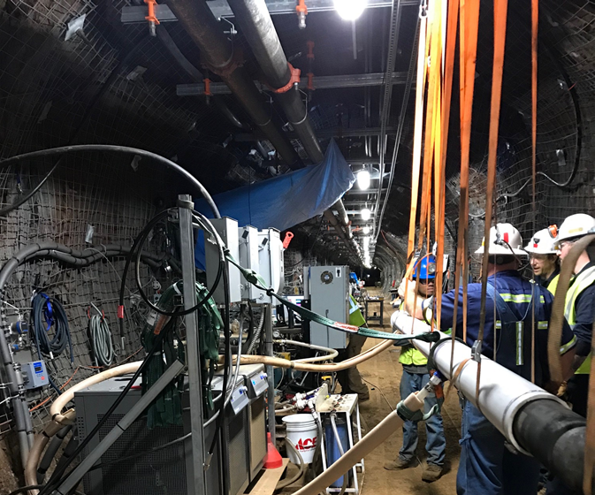
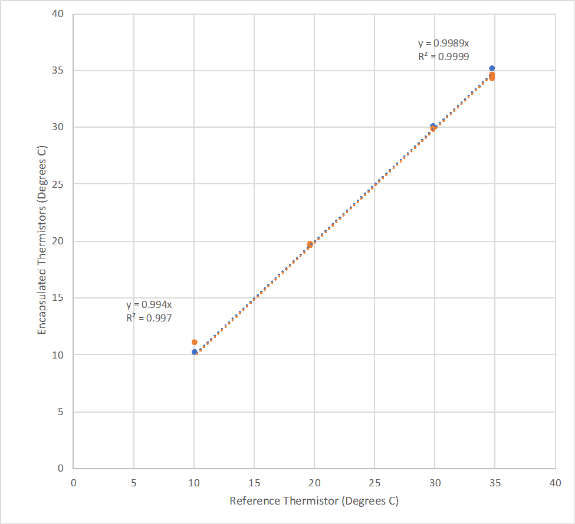
Field Installation
December 17th the production packer was removed, and encapsulated thermistors were installed in both the interval and bottom zones.
Performance of both thermistors was reassessed by inserting the packer/thermistor assembly into a recirculating temperature chamber on the 4850L.
Upper packer element was inflated, and chilled/heated water flowed in from the bottom of the packer and exited through the return lines (interval and bottom) to chiller tank.

Slide 5
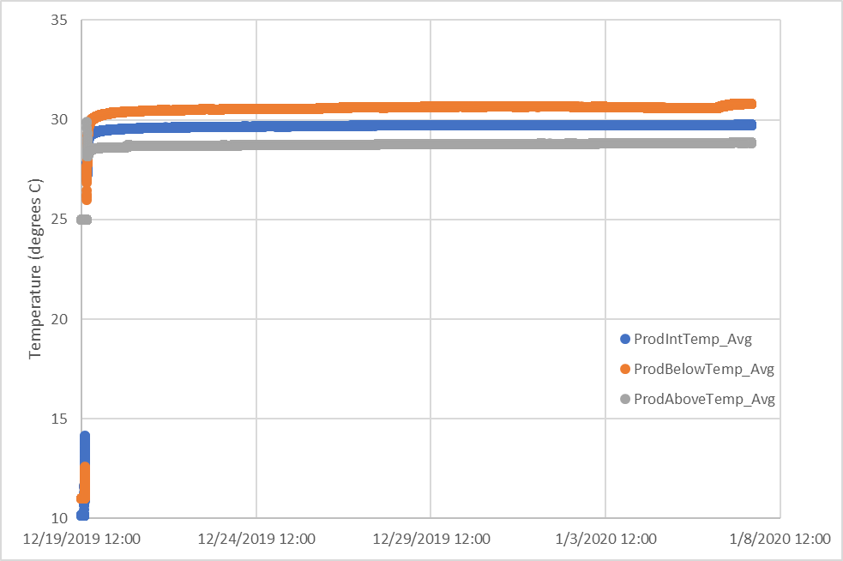
Results to Date
E1-P temperature measurements (original design) in April prior to failing:
  Interval ~29.6 C
  Bottom ~30.3C
New thermistor measurement:
  Interval ~29.6 C
  Bottom ~30.7C
New thermistor measurements suggest both interval and bottom zone production well temperatures have not changed since beginning of experiment

Slide 6
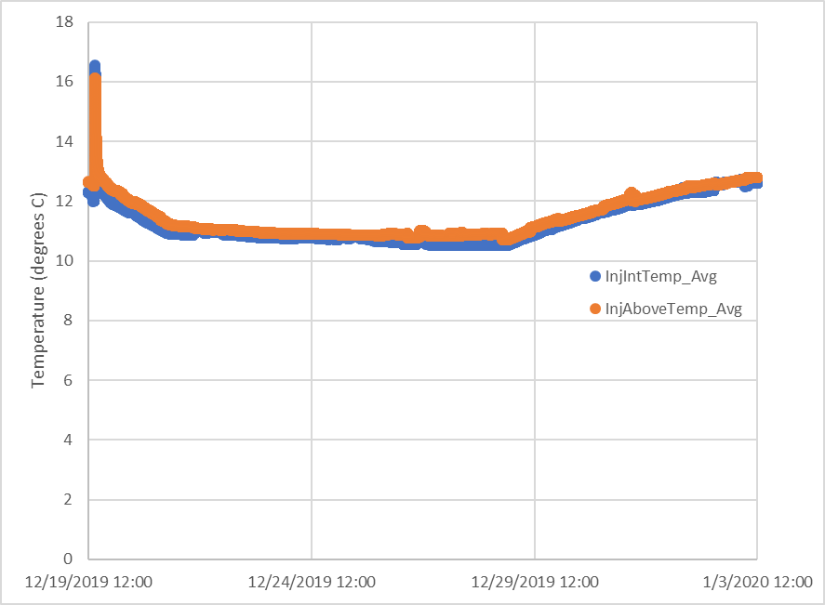
E1-I Thermistors
E1-I temperature above the packer were measured using a CSI-451 pressure transducer and show temperatures that are very similar to measurements in the injection between packer zone.
Gives confidence that injection well interval temperature measurements are correct.

