Slide 1

Application of Advanced Techniques for Determination of Reservoir-Scale Stress State at Utah FORGE/2-2404
PI: Ahmad Ghassemi

Slide 2
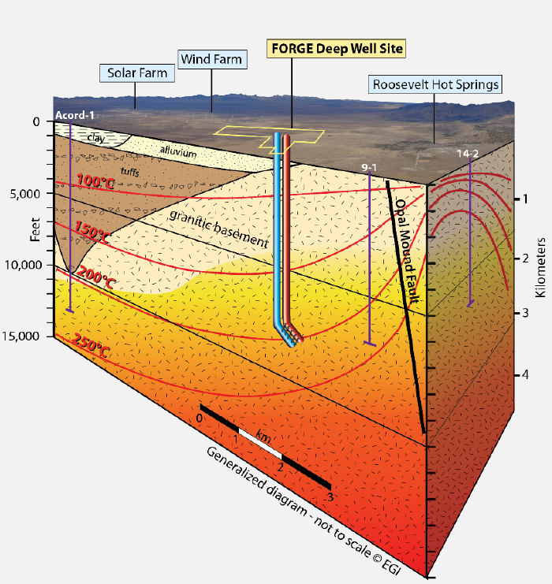




Background
In-situ Stress
  In-situ stress is of major interest to many subsurface science and engineering subjects
  EGS: In-situ stress impacts well drilling, hydraulic stimulation, induced seismicity, etc.
  In-situ stress tensor: the magnitude and orientation of three principal stresses
$$S_{v}$$
  Orientation
    borehole failure, seismic focal mechanisms, etc.
  Magnitude
    $S_{v}$: density log
    $S_{hmin}$: DFIT, LOT, XLOT…
    $S_{Hmax}$: challenging
$$S_{hmin}$$
$$S_{Hmax}$$
Source: Utah FORGE
  FORGE EGS
In-situ Stress Tensor

Slide 3
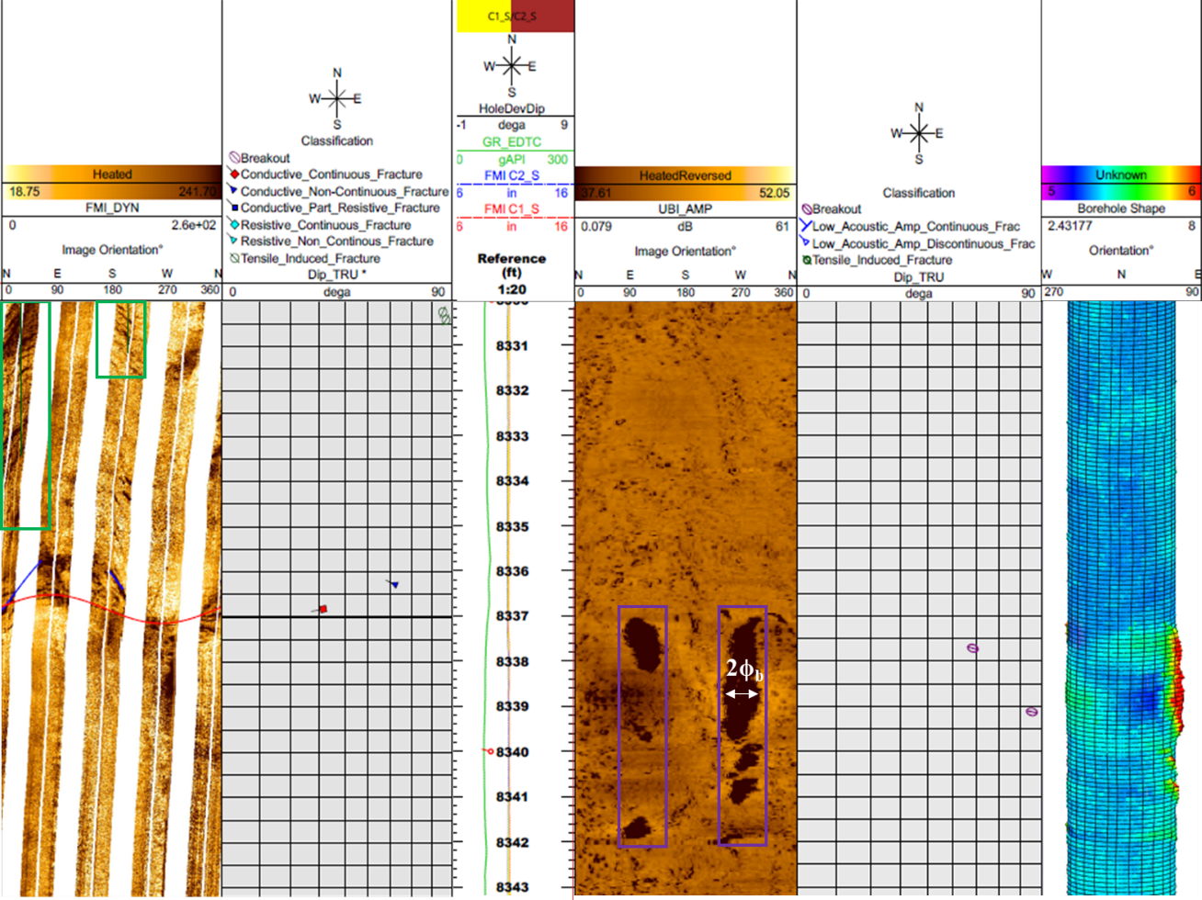
Background
Image Logs of FORGE Wells
  Deep FORGE wells with image logs
    Vertical wells: 78B-32, 56-32, and 58-32
    Deviated well: 16(A)78-32
    Image logs:
      Many drilling-induced fractures (DIFs) are observed
      Breakouts are rarely detected
    DIFs can be used to constrain in-situ stress
    Breakouts provide extra constraints
Tensile fractures
breakouts
Well name | Well Type | TVD, ft | Image Logs | Amount of DIFs | Amount of Breakouts
78B-32 | vertical | 9500 | FMI, UBI | 576 | 3
56-32 | vertical | 9145 | FMI | 260 | 1
58-32 | vertical | 7536 | FMI (Run 1) | 275 | 0
16A(78)-32 | deviated | 8560 | FMI, UBI | 399 | 0
Source: Utah FORGE
FMI and UBI Logs of 78B-32 @ 8330 ft. to 8342 ft.
(FMI = Formation Micro Imager; UBI=Ultrasonic Borehole Imager)

Slide 4
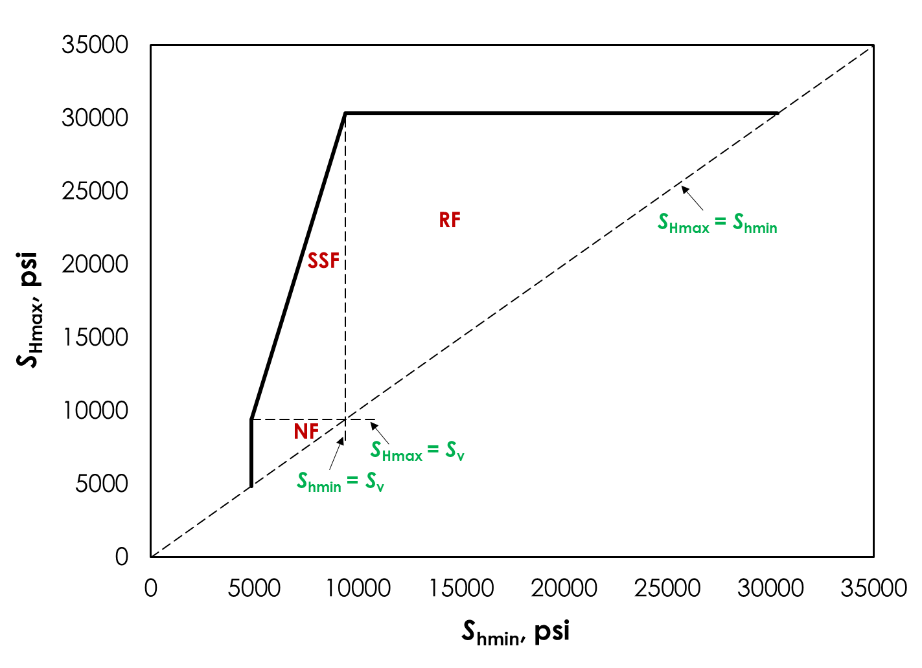
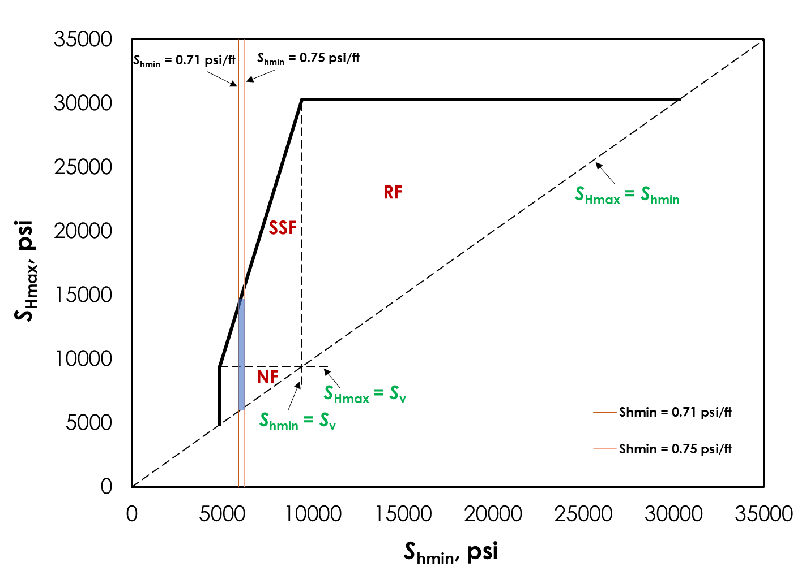
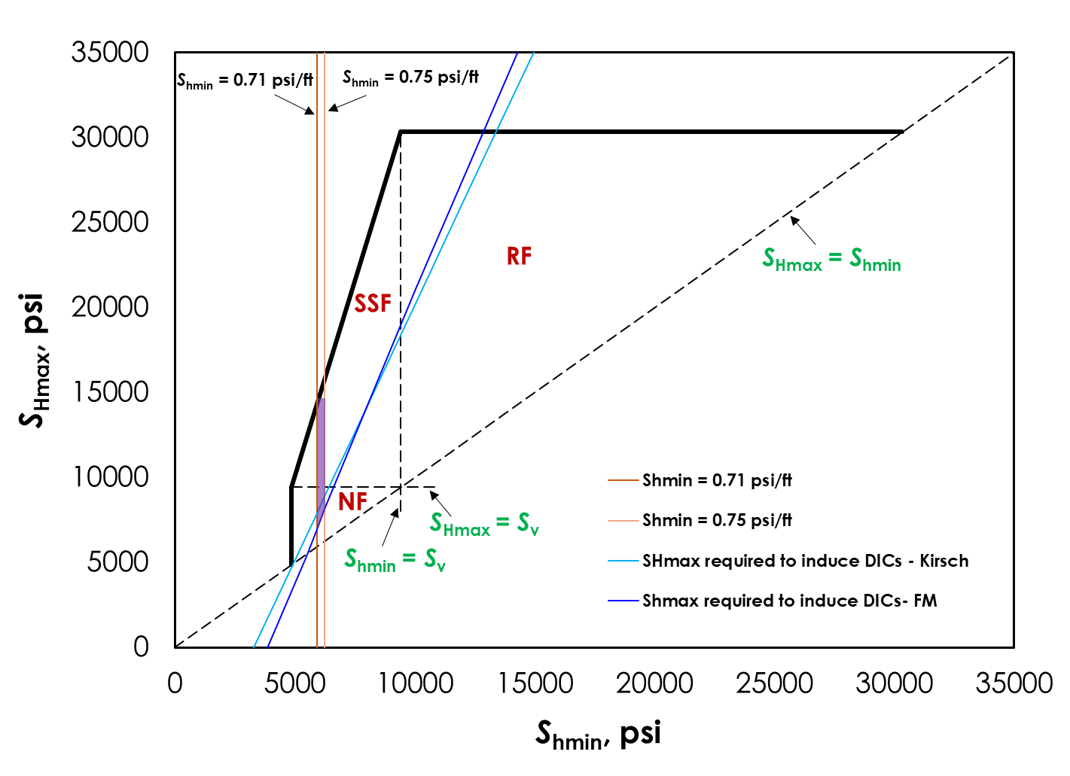
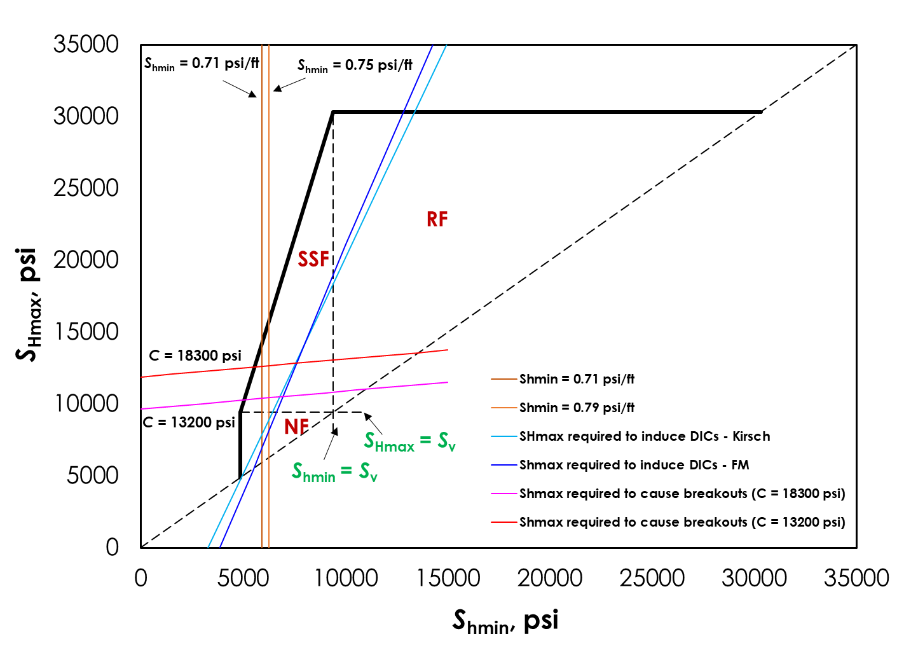
Stress Polygon
Stress Polygon @8336 ft. of 78B-32
(a)
(b)
(c)
(d)

Slide 5
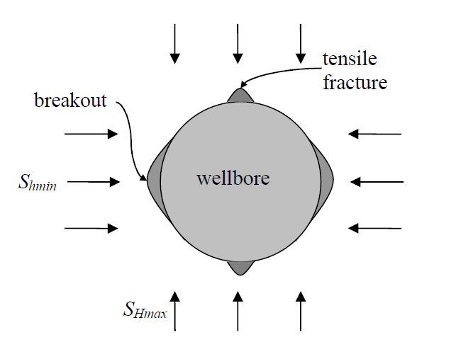
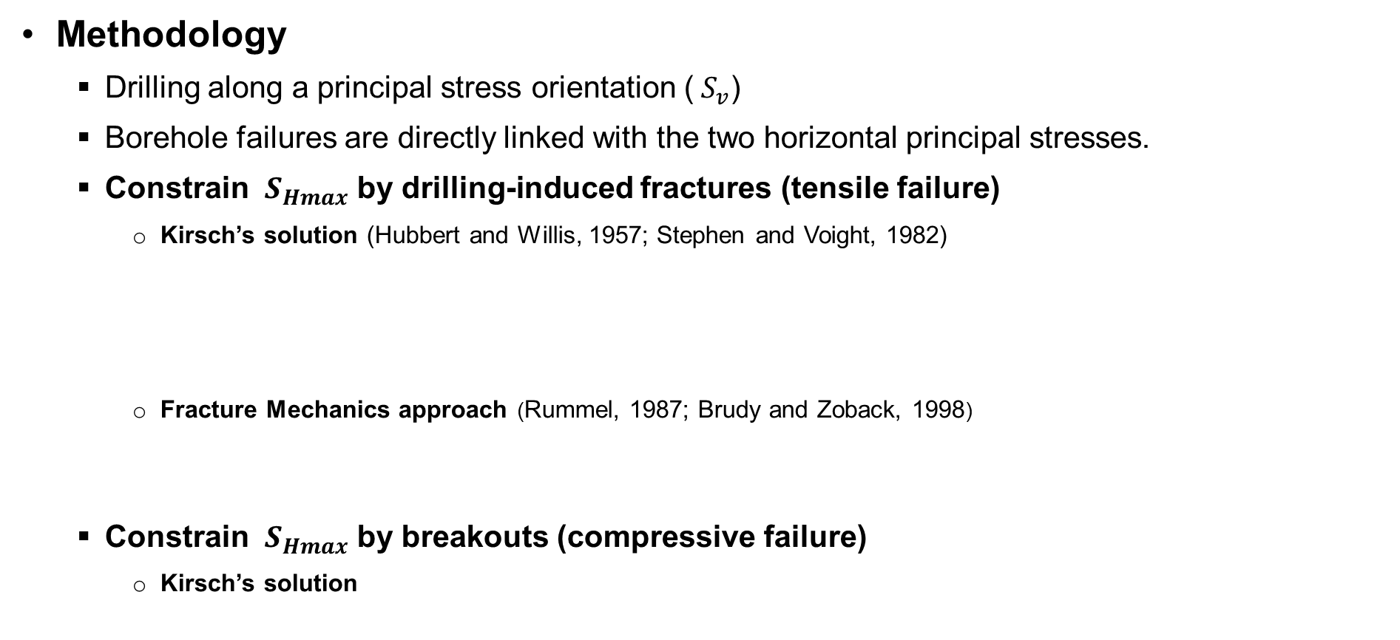
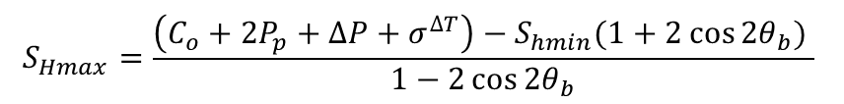
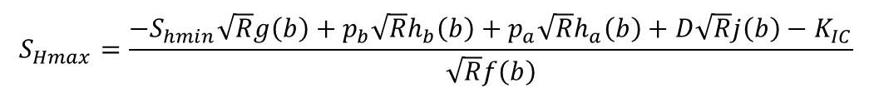


Determination of Stress in Vertical Wells
Methodology
  Drilling along a principal stress orientation (${ S}_{v}$)
  Borehole failures are directly linked with the two horizontal principal stresses.
  Constrain ${ S}_{Hmax}$ by drilling-induced fractures (tensile failure)
    Kirsch’s solution (Hubbert and Willis, 1957; Stephen and Voight, 1982)
    Fracture Mechanics approach (Rummel, 1987; Brudy and Zoback, 1998)
  Constrain ${ S}_{Hmax}$ by breakouts (compressive failure)
    Kirsch’s solution
$S_{Hmax}=3S_{hmin}+T−2P_{p}−∆P− σ^{∆T}$
$$σ^{∆T}=\frac{α_{T}E∆T }{1−ν}$$
$$S_{Hmax}=\frac{{−S}_{hmin}\sqrt{R}g\left(b\right)+p_{b}\sqrt{R}h_{b}\left(b\right)+p_{a}\sqrt{R}h_{a}\left(b\right)+D\sqrt{R}j\left(b\right)−K_{IC}}{\sqrt{R}f\left(b\right)}$$
$$S_{Hmax}=\frac{\left(C_{o}+2P_{p}+∆P+σ^{∆T}\right)−S_{hmin}(1+2{\cos{2θ}}_{b}) }{1−2{\cos{2θ}}_{b}}$$

Slide 6
Wellbore Stress Models

Slide 7
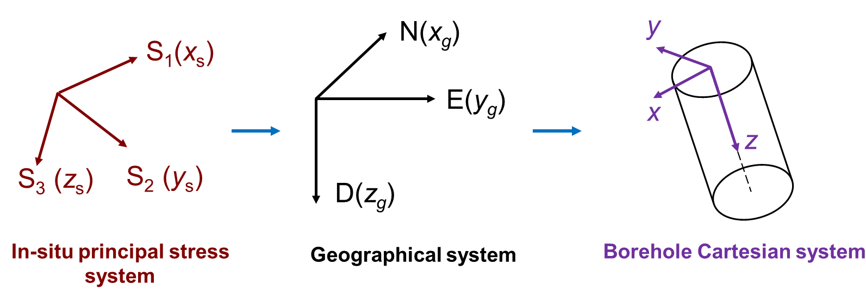
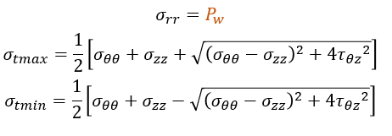
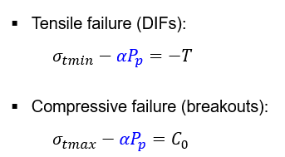
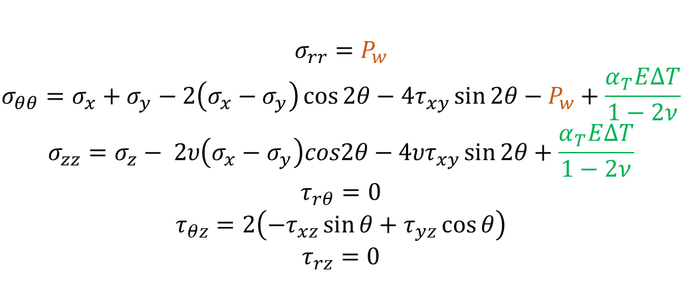
Determination of Stress in Deviated Wells
Methodology
  Wellbore axes are not aligned with the in-situ principal stresses
  Rotating stress from in-situ system to wellbore system through geographical system
1. Matrix rotation:
3. The principal stress around the wellbore:
In-situ stress in wellbore system: $S_{B}=R_{GB}{(R_{GP}^{T}S_{S}R_{GP})R}_{GB}^{T}$
4. Wellbore failure criteria:
2. Wellbore stress in cylindrical coordinate:

Slide 8
Determination of Stress in Deviated Wells
Methodology
  Wellbore axes are not aligned with the in-situ principal stresses
  Rotating stress from in-situ system to wellbore system through geographical system
1. Matrix rotation:
3. The principal stress around the wellbore:
In-situ stress in wellbore system: $S_{B}=R_{GB}{(R_{GP}^{T}S_{S}R_{GP})R}_{GB}^{T}$
4. Wellbore failure criteria:
2. Wellbore stress in cylindrical coordinate:

Slide 9
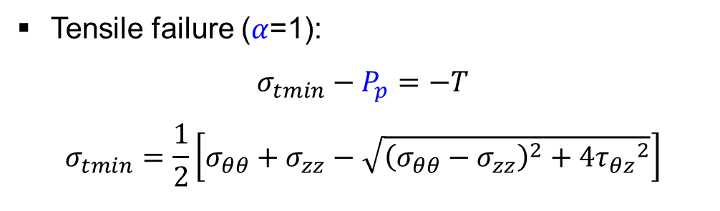
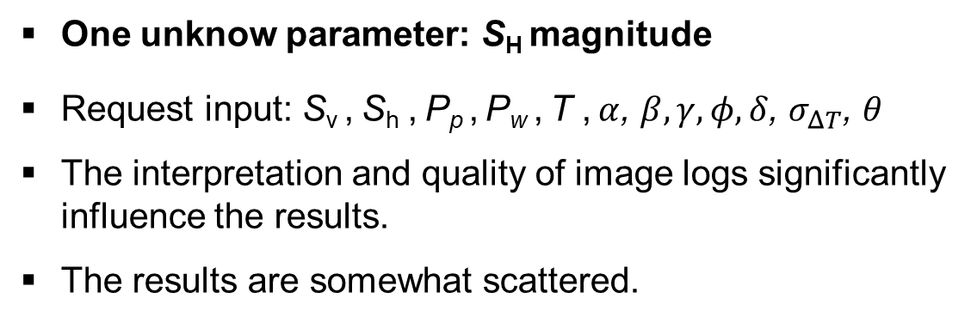
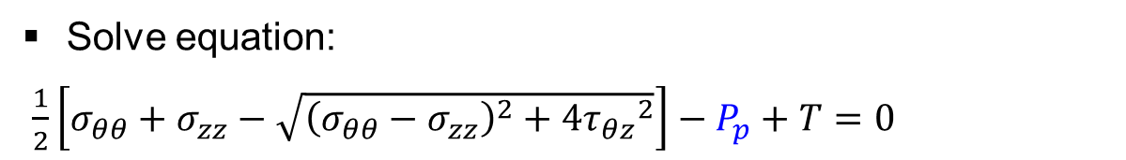
Method 1: Directly Solve the Equation
One equation based on DIFs/Tensile Failure:
Tensile failure ($α$=1):
$$σ_{tmin}−P_{p}=−T$$
$$σ_{tmin}=\frac{1}{2}\left[σ_{θθ}+σ_{zz}−\sqrt{{\left(σ_{θθ}−σ_{zz}\right)}^{2}+4{τ_{θz}}^{2}}\right]$$
Solve equation:
$\frac{1}{2}\left[σ_{θθ}+σ_{zz}−\sqrt{{\left(σ_{θθ}−σ_{zz}\right)}^{2}+4{τ_{θz}}^{2}}\right]−P_{p}+T=0$
The dogleg section is ignored
Vertical section: 0.96 -0.98 psi/ft
Inclined section: 0.90 – 1.21 psi/ft
One unknow parameter: S_{H} magnitude
Request input: S_{v} , S_{h} , P_{p} , P_{w} , T , $α$, $β, γ, φ,δ$, $σ_{ΔT}$, $θ$
The interpretation and quality of image logs significantly influence the results.
The results are somewhat scattered.
Notes:
$α$, $β, γ$ are the angles in the rotation matrix to rotate stresses from in-situ principal stress coordinate to geographical coordinate
$φ,δ$, are the angles in the rotation matrix to rotate stresses from geographical coordinate to wellbore coordinate
$σ_{ΔT}$, thermal stress due to cooling
$θ$ is the fracture/failure circumferential angle

Slide 10
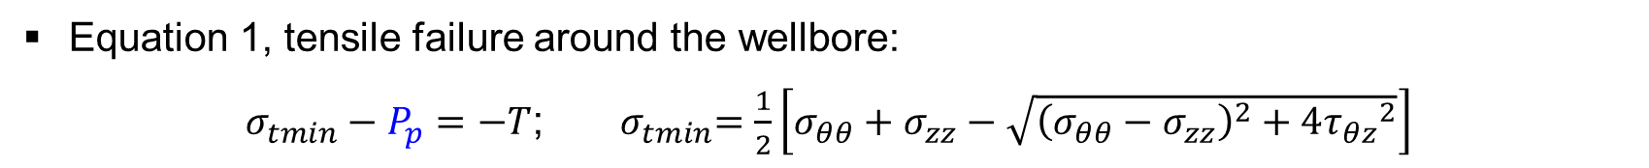
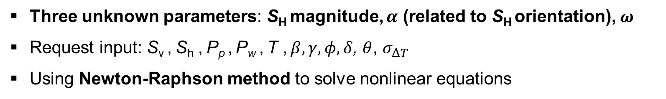
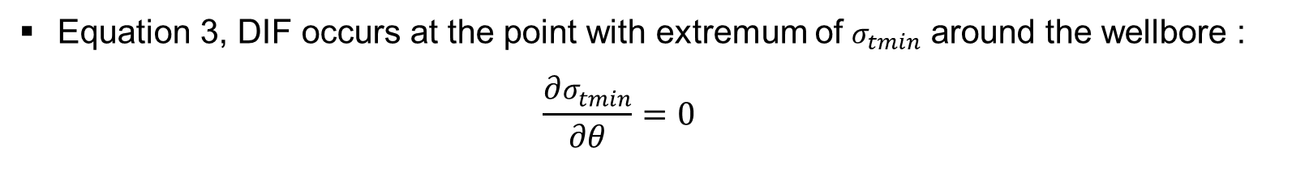
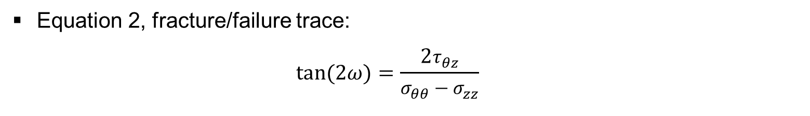
Method 2: Stress Inversion
Three Equations based on DIFs/Tensile Failure:
Equation 1, tensile failure around the wellbore:
$σ_{tmin}−P_{p}=−T$; ${ σ}_{tmin}=\frac{1}{2}\left[σ_{θθ}+σ_{zz}−\sqrt{{\left(σ_{θθ}−σ_{zz}\right)}^{2}+4{τ_{θz}}^{2}}\right]$
Equation 2, fracture/failure trace:
  $$tan⁡(2ω)=\frac{2τ_{θz}}{σ_{θθ}−σ_{zz}}$$
Equation 3, DIF occurs at the point with extremum of $σ_{tmin}$ around the wellbore :
  $$\frac{∂σ_{tmin}}{∂θ}=0$$
Three unknown parameters: S_{H} magnitude, $α$ (related to S_{H} orientation), $ω$
Request input: S_{v} , S_{h} , P_{p} , P_{w} , T , $β, γ, φ,δ$, $θ$, $σ_{ΔT}$
Using Newton-Raphson method to solve nonlinear equations
Notes:
$ω$ is fracture trace angle.

Slide 11
Method 2: Stress Inversion
Inversion Results: S_{Hmax} magnitude
The dogleg section is ignored
Vertical section: 0.96 -0.98 psi/ft
Inclined section: 0.87 – 1.06 psi/ft
The dogleg section is ignored
Vertical section: 0.96 -0.98 psi/ft
Inclined section: 0.90 – 1.21 psi/ft
Method 2
Method 1
Notes:
Left: method 2 stress inversion; Right: method 1, direct solve SH
The inversion results of SH magnitude are better than the method 1, which is direct solving the equation, the results are with less scattering even without smoothing.

Slide 12
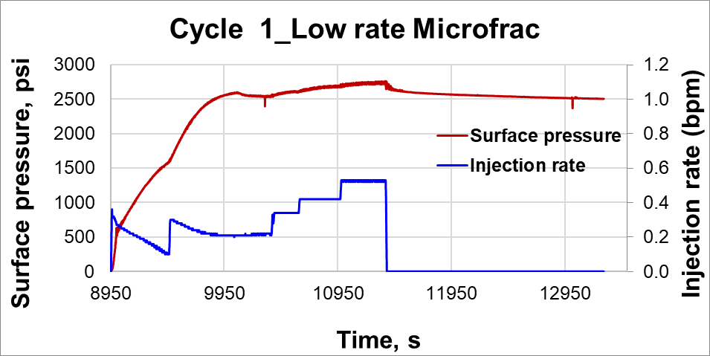
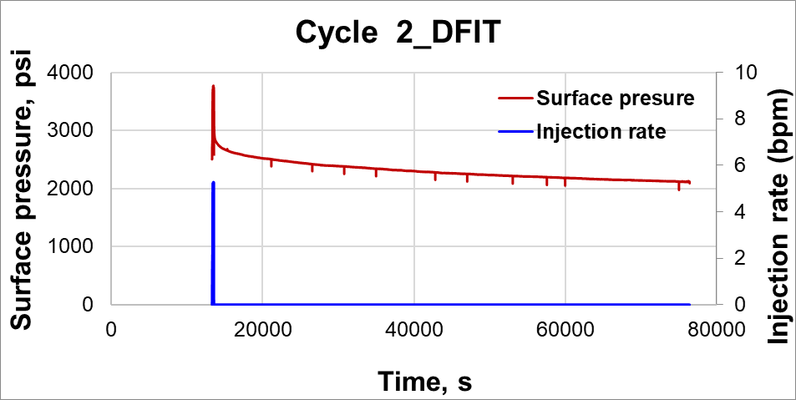

Re-examine${ S}_{hmin}$ of 16A(78)-32
Injection Tests Carried Out in FORGE Well 16A(78)-32
  Use the data of cycle 1 and cycle 2
    Cycle 1: Microfrac test with a low pumping rate (<0.6 bpm)
    Cycle 2: DFIT test (5.0 bpm pumping rate, 17.5 hrs. shut-in)
  Re-examine ${ S}_{hmin}$ cycle 1 and cycle 2 (${ S}_{hmin}$: 0.70-0.79 psi/ft)
    Techniques: reopen pressure, ISIP, G-function, Sqrt(t), delta(t), etc.

Slide 13
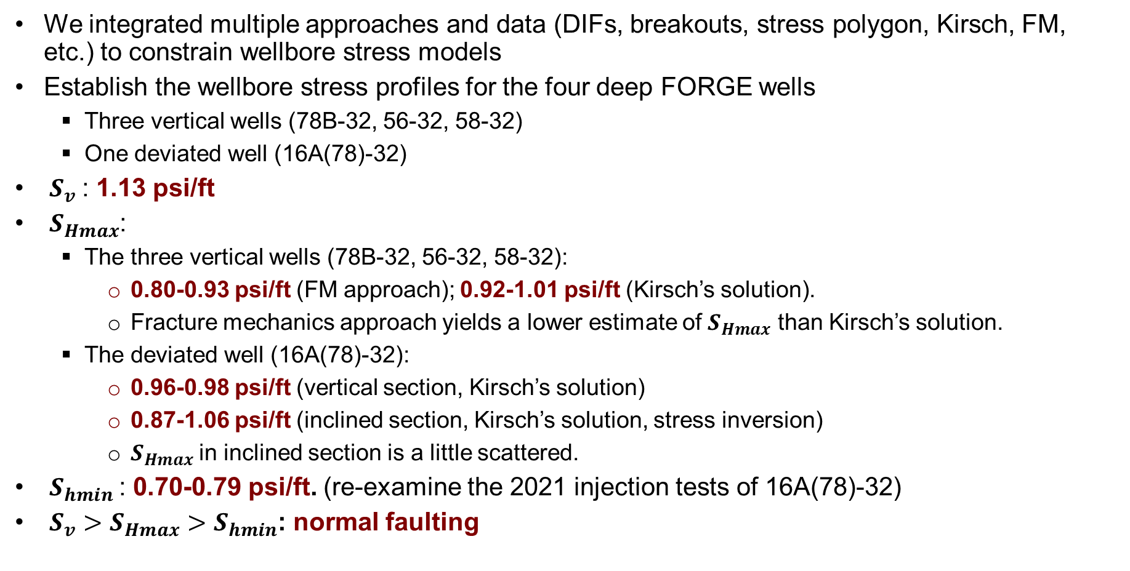
Summary
We integrated multiple approaches and data (DIFs, breakouts, stress polygon, Kirsch, FM, etc.) to constrain wellbore stress models
Establish the wellbore stress profiles for the four deep FORGE wells
  Three vertical wells (78B-32, 56-32, 58-32)
  One deviated well (16A(78)-32)
  $S_{v}$: 1.13 psi/ft
  $S_{Hmax}$:
  The three vertical wells (78B-32, 56-32, 58-32):
    0.80-0.93 psi/ft (FM approach); 0.92-1.01 psi/ft (Kirsch’s solution).
    Fracture mechanics approach yields a lower estimate of $S_{Hmax}$ than Kirsch’s solution.
  The deviated well (16A(78)-32):
    0.96-0.98 psi/ft (vertical section, Kirsch’s solution)
    0.87-1.06 psi/ft (inclined section, Kirsch’s solution, stress inversion)
    $S_{Hmax}$in inclined section is a little scattered.
  $S_{hmin}$: 0.70-0.79 psi/ft. (re-examine the 2021 injection tests of 16A(78)-32)
  ${S_{v}>S}_{Hmax}>$ $S_{hmin}$: normal faulting

Slide 14
Publications
Ye, Z., Fang, Y., Ghassemi, A., & McLennan, J. (2022). A Preliminary Wellbore In-situ Stress Model for Utah FORGE. Paper presented at the 55th U.S. Rock Mechanics/Geomechanics Symposium, Santa Fe, New Mexico, USA.
Fang, Y., Ye, Z., & Ghassemi, A. (2022). Preliminary Wellbore In-situ Stress Models for Utah FORGE. Paper presented by 2022 Geothermal Rising Conference, Reno, Nevada.
Ye, Z. & Ghassemi, A. (2024). The Updated Wellbore Stress Models for Utah FORGE. Paper presented at the 49th Workshop on Geothermal Reservoir Engineering, Stanford, California, USA.

