Slide 1
Ahmad Ghassemi
Reservoir Geomechanics and Seismicity Research Group
The University of Oklahoma
06/20/2023

Slide 2
Objective:
Compute stress distribution on the wellbore wall (or casing) and the packer stress and deformation caused by applying high pressure in the interior of the packer.
Method:
A 3D model has been constructed to simulate the packer expansion in a hole. After defining the mechanical properties of the rock and the packer, and applying boundary conditions, the following parameters are calculated:
induced normal stress on the wellbore(or casing)
the stress and deformation of the packer

Slide 3
Simulations:
We study different cases based on the packer shape and the boundary condition:
The packer consists of one or a couple of donut shapes (torus) with a thickness of 1 mm which is pressurized (e.g., 38 MPa). In the following cases, we study the response of a packer consisting of two donuts:
Case 1: The donuts are separated, and have a distance of 4 cm.
Case 2: The donuts are attached edge to edge.
Cases 3 and 4: The donuts penetrate each other.
(2) The packer is a hollow cylinder (cylindrical annulus, thickness of 2 mm)
Cases 5 and 6 : the entire system (the rock, cylinder, and packer) is assumed to be elastic. In case I, the packer is assumed to be more deformable (with lower elastic moduli) than the cylinder. In Case II, the elastic moduli of the packer and the cylinder are identical and equal to the steel.
In Cases 7 and 8 a yield strength (200 MPa) for the packer and a Mohr-Coulomb failure criteria for the rock are defined. Case 8 has smaller block size than case 7, and is equal to the length of the packer.
(3) A similar boundary condition and rock properties as those of the FORGE project are defined for the rock
Case 9: The rock properties and initial condition (e.g. in-situ stresses and pore pressure, etc) are identical as those of FORGE project.
Case 10: A small model in the lab with similar rock properties and differential stress (σ_{x'x'} - σ_{y'y'} ) as case 9 is studied.

Slide 4
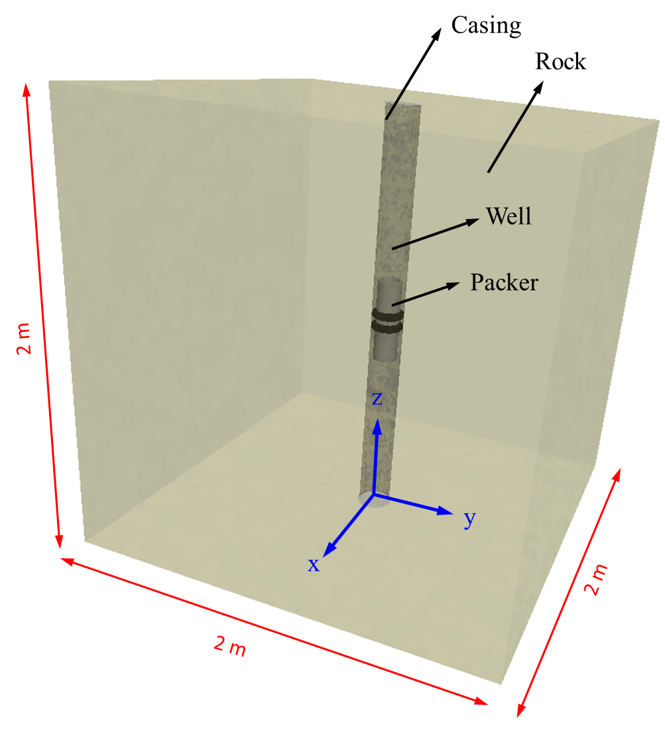
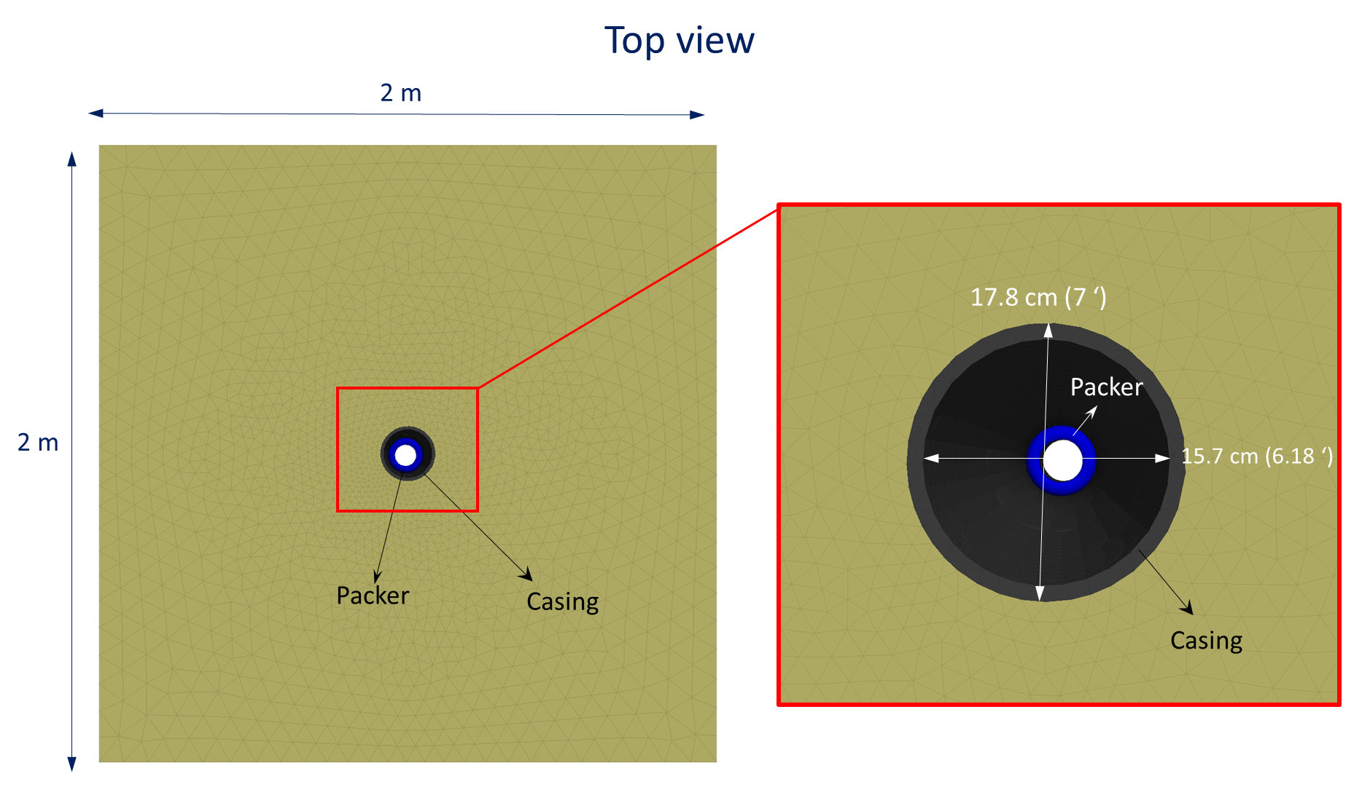
(1) Donut (torus) shape packers -Domain of the model and mechanical properties
The domain consists of a 2×2×2 m cube including a 7' (17.8 cm) diameter well at the center.
The well has a casing with a thickness of ∼1 cm.
The donut-shape packer is located at the middle depth of the model.

Slide 5
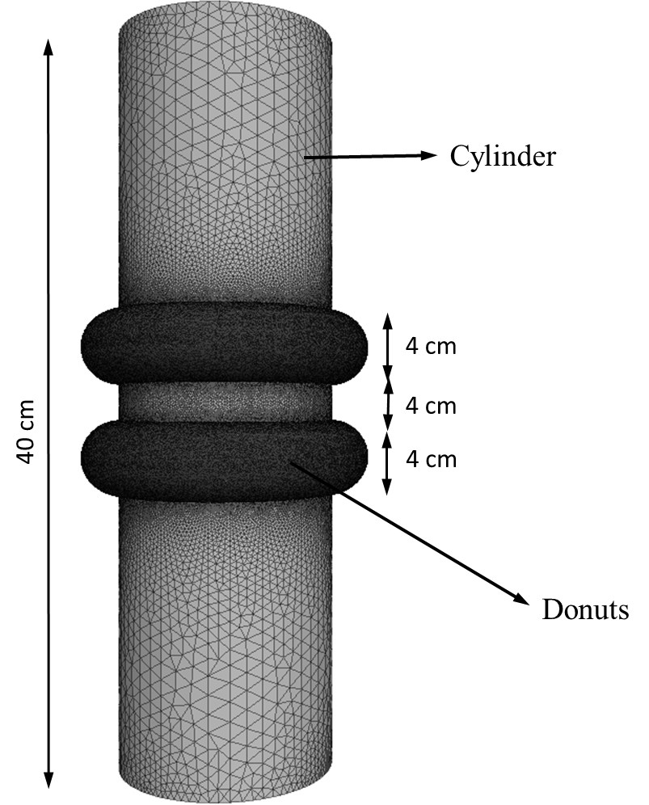
(1) Donut (torus) shape packers –The Packer shape
The packer consists of two soft donuts (two toruses with thickness of 1 mm) attached to a stiff cylinder.
The cylinder is stiff and assumed to have a negligible deformation during packer pressurization.
It is assumed that the packer is attached to the cylinder, and not dethatched.
Two toruses has a distance of are 4 cm.

Slide 6
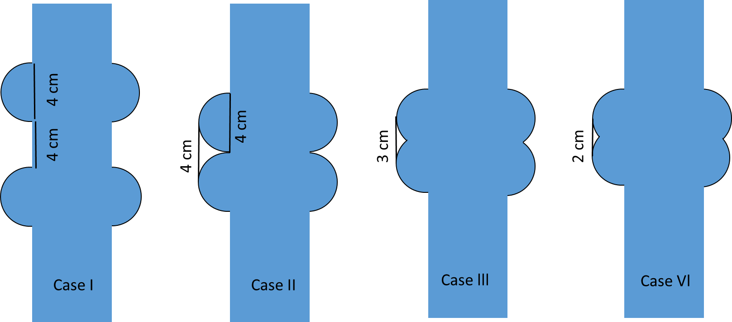
(1) Donut (torus) shape packers –The Packer shape
We define the following cases for donut-shape packer:
Case 1: The donuts are separated, and has distance of 4 cm.
Case 2: The donuts are attached edge to edge.
Cases 3 and 4: The donuts penetrate into each other.

Slide 7
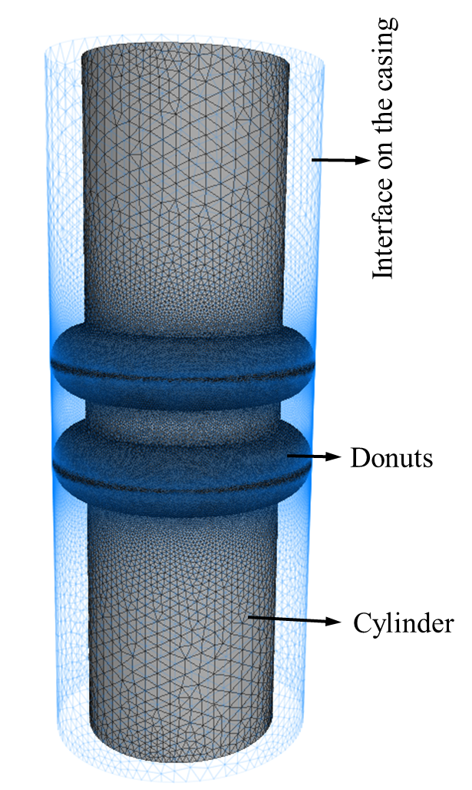
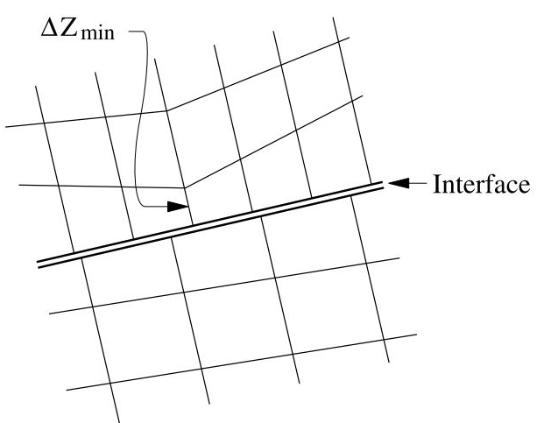
(1) Donut (torus) shape packers –Interface elements
An interface is defined on the casing wall to calculate contact stress between the packer and the casing.
Since, we need to provide a mean for one sub-grid to slide and/or open relative to another sub-grid, the friction is important, but the elastic stiffness is not.
k_{n} and k_{s} are set to ten times the equivalent stiffness of the stiffest neighboring zone (Itasca, 2012).
The apparent stiffness of a zone in the normal direction is:
max$\left[\frac{K+4/3G}{Δzmin}\right]$
Normal stiffness, k_{n} (MPa/mm) | 1 x 10⁵
Shear stiffness k_{s} (MPa/mm) | 1 x 10⁵

Slide 8
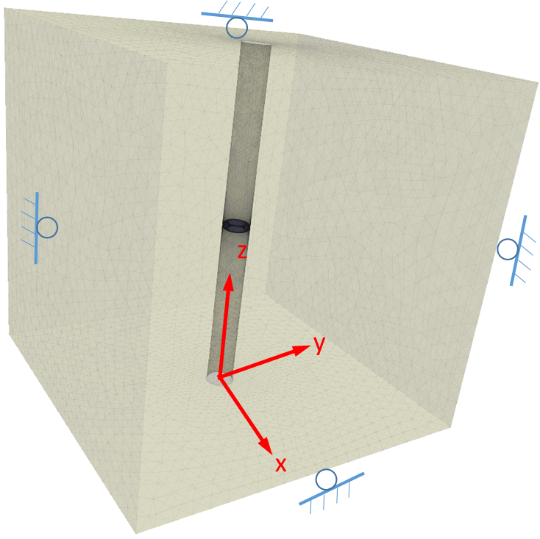
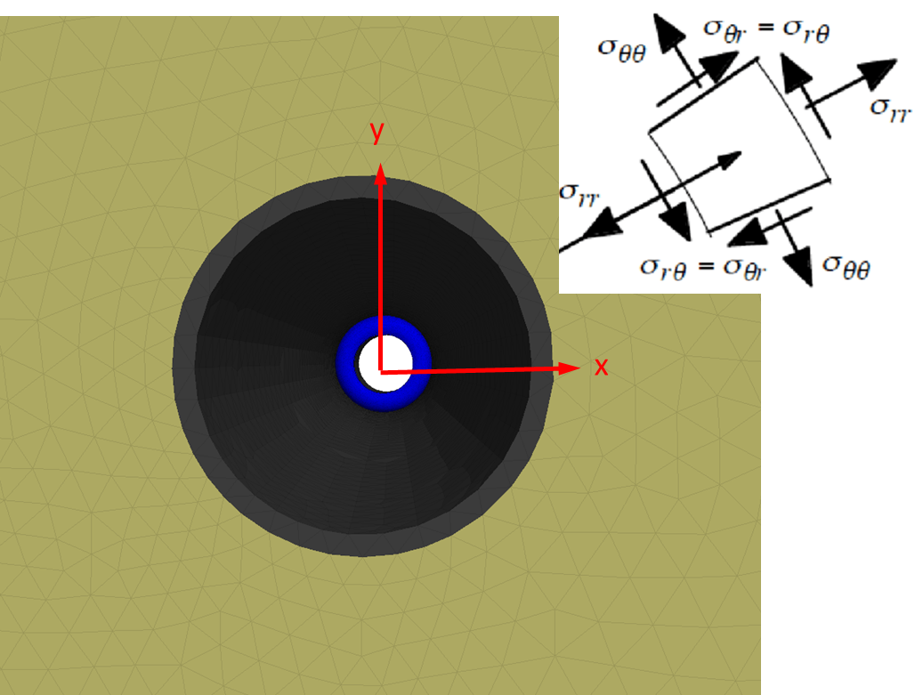
(1) Donut (torus) shape packers –Boundary condition, setup, and assumptions
Rollers on all six sides.
The Packer is located at the middle depth of the well.
Zero gravity
Hydrostatic stress of 38 MPa (∼5500 psi) MPa is applied on the interior walls of the packers.
Polar coordination in the well is defined as the figure.
In the following slides, σ_{rr},σ_{θθ}, δ_{rr}, ε_{rr}, and ε_{θθ} for both cases are shown.
All of the following figures are compression positive.

Slide 9
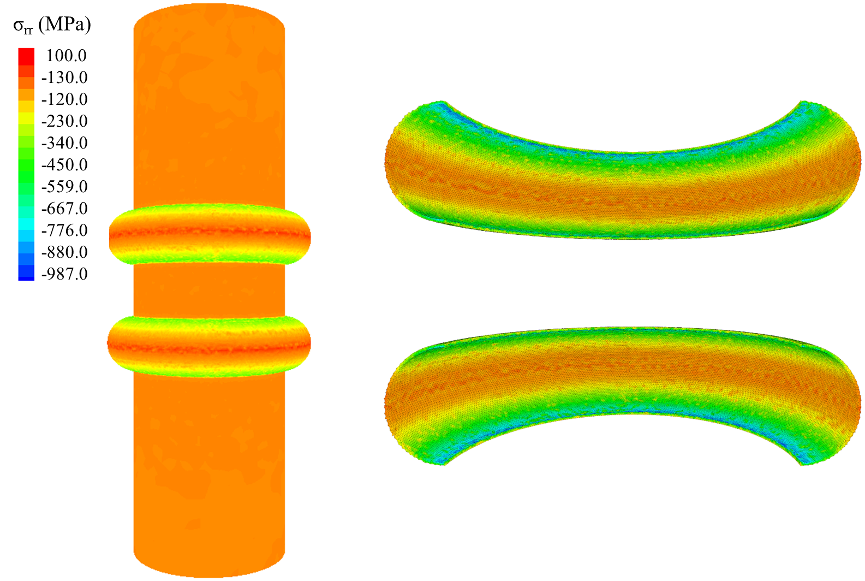
(1) Donut (torus) shape packers – Case I
Applying 38 MPa pressure in the packer induces σ_{rr} of 100 MPa compression in the packer-casing contact in case 1. Tensile stress up to 987 MPa is induced in the packer. A higher tension exists in the area the packer is attached to the cylinder.
Compression is positive.

Slide 10
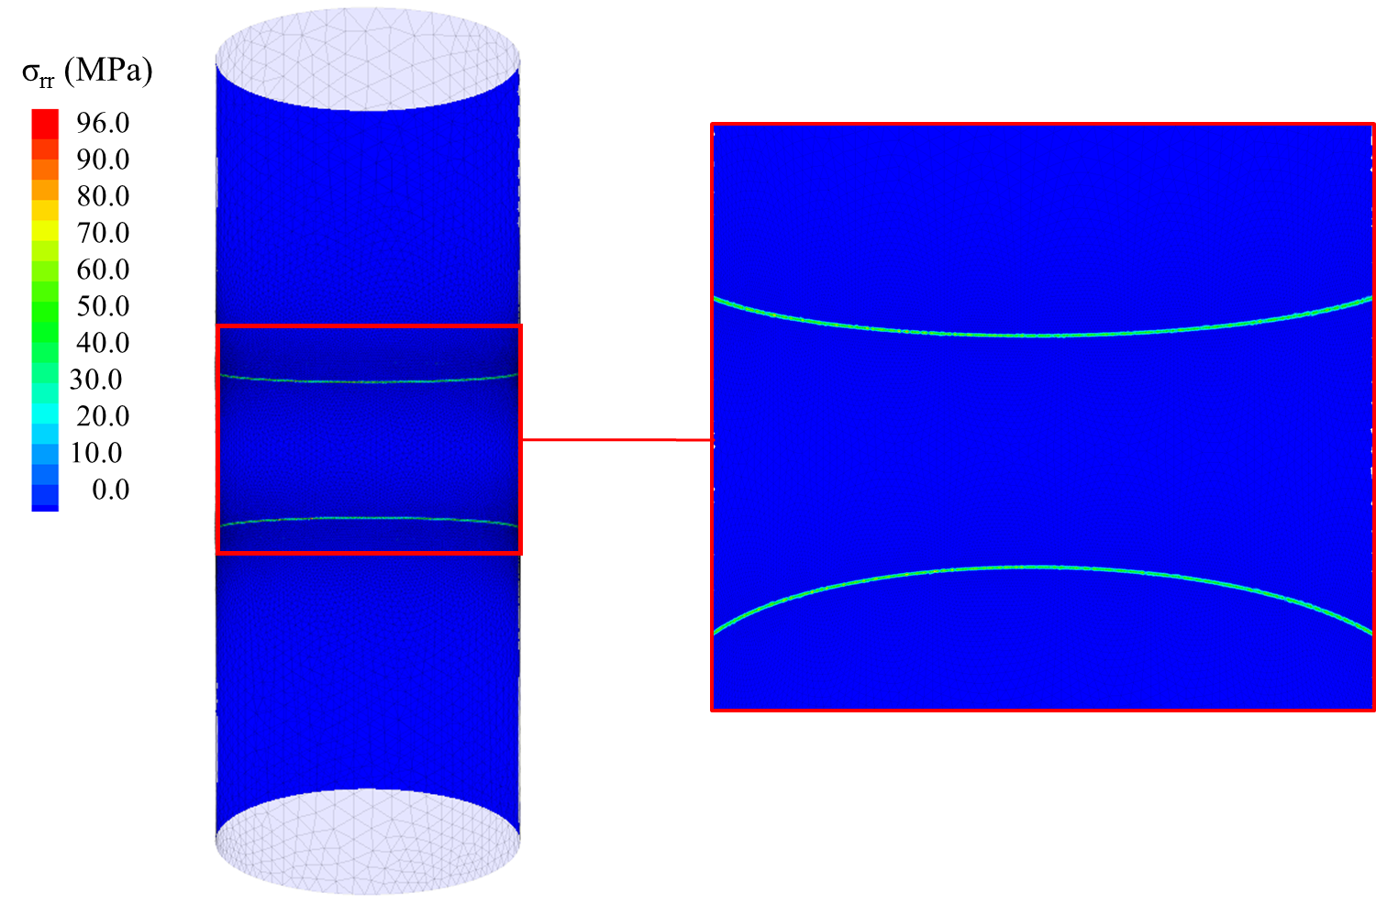
(1) Donut (torus) shape packers – Case I
Applying 38 MPa pressure in the packer induces σ_{rr} of 100 MPa compression on the wellbore wall (casing).
Compression is positive.

Slide 11
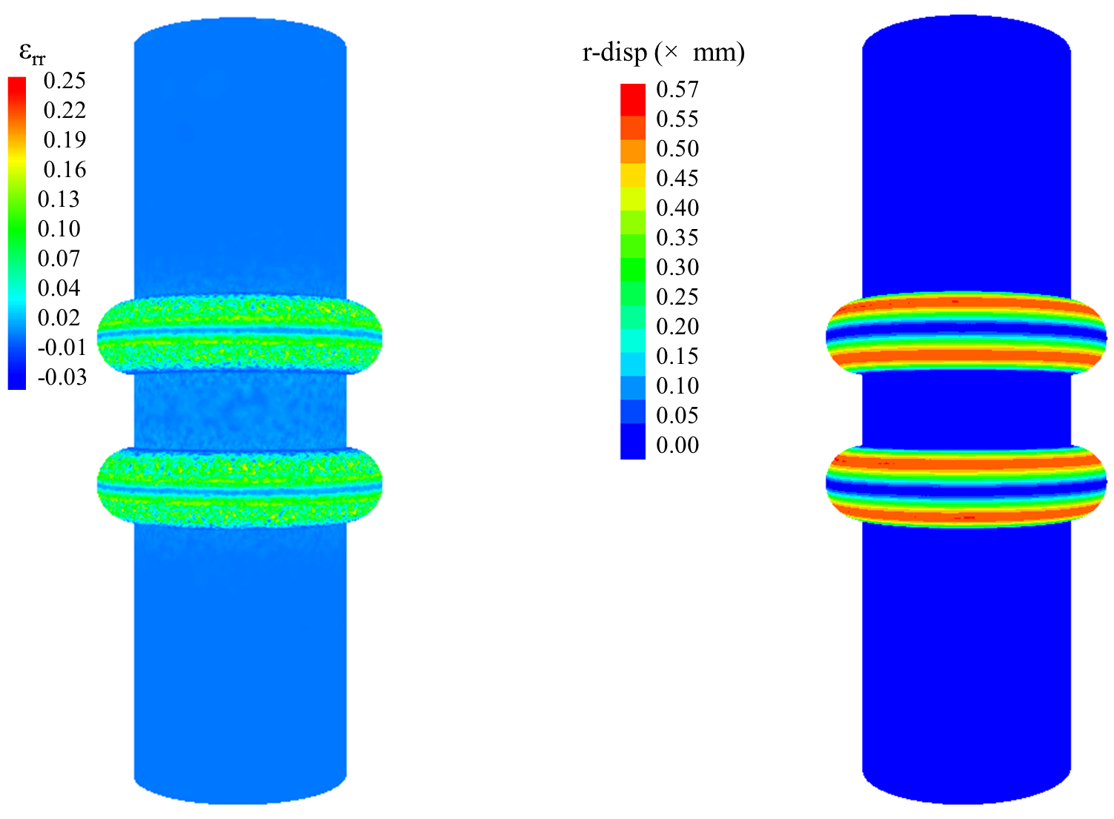
(1) Donut (torus) shape packers – Case I
The induced ε_{rr} and r-displacement after applying 38 MPa pressure in the packer in case 1 are shown here.
The induced ε_{rr} is compression on the outer surface of the packer.
The packer-casing contact and where the packer is attached to the cylinder have the minimum displacement in r direction. The zone between them has the maximum displacement.
Compression is positive.

Slide 12
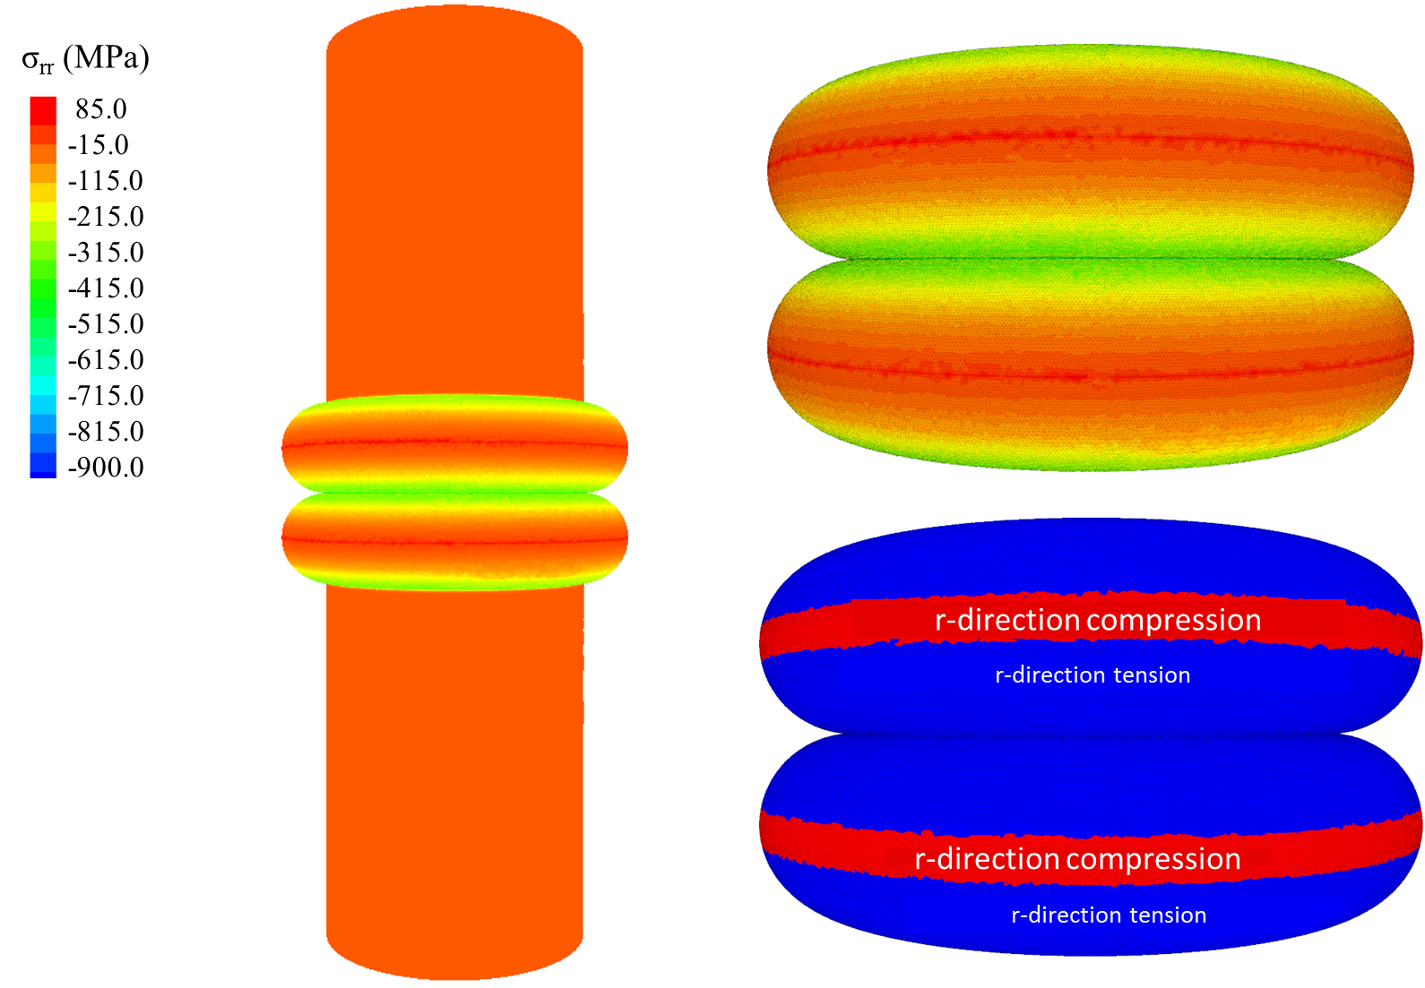
(1) Donut (torus) shape packers – Case II
Applying 38 MPa pressure in the packer induces σ_{rr} of 85 MPa compression in the packer-casing contact in case II. Tensile stress up to 987 MPa is induced in the packer. A higher tension exists in the area the packer is attached to the cylinder.
Compression is positive.

Slide 13
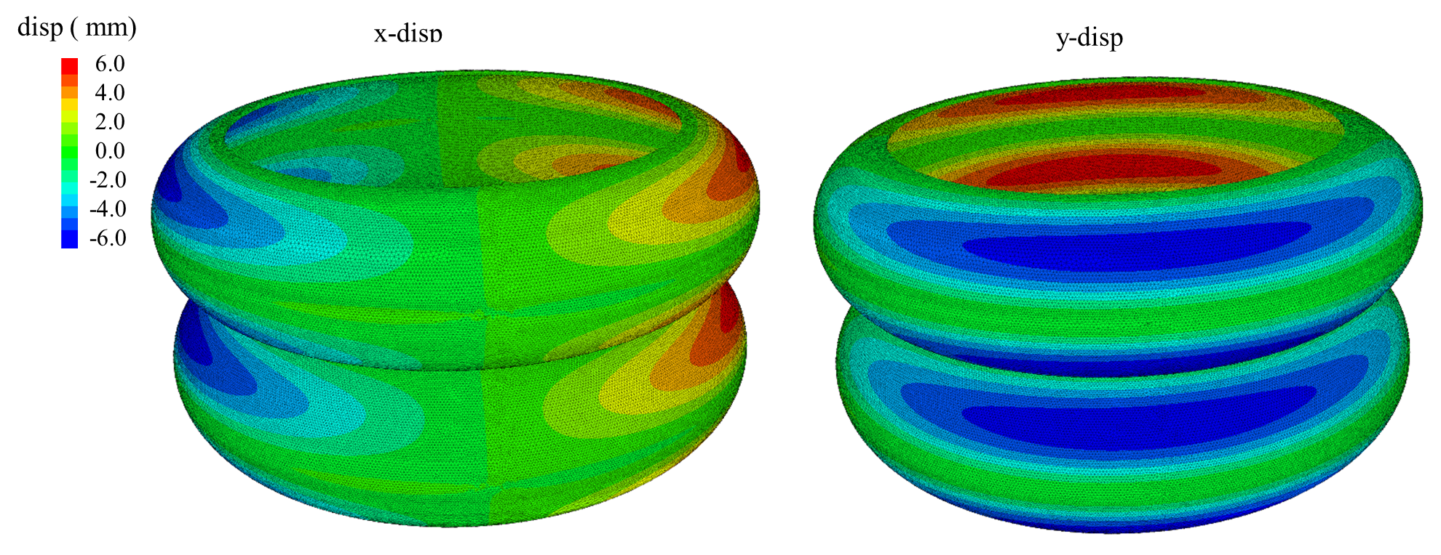
(1) Donut (torus) shape packers – Case II
The induced x and y-displacements after applying 38 MPa pressure in the packer in case II are shown.
Compression is positive.

Slide 14
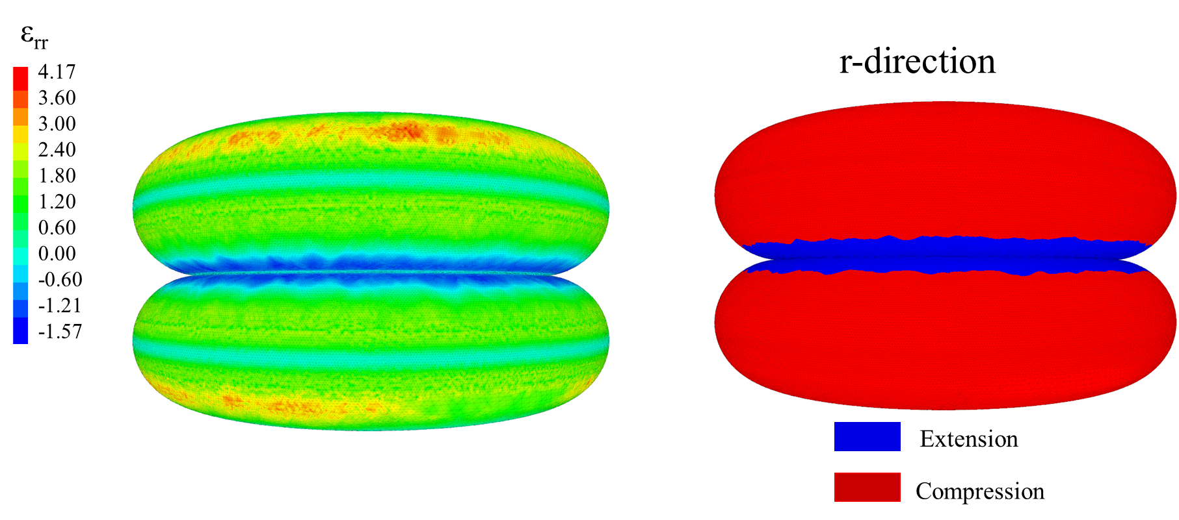
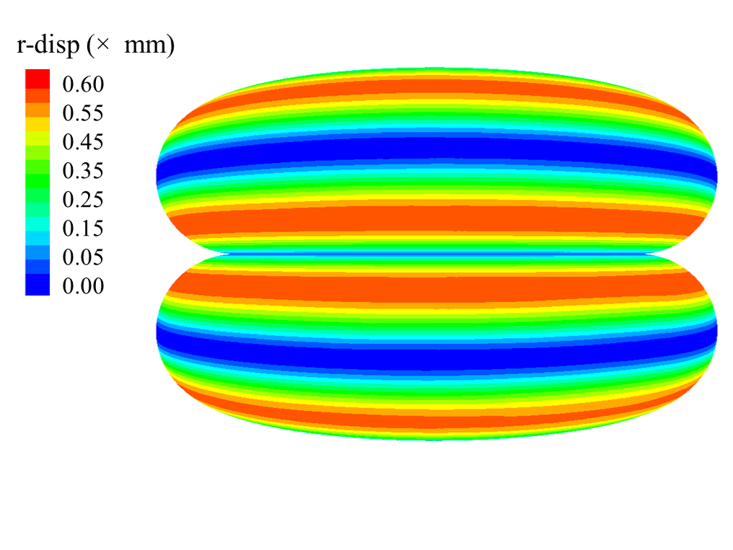
(1) Donut (torus) shape packers – Case II
The induced ε_{rr} and r-displacement after applying 38 MPa pressure in the packer in case II are shown here.
The induced ε_{rr} is compression on the outer surface of the packer and extension on the area close to where the packers attached.
The packer-casing contact and where the packer is attached to the cylinder have the minimum displacement in r direction. The zone between them has the maximum displacement.
Compression is positive.

Slide 15
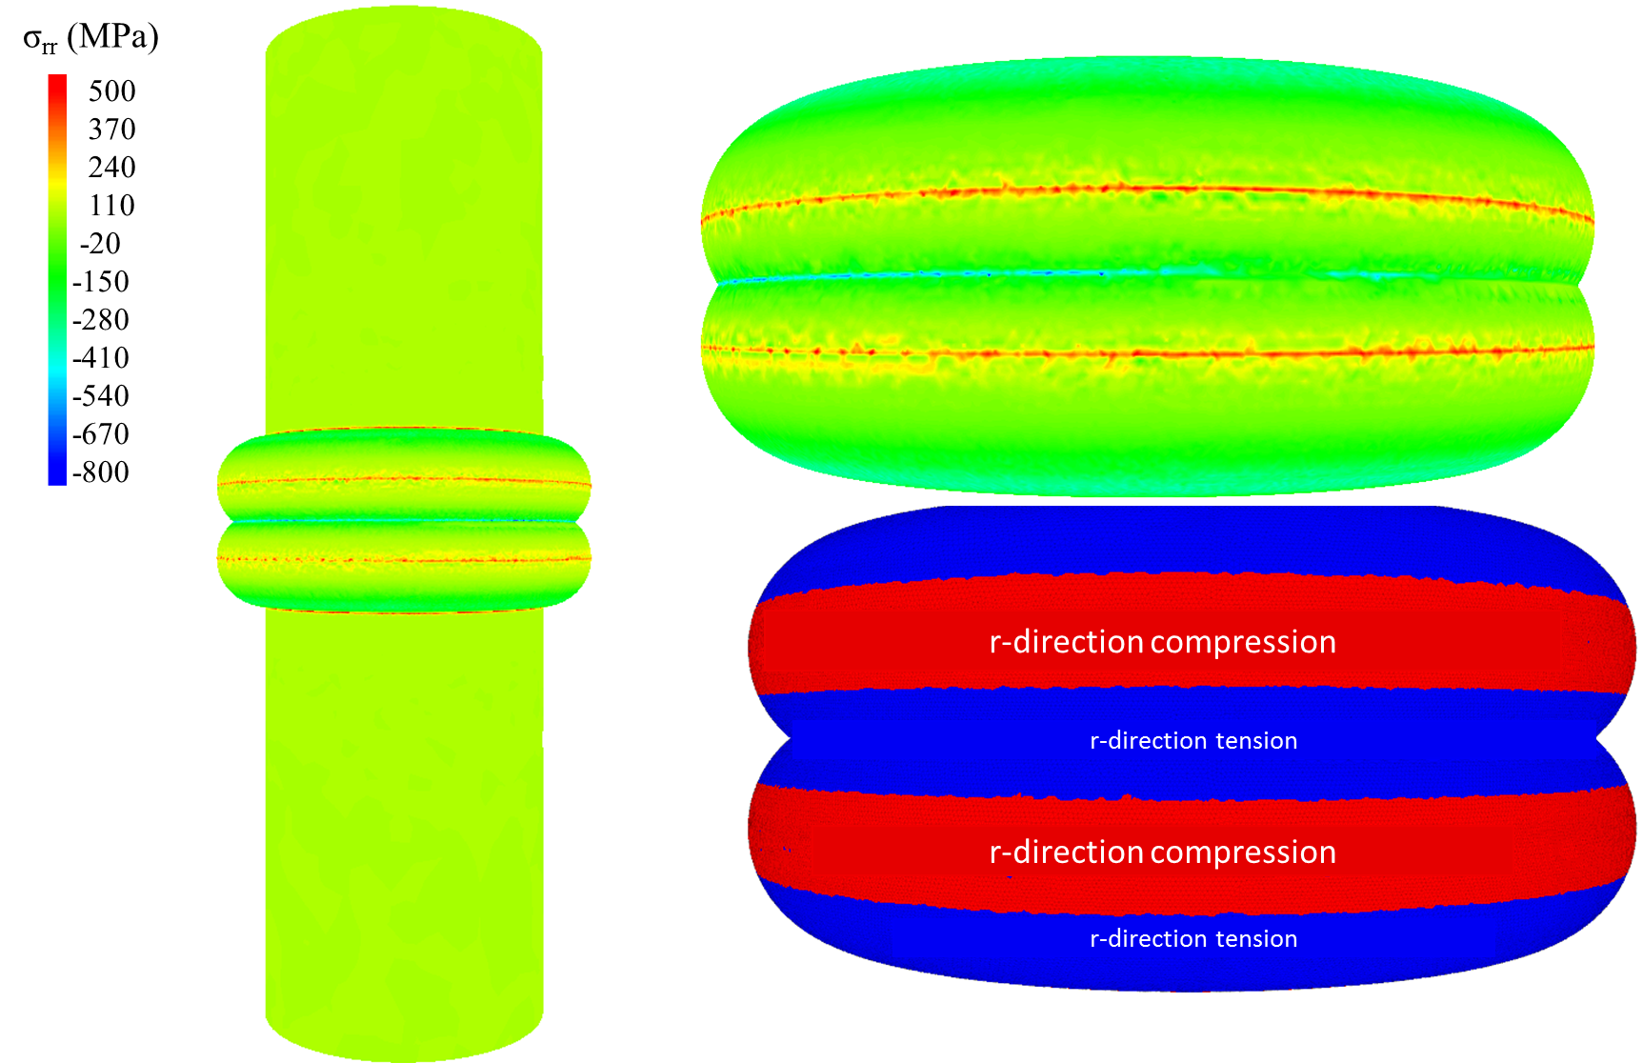
(1) Donut (torus) shape packers – Case III
Applying 38 MPa pressure in the packer induces σ_{rr} of 500 MPa compression in the packer-casing contact in case III. Tensile stress up to 800 MPa is induced in the packer. A higher tension exists in the area the packer is attached to the cylinder.
Compression is positive.

Slide 16
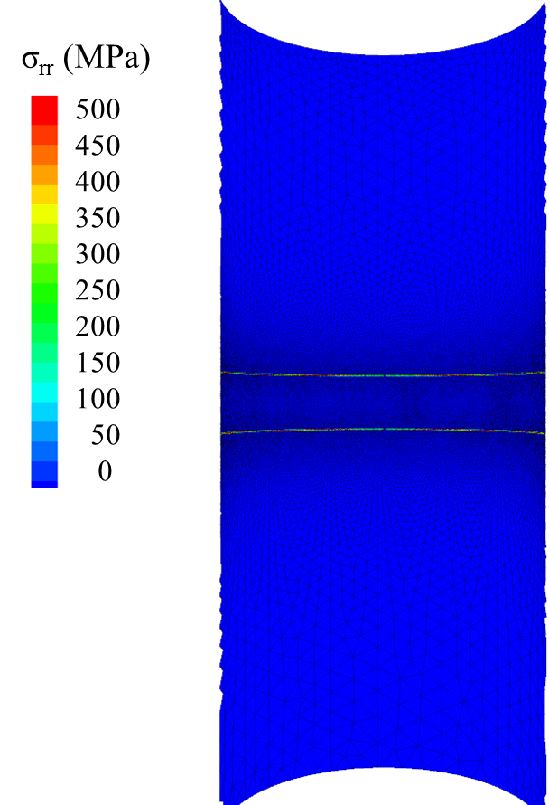
(1) Donut (torus) shape packers – Case III
Applying 38 MPa pressure in the packer induces σrr of 500 MPa compression on the wellbore wall (casing) in case III. The reason the induced normal stress is much more than in previous cases is the contact area of the packer and the cylinder remains small, and the induced stress is high.
Compression is positive.

Slide 17
(1) Donut (torus) shape packers – Case III
The induced x and y-displacements after applying 38 MPa pressure in the packer in case III are shown.
Compression is positive.

Slide 18
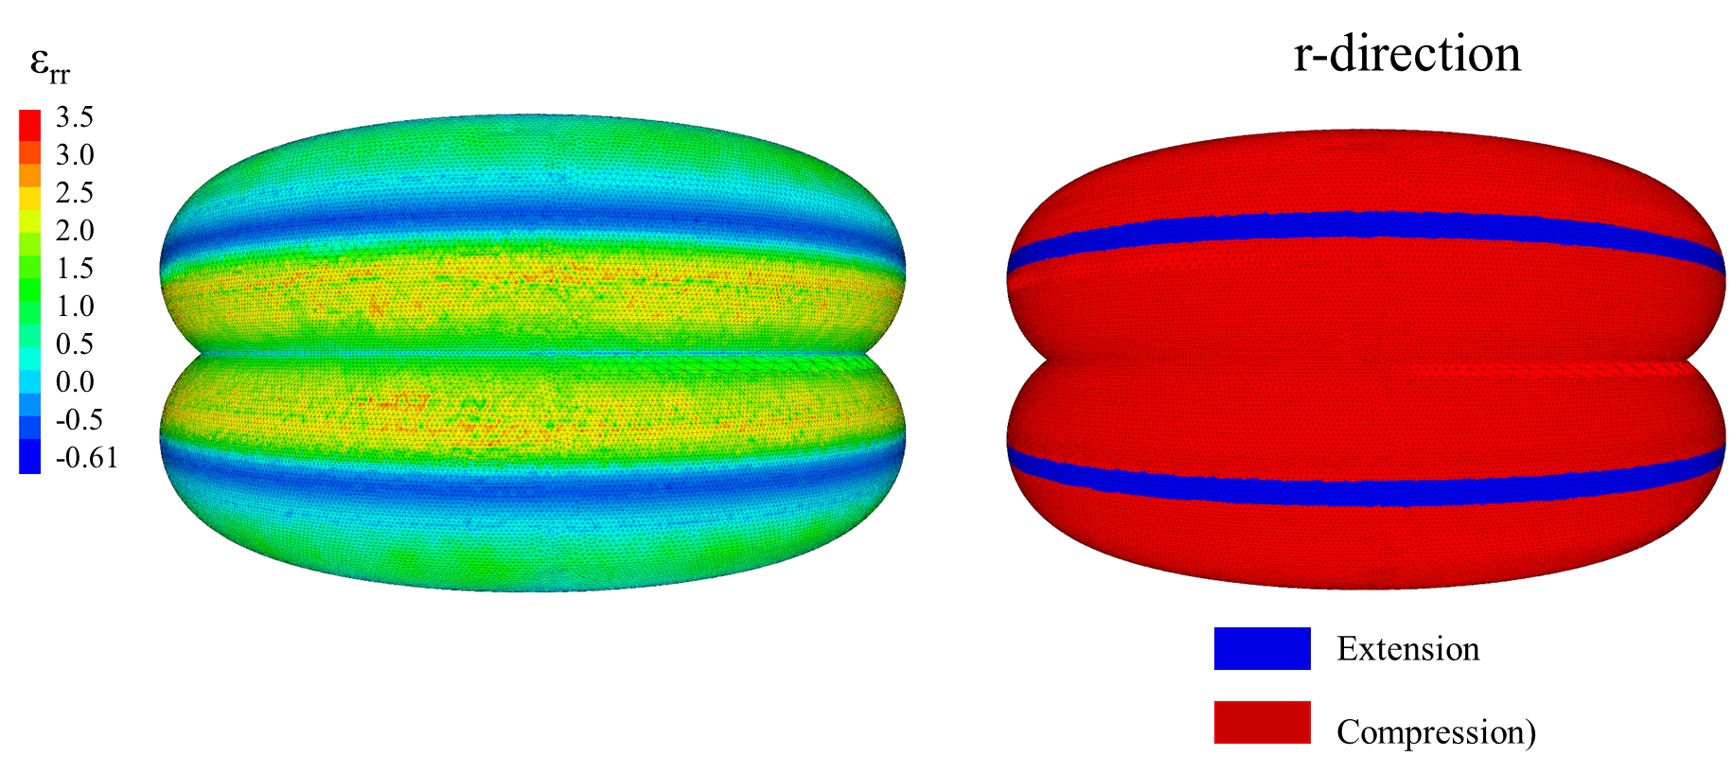
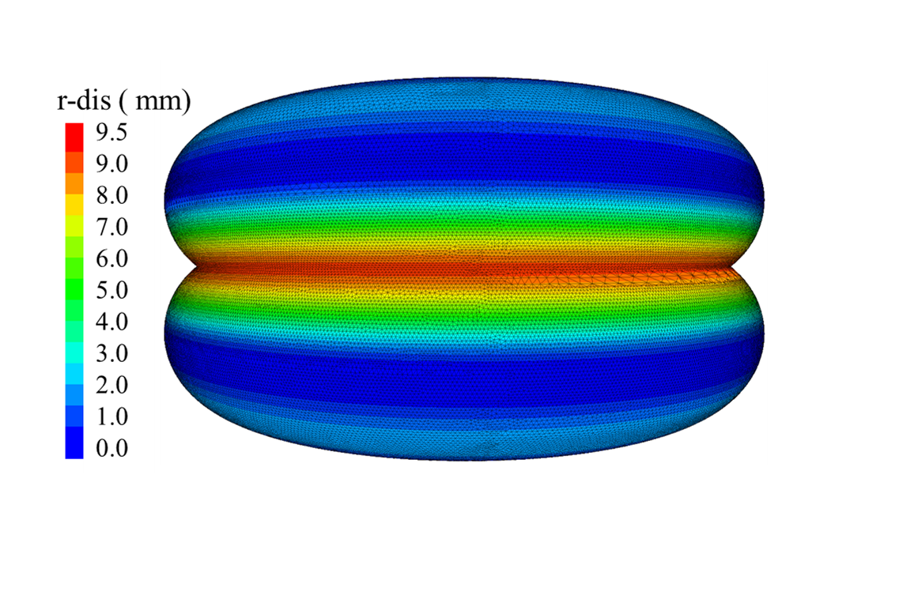
(1) Donut (torus) shape packers – Case III
The induced ε_{rr} and r-displacement after applying 38 MPa pressure in the packer in case III are shown here.
The induced ε_{rr} is compression on the outer surface of the packer and extension on the area close to where the packers attached.
The packer-casing contact and where the packer is attached to the cylinder have the minimum displacement in r direction. The zone between them has the maximum displacement.
Compression is positive.

Slide 19
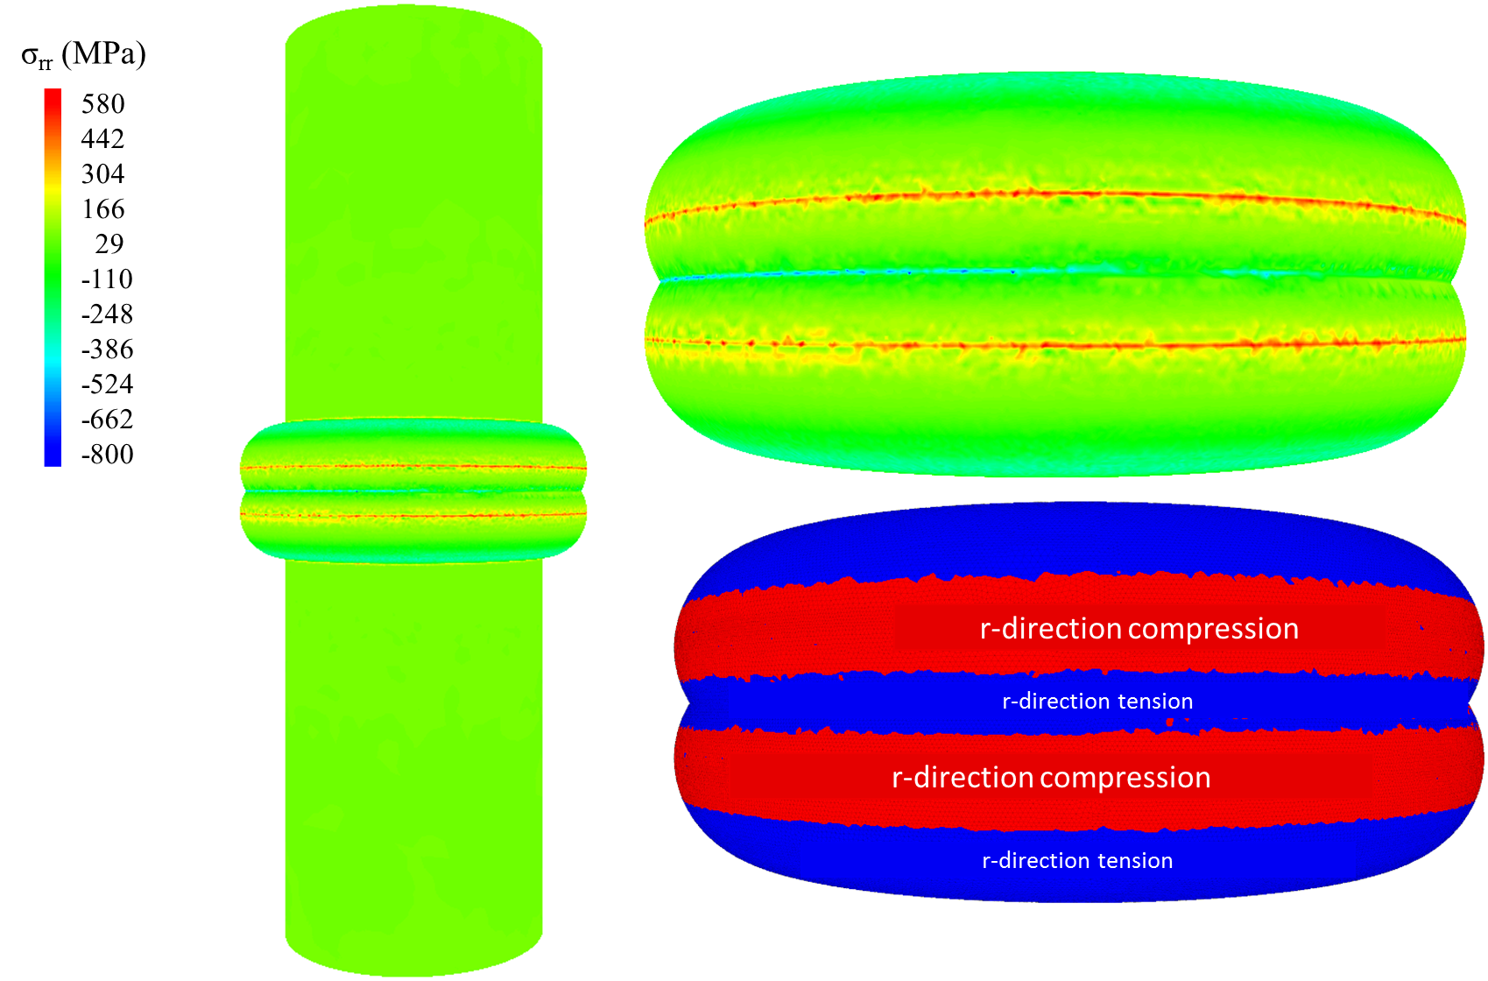
(1) Donut (torus) shape packers – Case IV
Applying 38 MPa pressure in the packer induces σ_{rr} of 580 MPa compression in the packer-casing contact in case IV. Tensile stress up to 800 MPa is induced in the packer. A higher tension exists in the area the packer is attached to the cylinder.
Compression is positive.

Slide 20
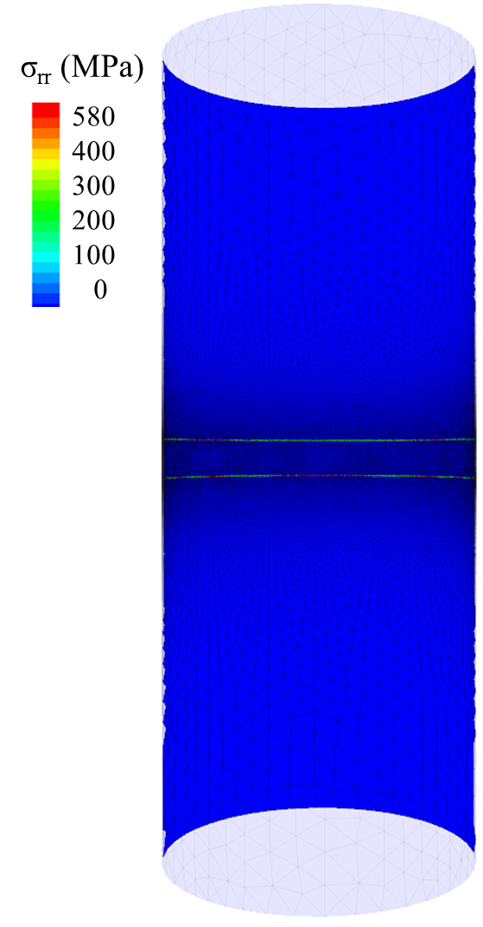
(1) Donut (torus) shape packers – Case IV
Applying 38 MPa pressure in the packer induces σ_{rr} of 500 MPa compression on the wellbore wall (casing) in case IV. The reason the induced normal stress is much more than in previous cases is that the contact area of the packer and the cylinder remains small, and the induced stress is high.
Compression is positive.

Slide 21
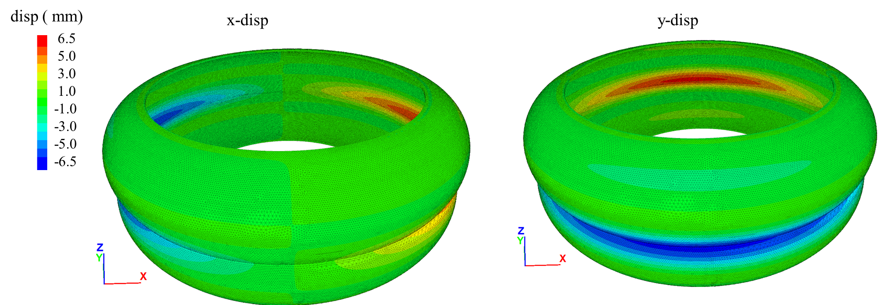
(1) Donut (torus) shape packers – Case IV
The induced x and y-displacements after applying 38 MPa pressure in the packer in case IV are shown.
Compression is positive.

Slide 22
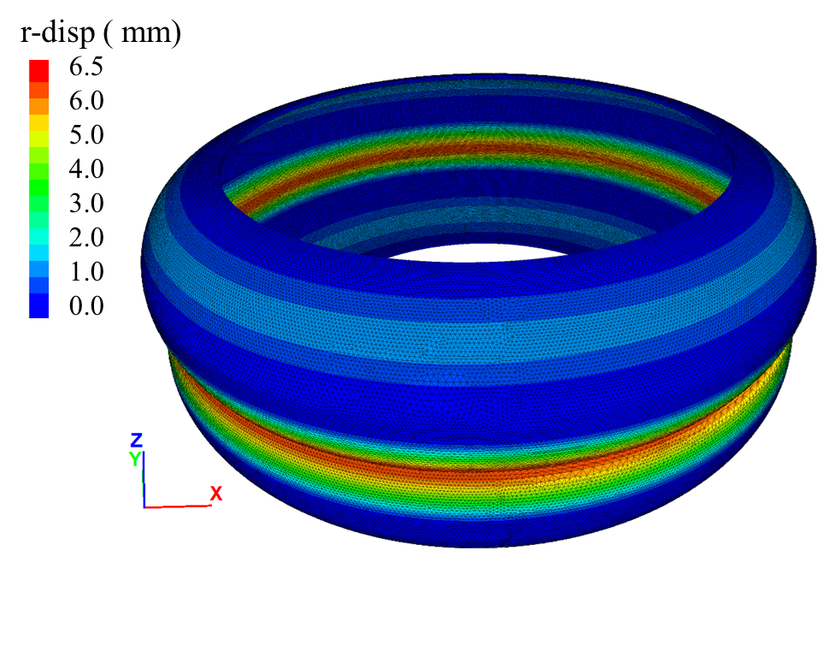
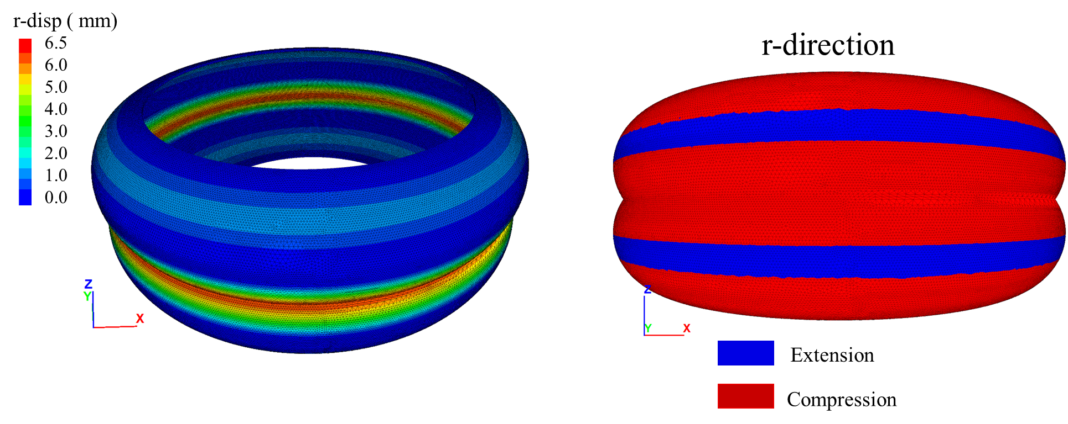
(1) Donut (torus) shape packers – Case IV
The induced ε_{rr} and r-displacement after applying 38 MPa pressure in the packer in case IV are shown here.
The induced ε_{rr} is compression on the outer surface of the packer and extension on the area close to where the packers attached.
The packer-casing contact and where the packer is attached to the cylinder have the minimum displacement in r direction. The zone between them has the maximum displacement.
Compression is positive.

Slide 23
(2) The packer is a hollow cylinder (cylindrical annulus)

Slide 24
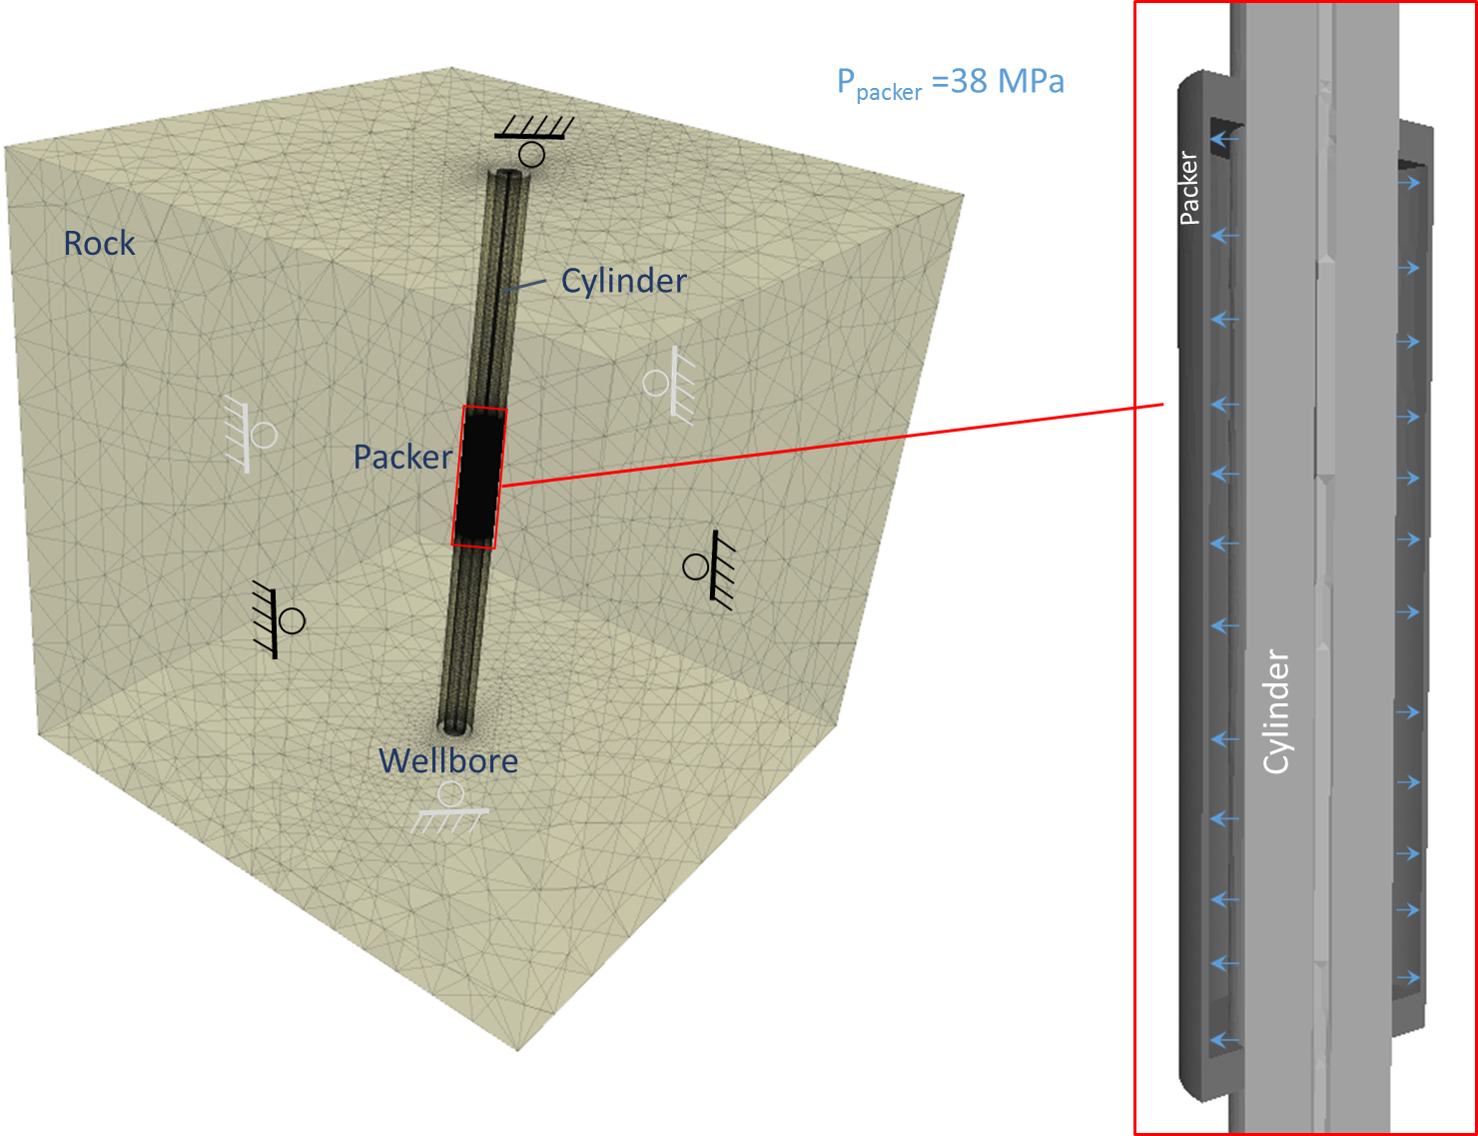
(2) The packer is a hollow cylinder (cylindrical annulus) - Boundary condition, setup, and assumptions
Rollers on all six sides.
The Packer is located at the middle depth of the well.
Zero gravity
Hydrostatic stress of 38 MPa (∼5500 psi) MPa is applied on the interior walls of the packers.
Polar coordination in the well is defined as the figure.
In the following slides, σ_{rr},σ_{θθ}, δ_{rr}, ε_{rr}, and ε_{θθ} for both cases are shown.
All of the following figures are compression positive.
The mechanical properties of the model are shown in the following paper.
 | Rock | Casing | Packer
Young's Modulus, E (GPa) | 67 | 210 | 26.34 (case I)- 210 (Case II)
Poisson's Ratio, ν | 0.32 | 0.3 | 0.3
Density (kg/m³) | 2500 | 7850 | 7850

Slide 25
The packer with a shape of hollow cylinder (cylindrical annulus) setup
The model consists of a cubic rock block with size of 124 cm × 124 cm × 124 cm
The wellbore is located at the center of the block with diameter of 7.6 cm.
There is a cylinder in the wellbore to which the packer is attached.
The cylinder is a annulus with larger and smaller radiuses of 0.3 cm and 2.3 cm, respectively.
The packer is a hollow cylinder with a thickness of 2 mm attached to the cylinder.
The packer has a distance of 3 mm to the wellbore wall.
The model has 1.5 million elements. We defined a finer mesh (0.6 mm) around the packer and the wellbore wall touched by the packer, and coarser mesh for the further elements from the packer.
The next slides show the geometry of the model setup.

Slide 26
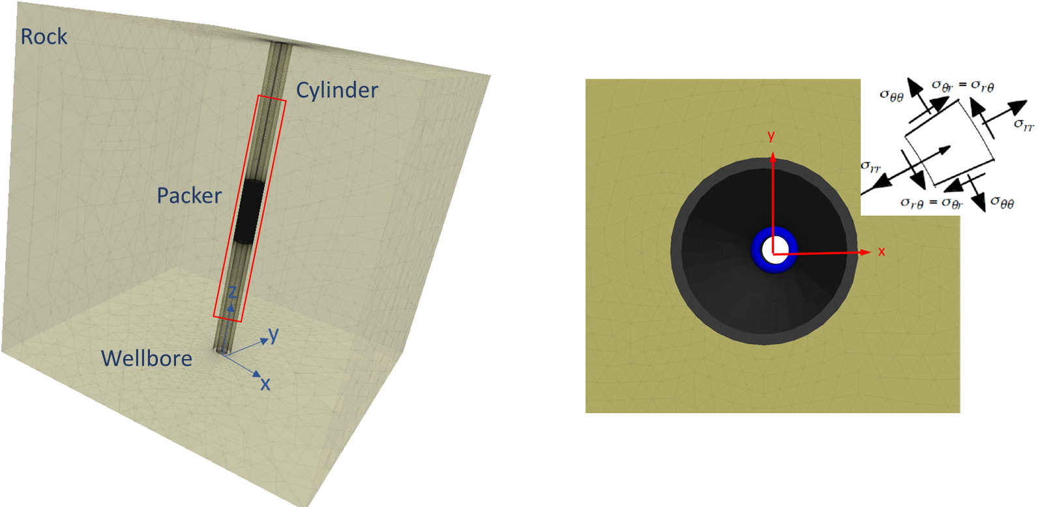
(2) The packer is a hollow cylinder (cylindrical annulus) - Boundary condition, setup, and assumptions
Polar coordinate in the well
In the following slides, σ_{rr},σ_{θθ}, δ_{rr}, ε_{rr}, and ε_{θθ} for both cases are shown
All of the following figures are compression positive

Slide 27
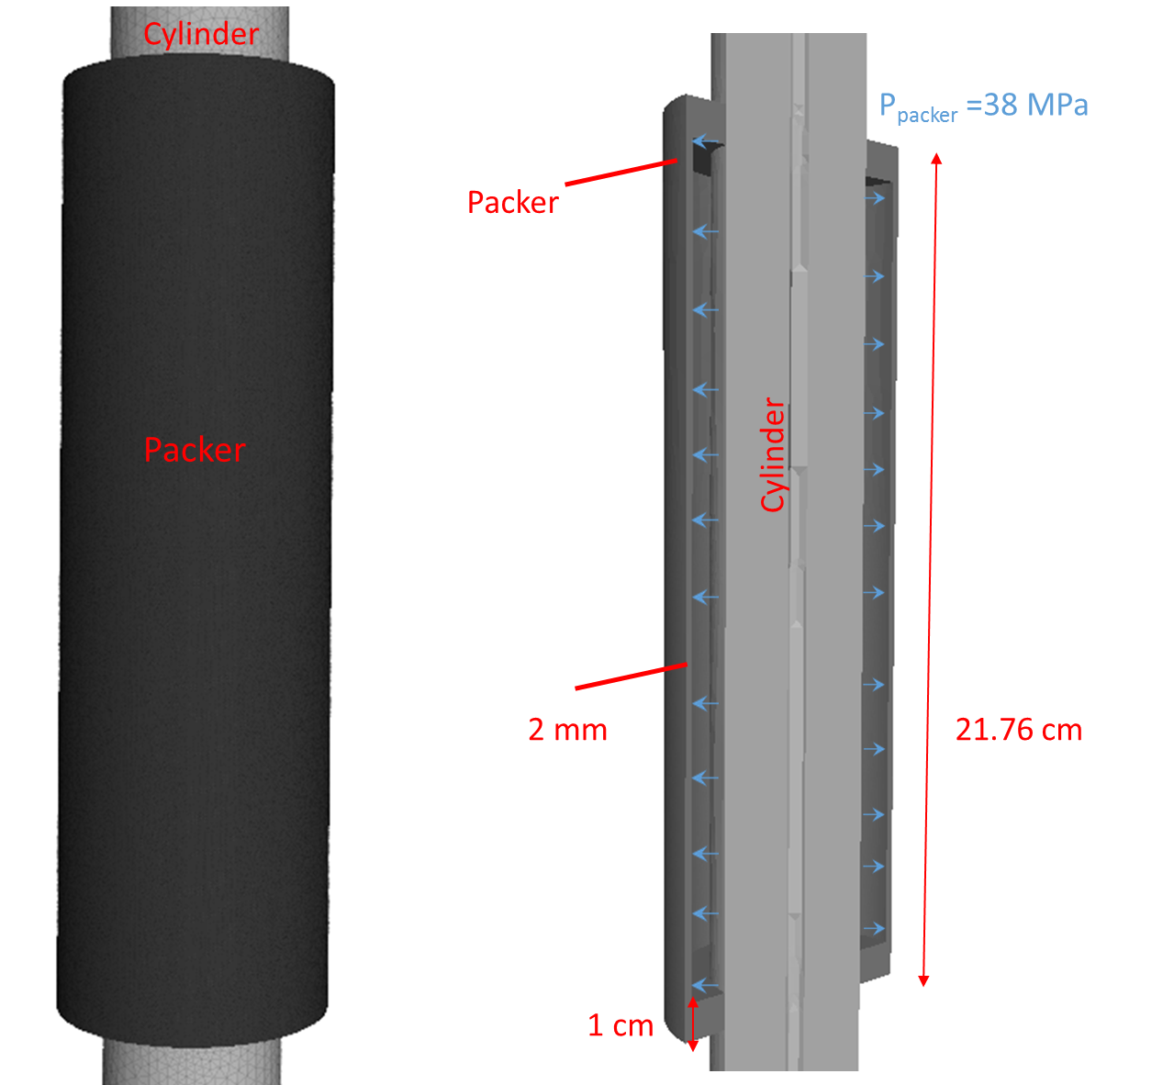
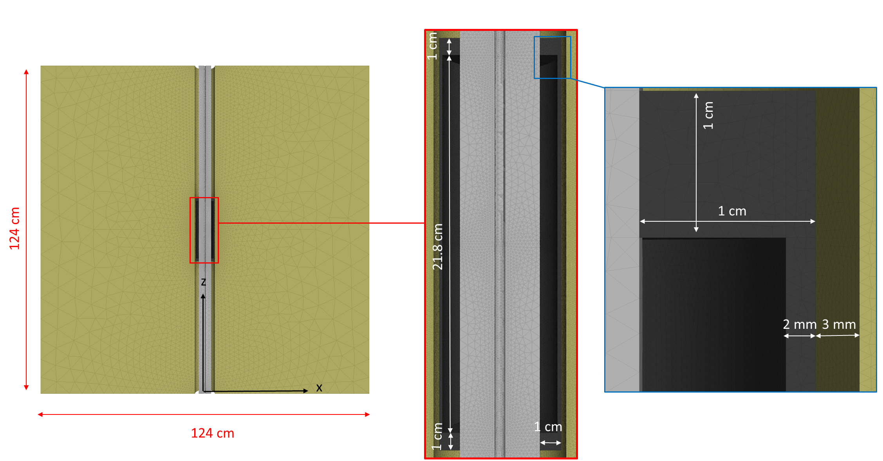
(2) The packer is a hollow cylinder (cylindrical annulus) - The packer shape and geometry
The packer is a hollow cylinder (cylindrical annulus, thickness of 2 mm) attached to a stiff cylinder.
The cylindrical tube has an internal and external radius of 0.3 cm and 2.3 cm.
The packer’s surface is at a distance of 3 mm from the wellbore wall.
The packer is pressurized internally to a pressure of 38 MPa

Slide 28
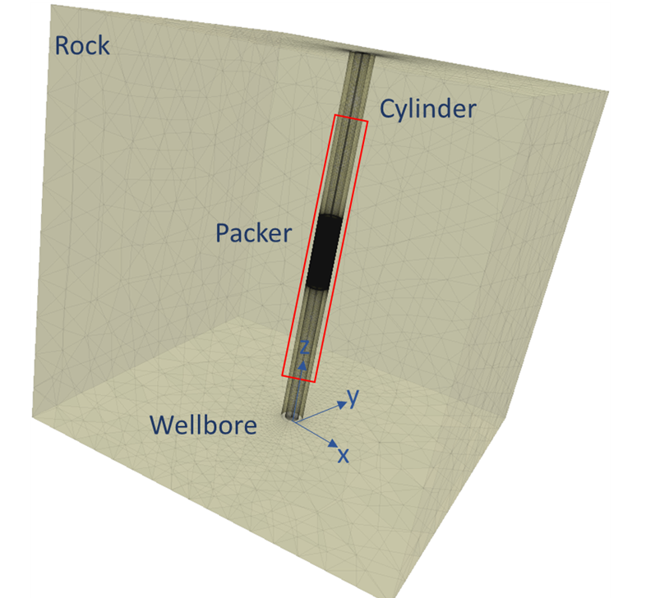
(2) The packer is a hollow cylinder (cylindrical annulus) - Domain of the model
The domain consists of a 1.24×1.24×1.24 m cube including a 4' (17.8 cm) diameter well at the center.
The well has a casing with a thickness of ∼1 cm.
The donut-shape packer is located at the middle depth of the model.
The horizontal cross-section of the model (x-y plane).

Slide 29
(2) The packer is a hollow cylinder (cylindrical annulus) - The vertical (x-z plane) cross-section of the model

Slide 30
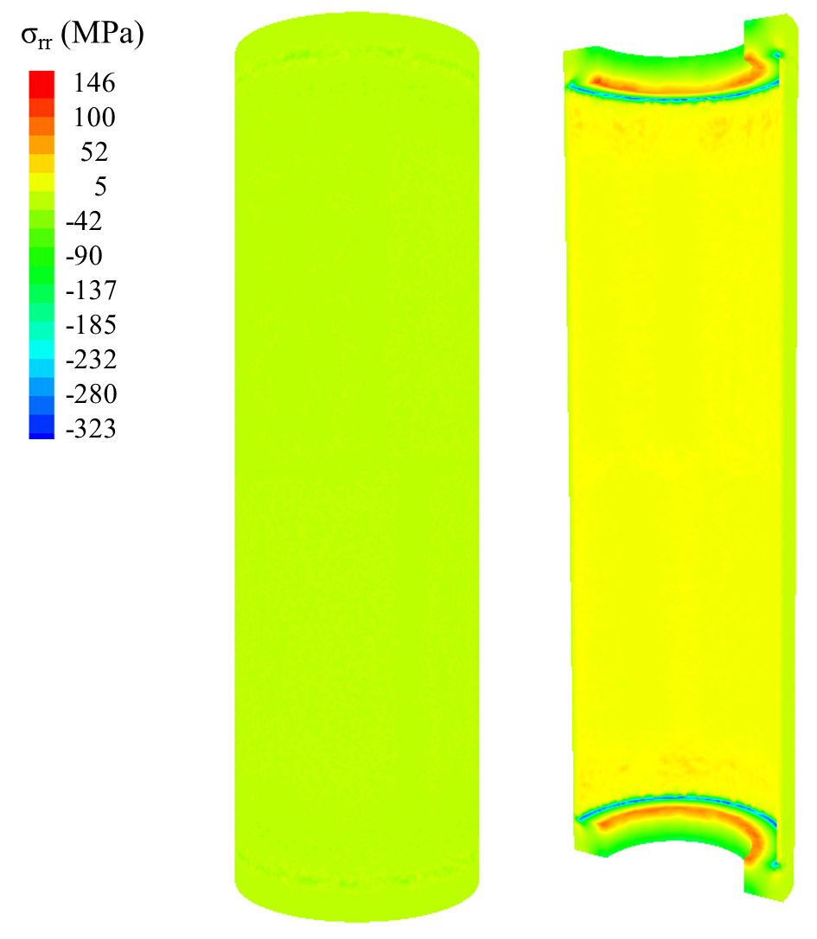
(2) The packer is a hollow cylinder (cylindrical annulus) – Cases 5 and 6
Applying 38 MPa pressure in the packer induces σ_{rr} of 146 MPa compression in the packer-casing contact in cases 5 and 6. Tensile stress up to 323 MPa is induced in the packer. A higher tension exists in the area the packer is attached to the cylinder.
Compression is positive.
Case 5: The more deformable packer than the cylinder (: Elastic packer with lower Young's modulus (E) than steel)
Case 6: The packer and the cylinder mechanical properties are identical

Slide 31
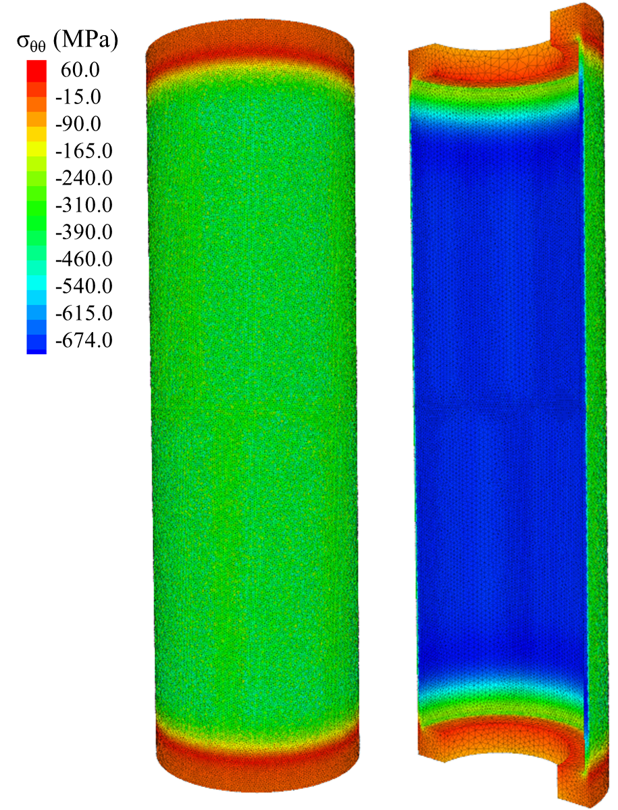
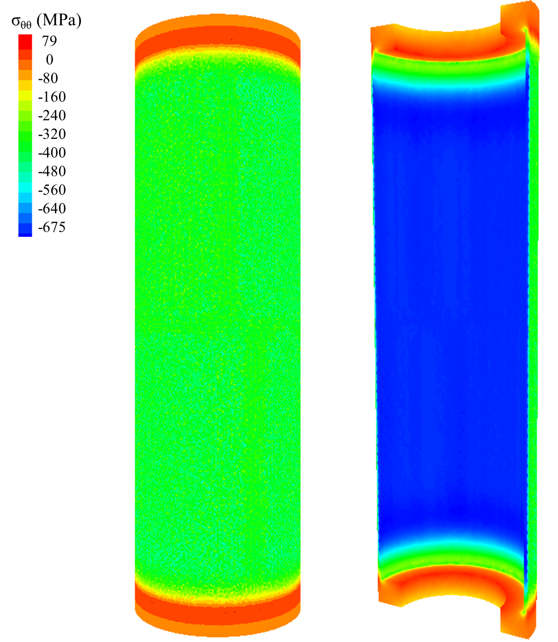
(2) The packer is a hollow cylinder (cylindrical annulus) – Cases 5 and 6
The induced normal tangential stress (σ_{θθ}) on the wellbore wall is zero in both cases 5 and 6.
Pressure of 38 MPa induces up to 79 MPa compressive and 675 MPa tensile tangential stresses in the packer in both cases 5 and 6.
Case 5: The more deformable packer than the cylinder (: Elastic packer with lower Young's modulus (E) than steel)
Case 6: The packer and the cylinder mechanical properties are identical

Slide 32
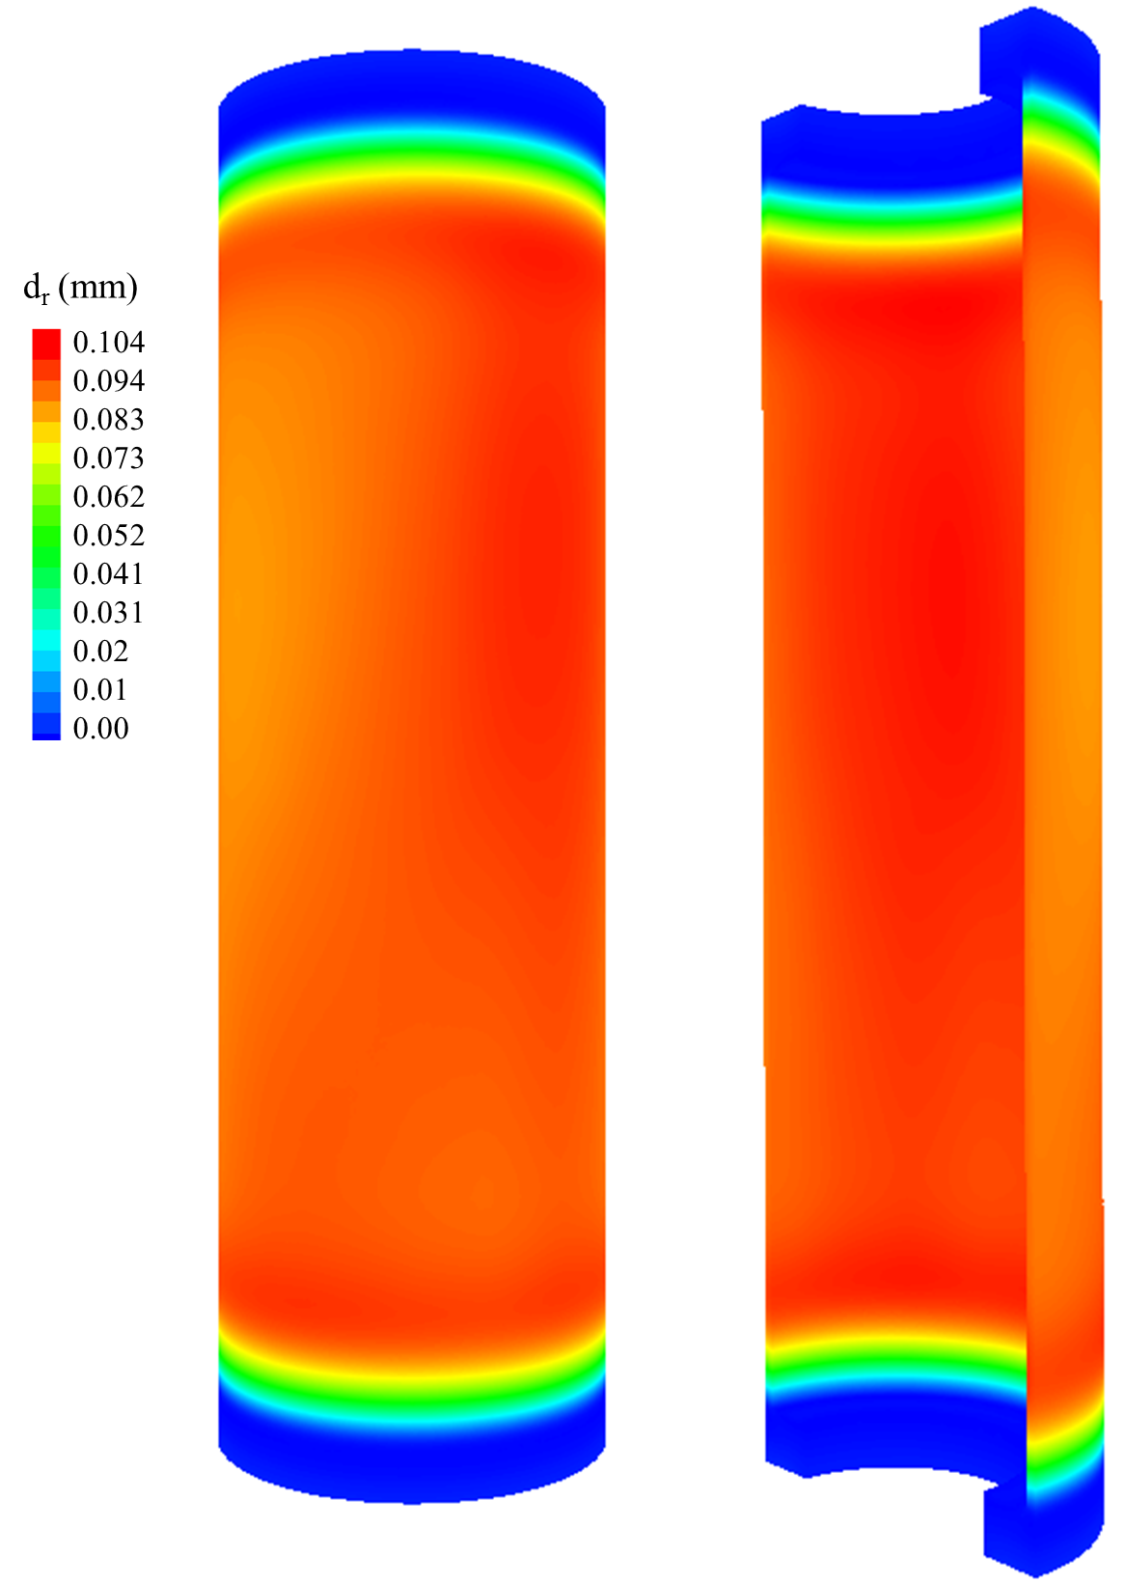
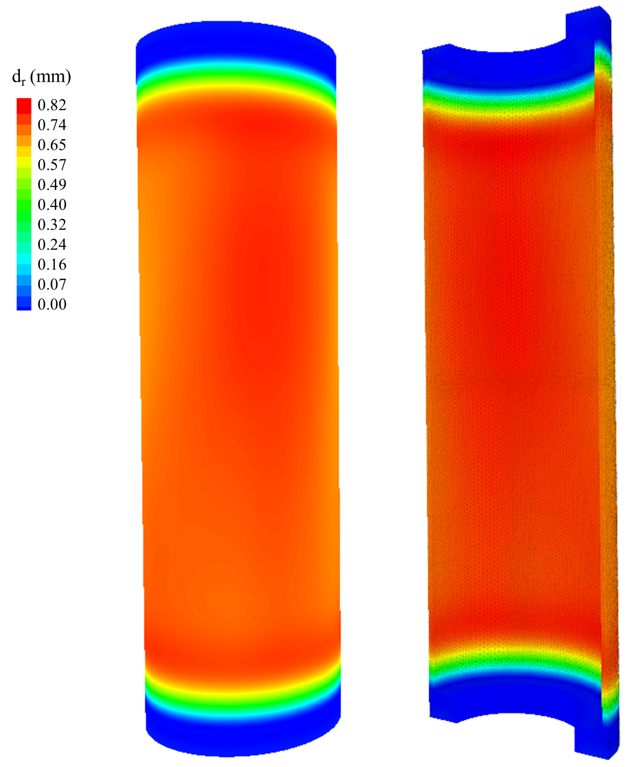
(2) The packer is a hollow cylinder (cylindrical annulus) – Cases 5 and 6
In cases 5 and 6 the pressurized packer deforms, but deformation is not enough to cause the packer have contact with the wellbore wall. In other word, the radial deformation (d_{r}) is less than 3 mm (the distance from the outer boundary of the packer and the wellbore wall).
The induced normal stress is zero in this case.
Compression is positive.
Case 5: The more deformable packer than the cylinder (: Elastic packer with lower Young's modulus (E) than steel)
Case 6: The packer and the cylinder mechanical properties are identical

Slide 33
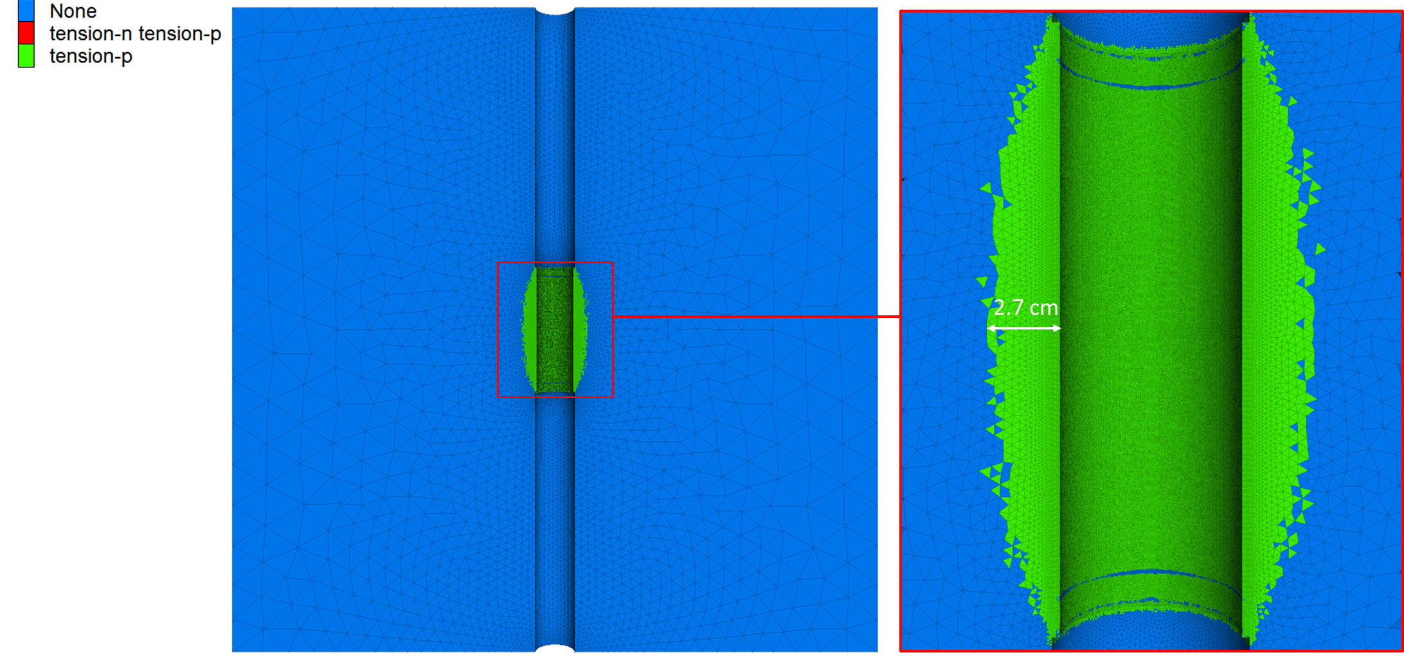
(2) The packer is a hollow cylinder (cylindrical annulus) – Cases 7 and 8
Pressure of 38 MPa induces tensile failure on the wellbore wall up to a distance of 2.7 cm.
The results show that the failure occurred at a higher distance from the wellbore wall in the middle depth of the packer than in the upper and lower area.

Slide 34
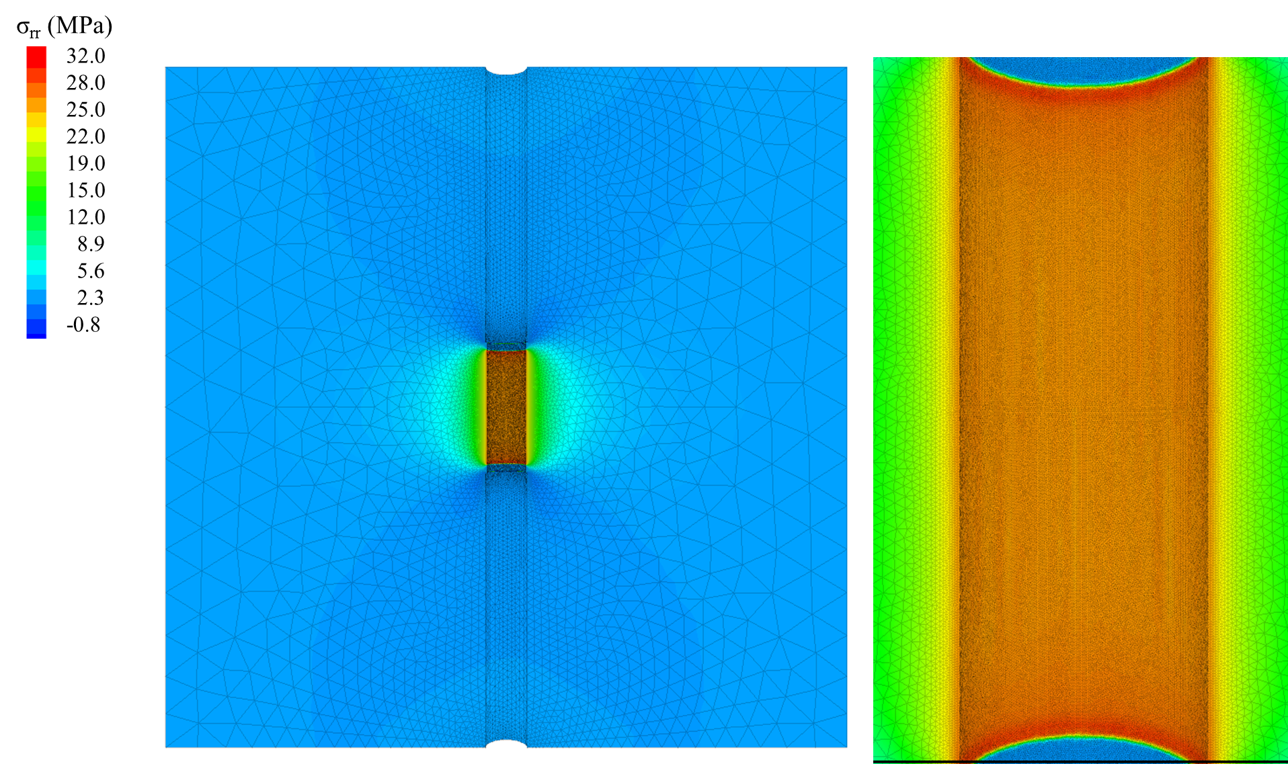
(2) The packer is a hollow cylinder (cylindrical annulus) – Cases 7 and 8
In cases III, the pressurized (38 MPa) packer induces compression stress of σ_{rr} up to 32 MPa on the wellbore wall in the rock.
It is almost uniform of 28 MPa on the whole wellbore, and at the upper and lower end of the packer, it has higher values.
Compression is assumed positive.

Slide 35
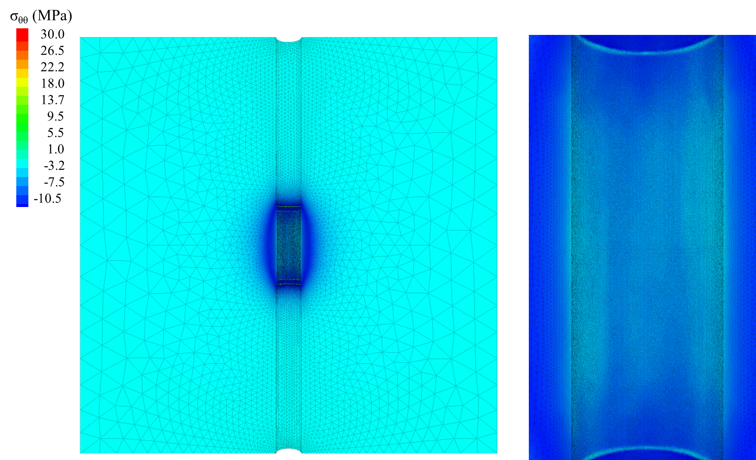
(2) The packer is a hollow cylinder (cylindrical annulus) – Cases 7 and 8
In cases III, the pressurized (38 MPa) packer induces tensile stress of σ_{θθ} up to 10.5 MPa on the wellbore wall in the rock (after failure).
Compression is assumed positive.

Slide 36
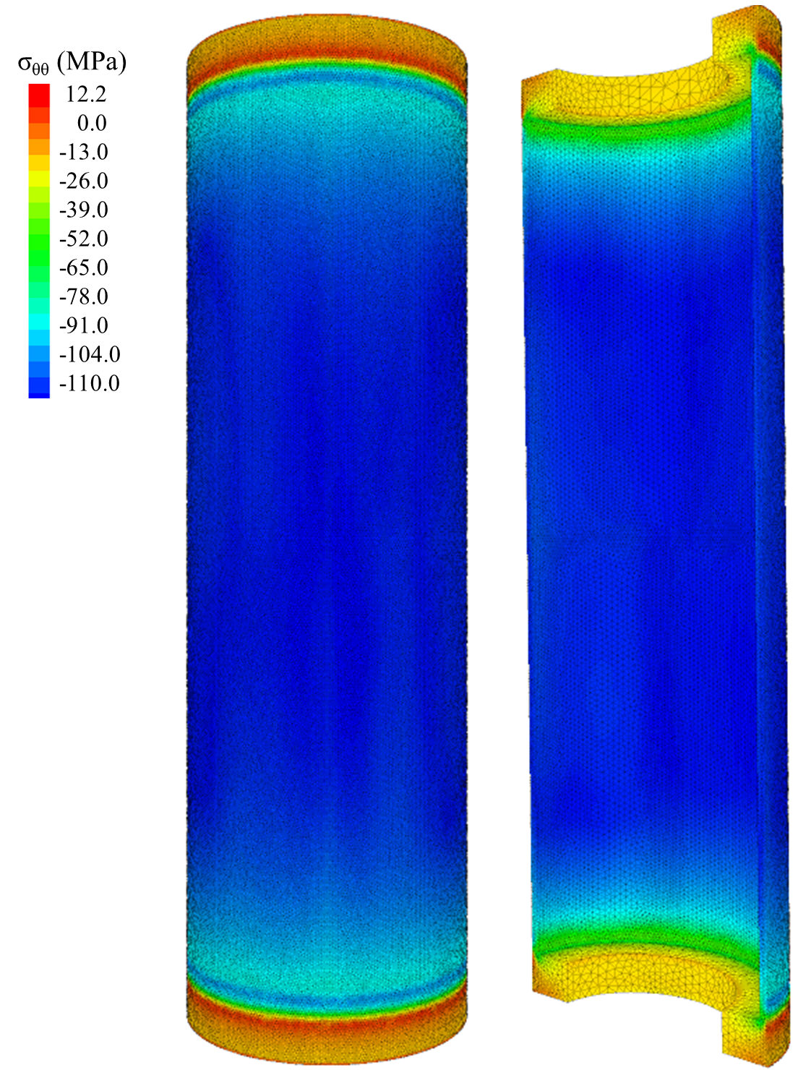
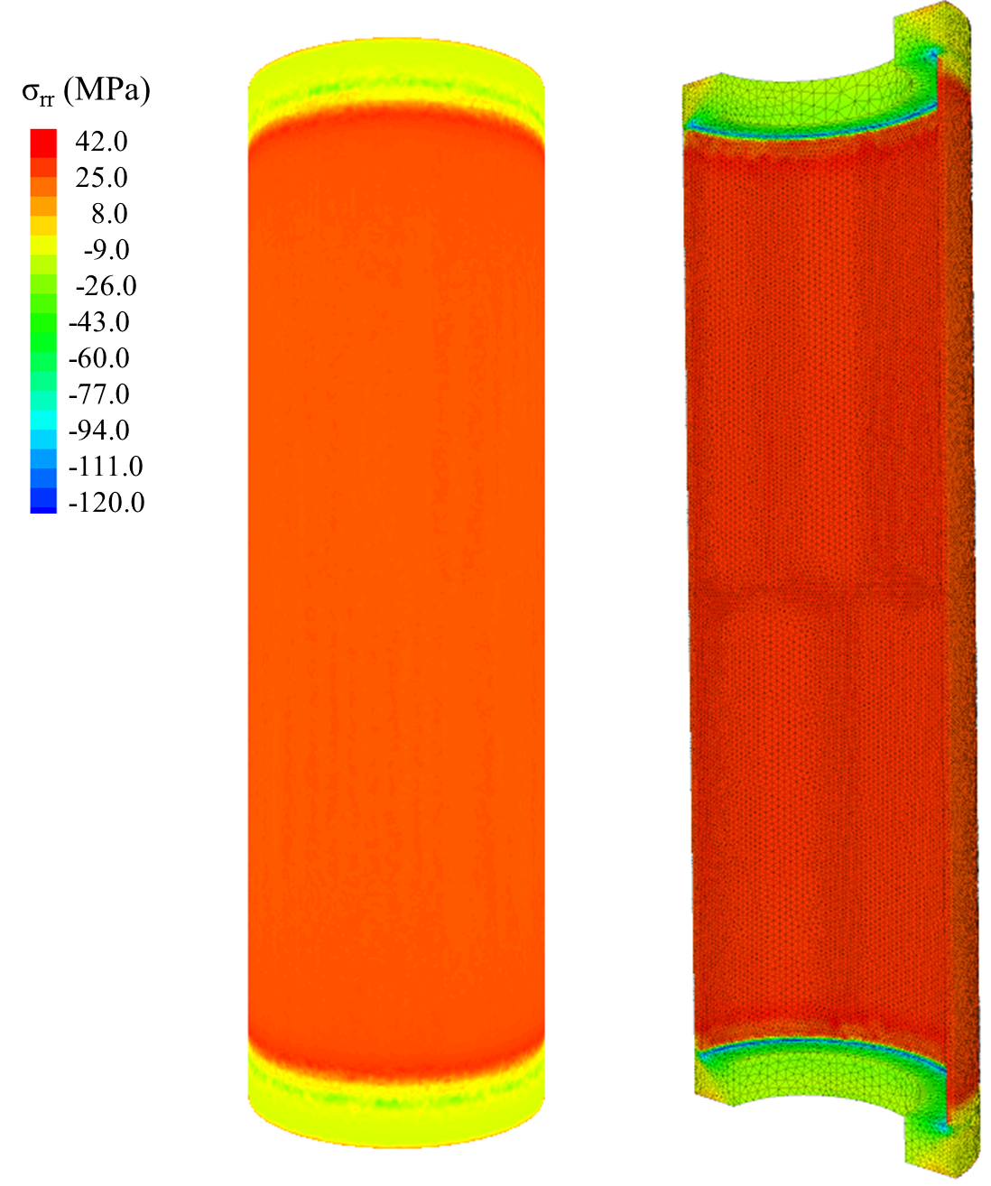
(2) The packer is a hollow cylinder (cylindrical annulus) – Cases 7 and 8
In the packer, the pressure of 38 MPa induces σ_{θθ} up to 110 MPa tensile stress and 12 MPa compressive stress.
The induced σ_{rr} is up to compressive stress of 42 MPa and tensile stress of 120.

Slide 37
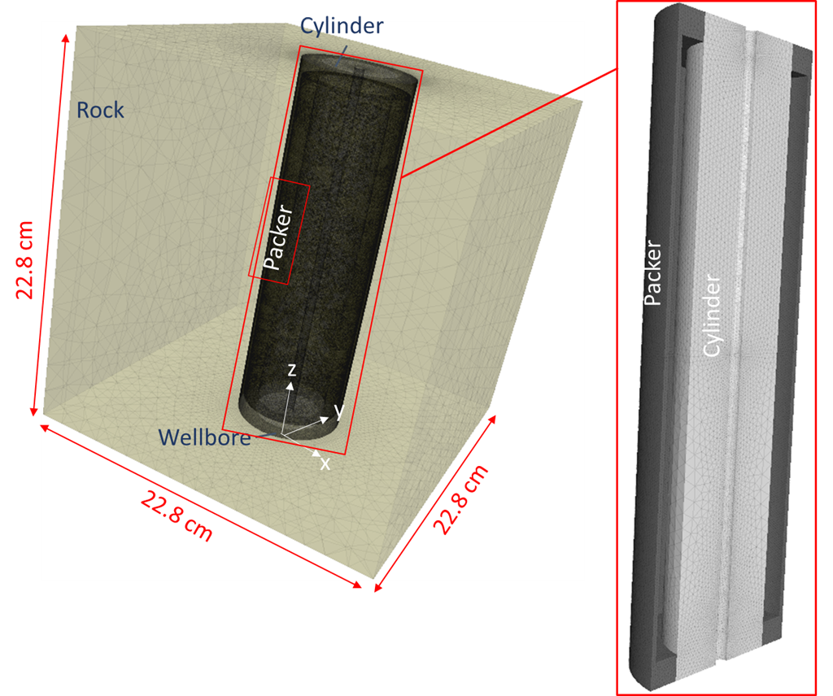
(2) The packer is a hollow cylinder (cylindrical annulus) – Case 8
In this case, the rock block has a smaller domain of 22.8 cm ×22.8 cm.
The initial and the boundary conditions are similar to the previous cases.

Slide 38
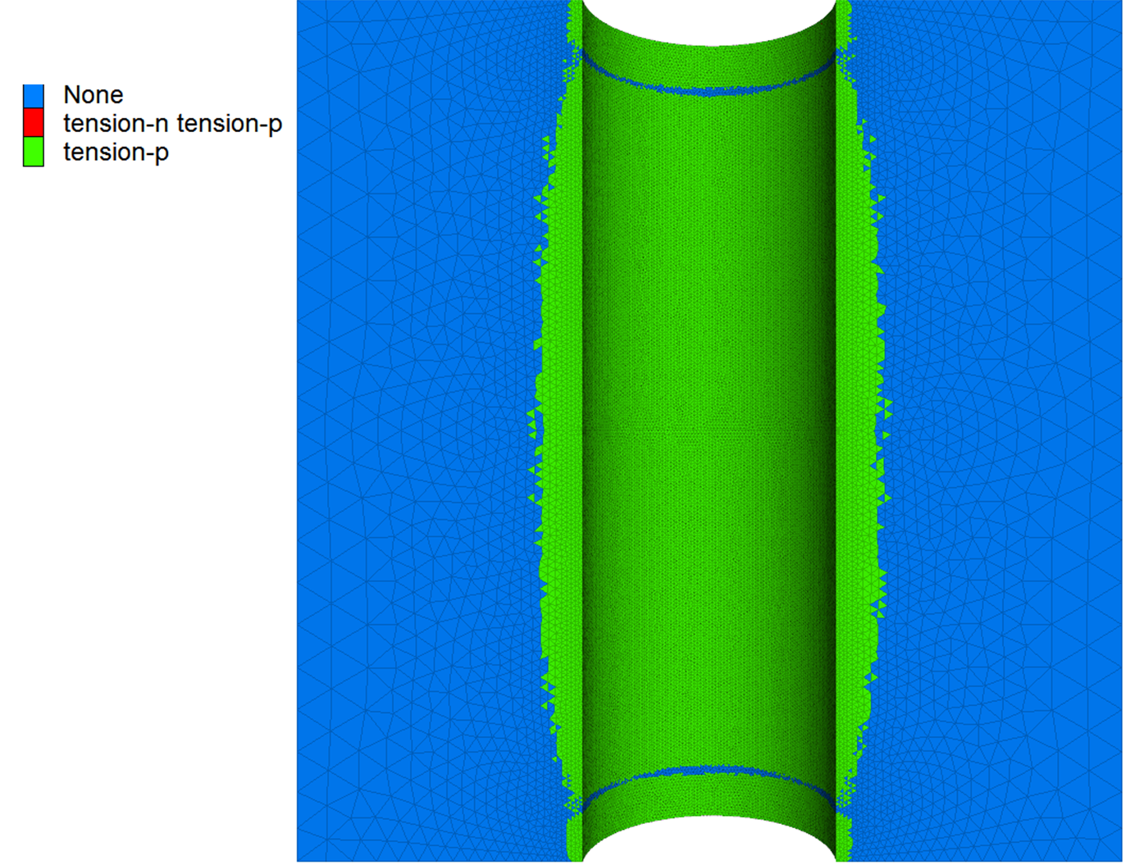
(2) The packer is a hollow cylinder (cylindrical annulus) – Case 8
Pressure of 38 MPa induces tensile failure on the wellbore wall up to a distance of 2.7 cm.
The results show that the failure occurred at a higher distance from the wellbore wall in the middle depth of the packer than in the upper and lower area.

Slide 39
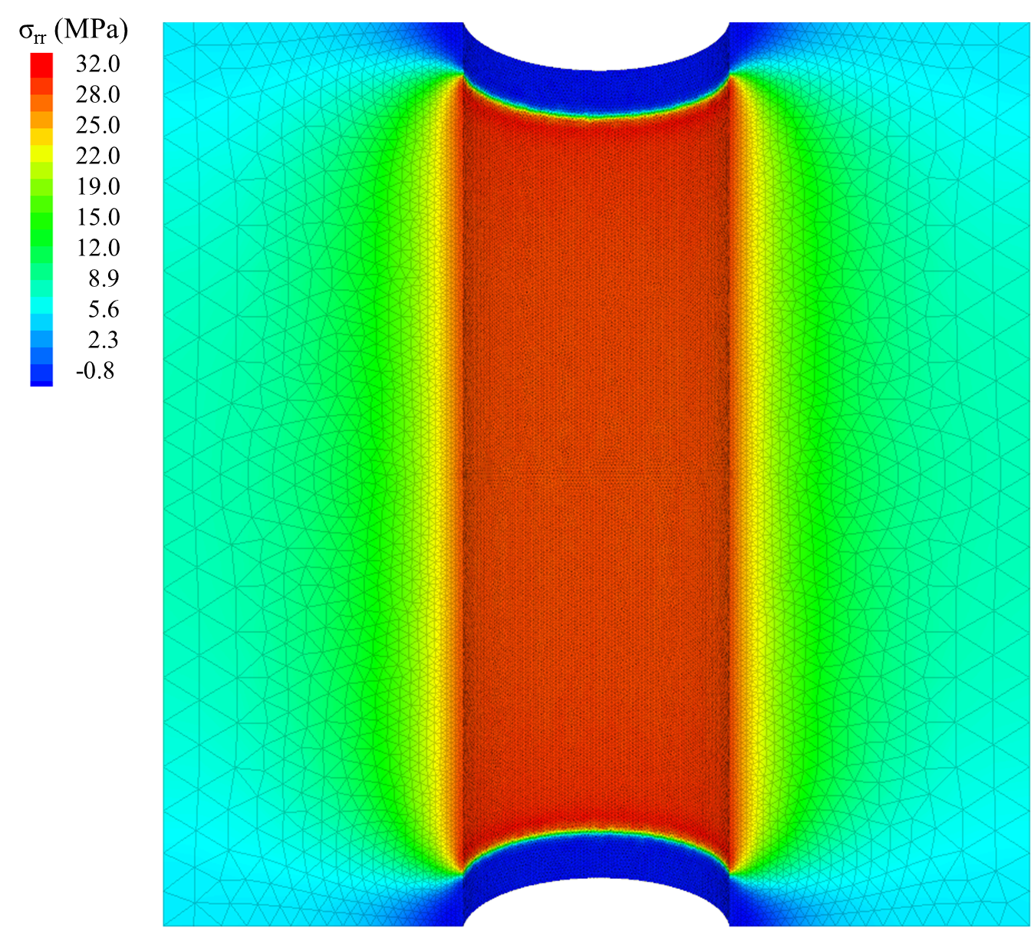
(2) The packer is a hollow cylinder (cylindrical annulus) – Case 8
In cases IV, the pressurized (38 MPa) packer induces compression stress of σ_{rr} up to 32 MPa on the wellbore wall in the rock.
It is almost uniform of 28 MPa on the whole wellbore, and at the upper and lower end of the packer, it has higher values.
Compression is assumed positive.

Slide 40
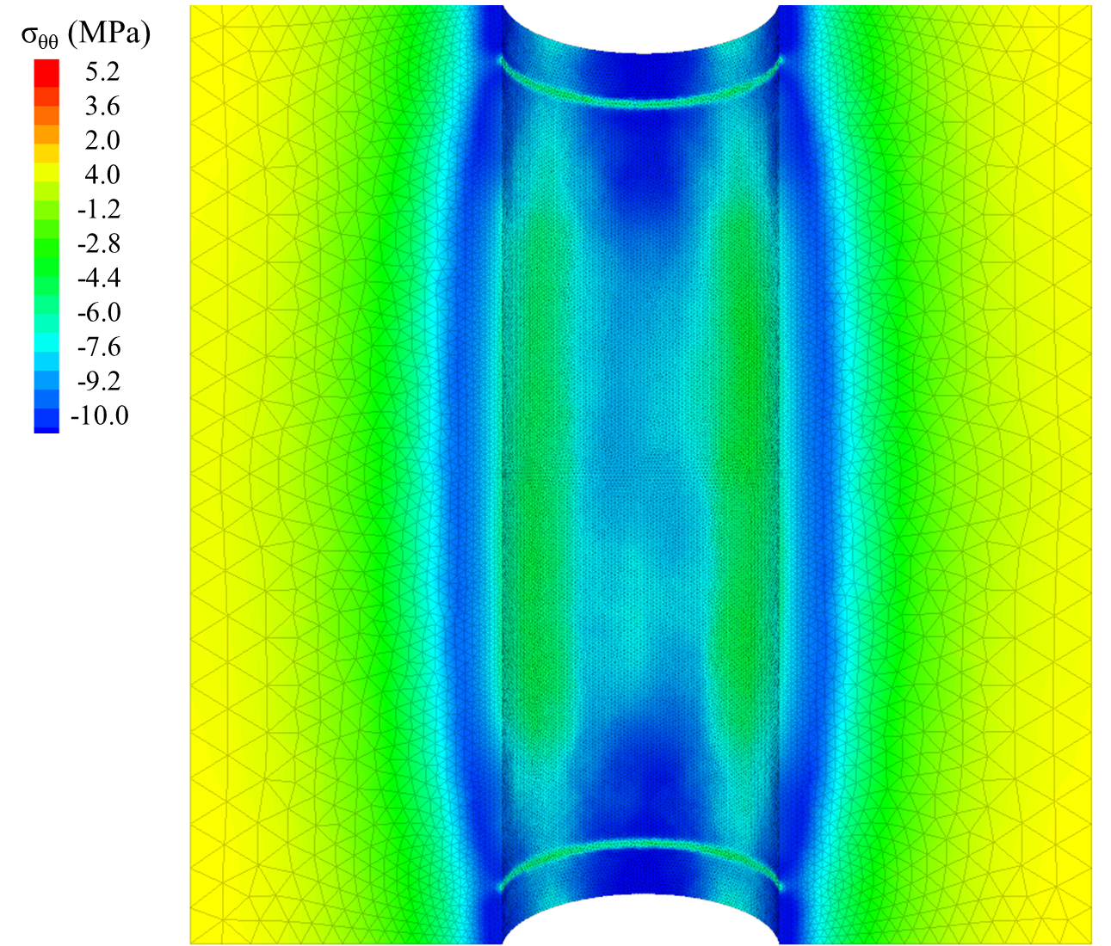
(2) The packer is a hollow cylinder (cylindrical annulus) – Case 8
In cases IV, the pressurized (38 MPa) packer induces tensile stress of σ_{θθ} up to 10.5 MPa on the wellbore wall in the rock (after failure).
Compression is assumed positive.

Slide 41
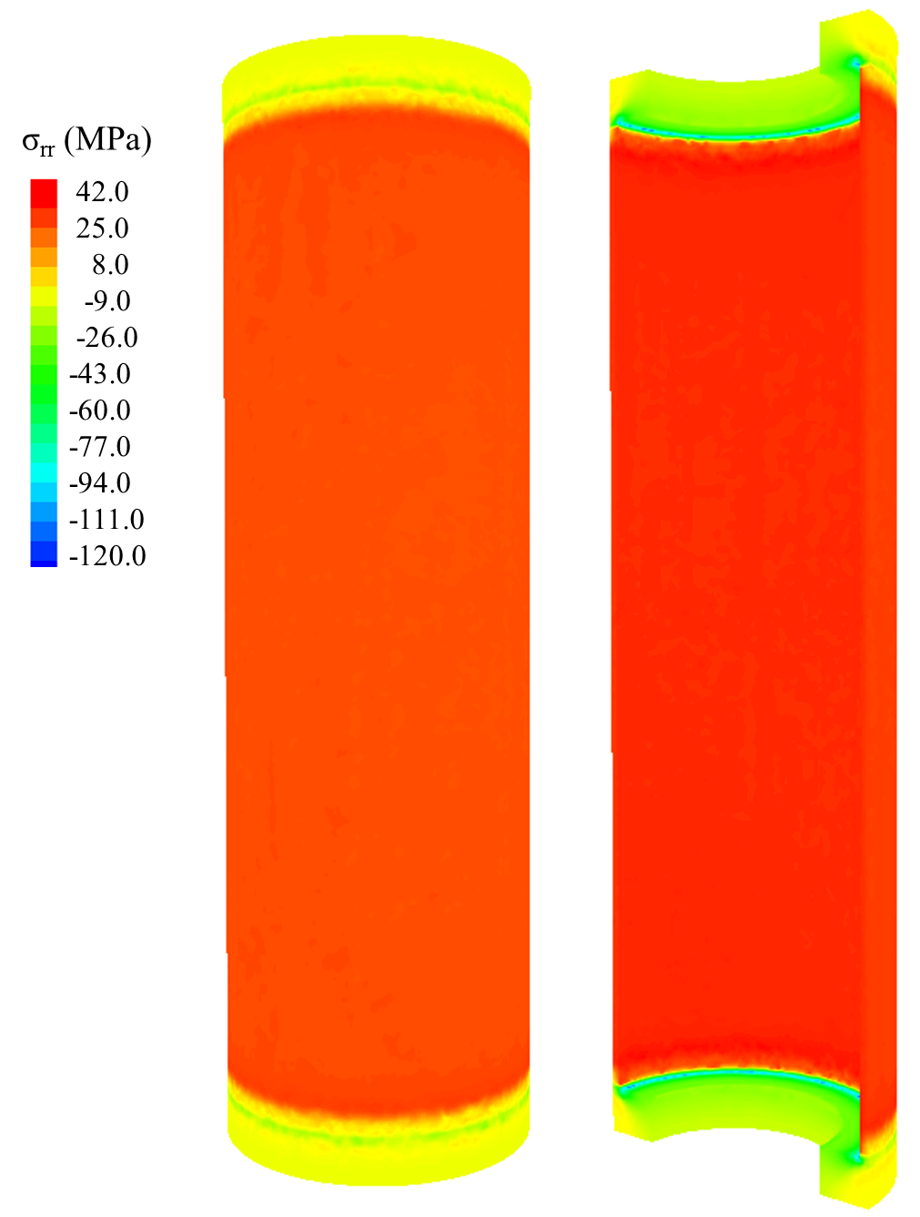
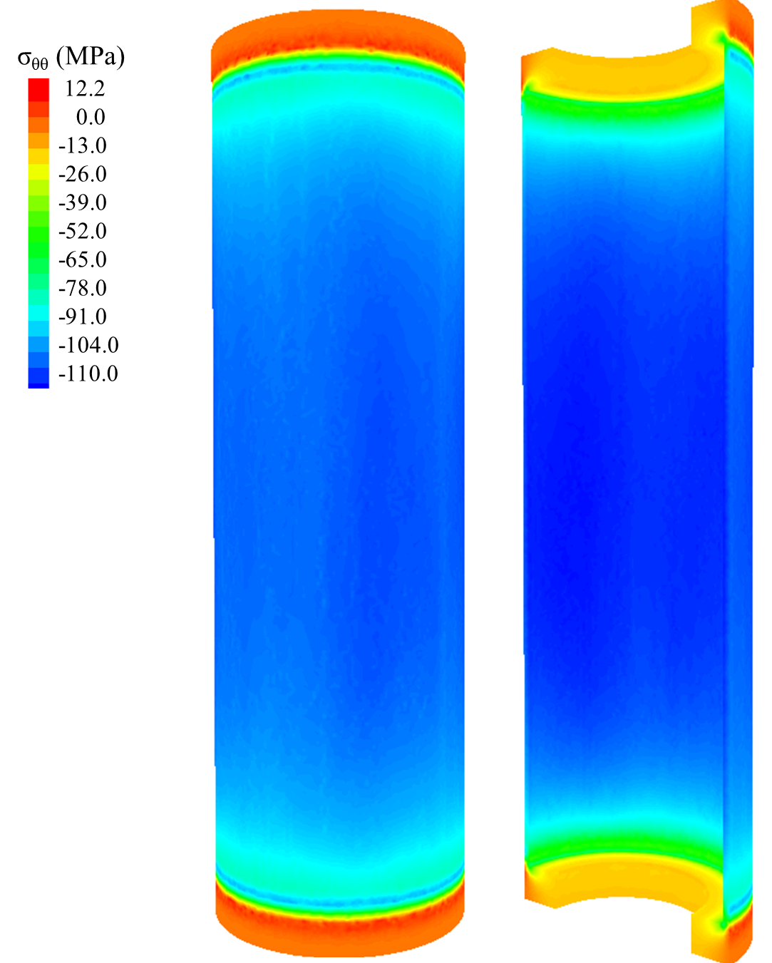
(2) The packer is a hollow cylinder (cylindrical annulus) – Case 9
In the packer, the pressure of 38 MPa induces σ_{θθ} up to 110 MPa tensile stress and 12 MPa compressive stress.
The induced σ_{rr} is up to compressive stress of 42 MPa and tensile stress of 120.

Slide 42
(3) A similar boundary condition and rock properties as those of the FORGE project are defined for the rock

Slide 43
(3) The FORGE project setup – Case 9
Case 9: A 1.24×1.24×1.24 m model is located at depth of 2.6 km (8533 ft.). The rock properties , initial condition (e.g. in-situ stresses and pore pressure, etc.), and the boundary condition are identical to those of FORGE project. The well direction is similar to that of S_{h} (minimum horizontal principal stress, N60W) and has inclination of 65°.

Slide 44
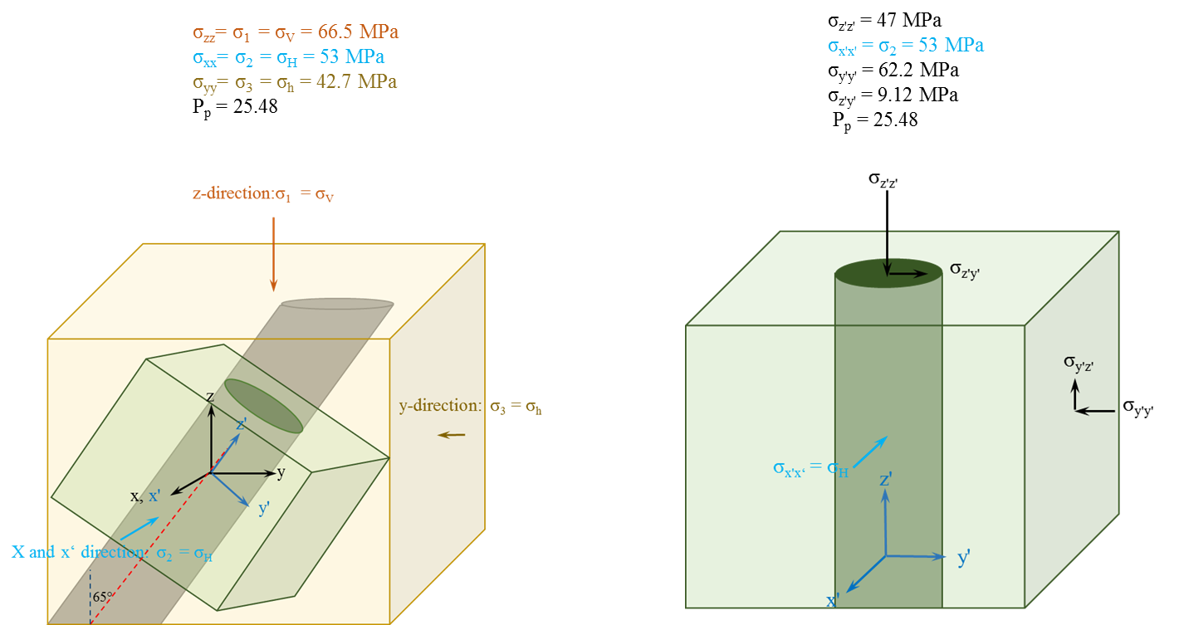
(3) The FORGE project setup – Case 9
For the sake of simplicity, we constructed the model in a way that the well is parallel to one of the cube edges (z'). So, the stress state in this new coordination should be calculated by in-situ stress transformation. To apply the new boundary condition, we should apply shear stresses on the two planes of the cube (x'z' and x'y') and there is no shear stress on the y'z' plane (shown in the figure). In other word, x' is one of the principal streses direction.

Slide 45
(3) The FORGE project setup – Case 9
The gradients of the maximum and minimum horizontal stresses, and overburden gradient are ∂σ_{H, max}/∂z =20.35 MPa/km (0.9 psi/ft), ∂ σ_{H, min} /∂z =16.4 MPa/km (0.725 psi/ft), and ∂σ_{v}/∂z =25.56 MPa/km (1.3 psi/ft), respectively. The gradient of pore pressure is ∂P_{p} /∂z = 9.79 MPa/km (0.43 psi/ft).
Parameters | SI Unit | English Unit
E | 54.55 GPa | 7910000 psi
v | 0.29
θ | 44 - 54 degrees
UCS | 91.03 MPa | 13200 psi

Slide 46
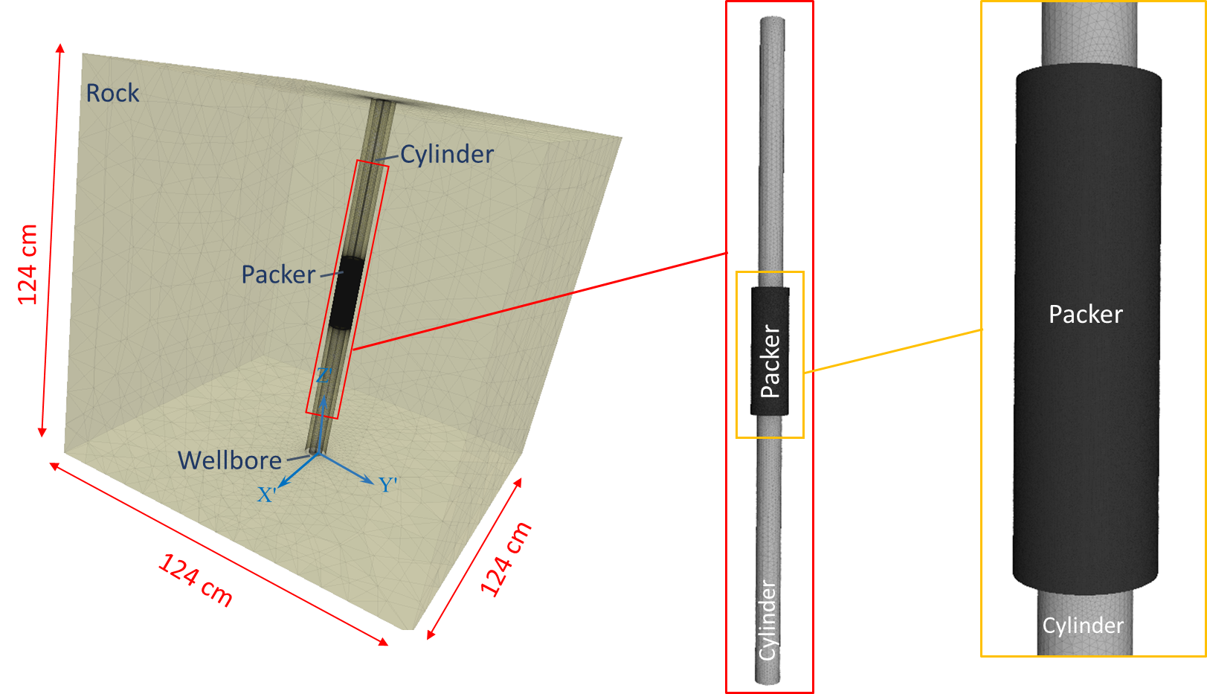
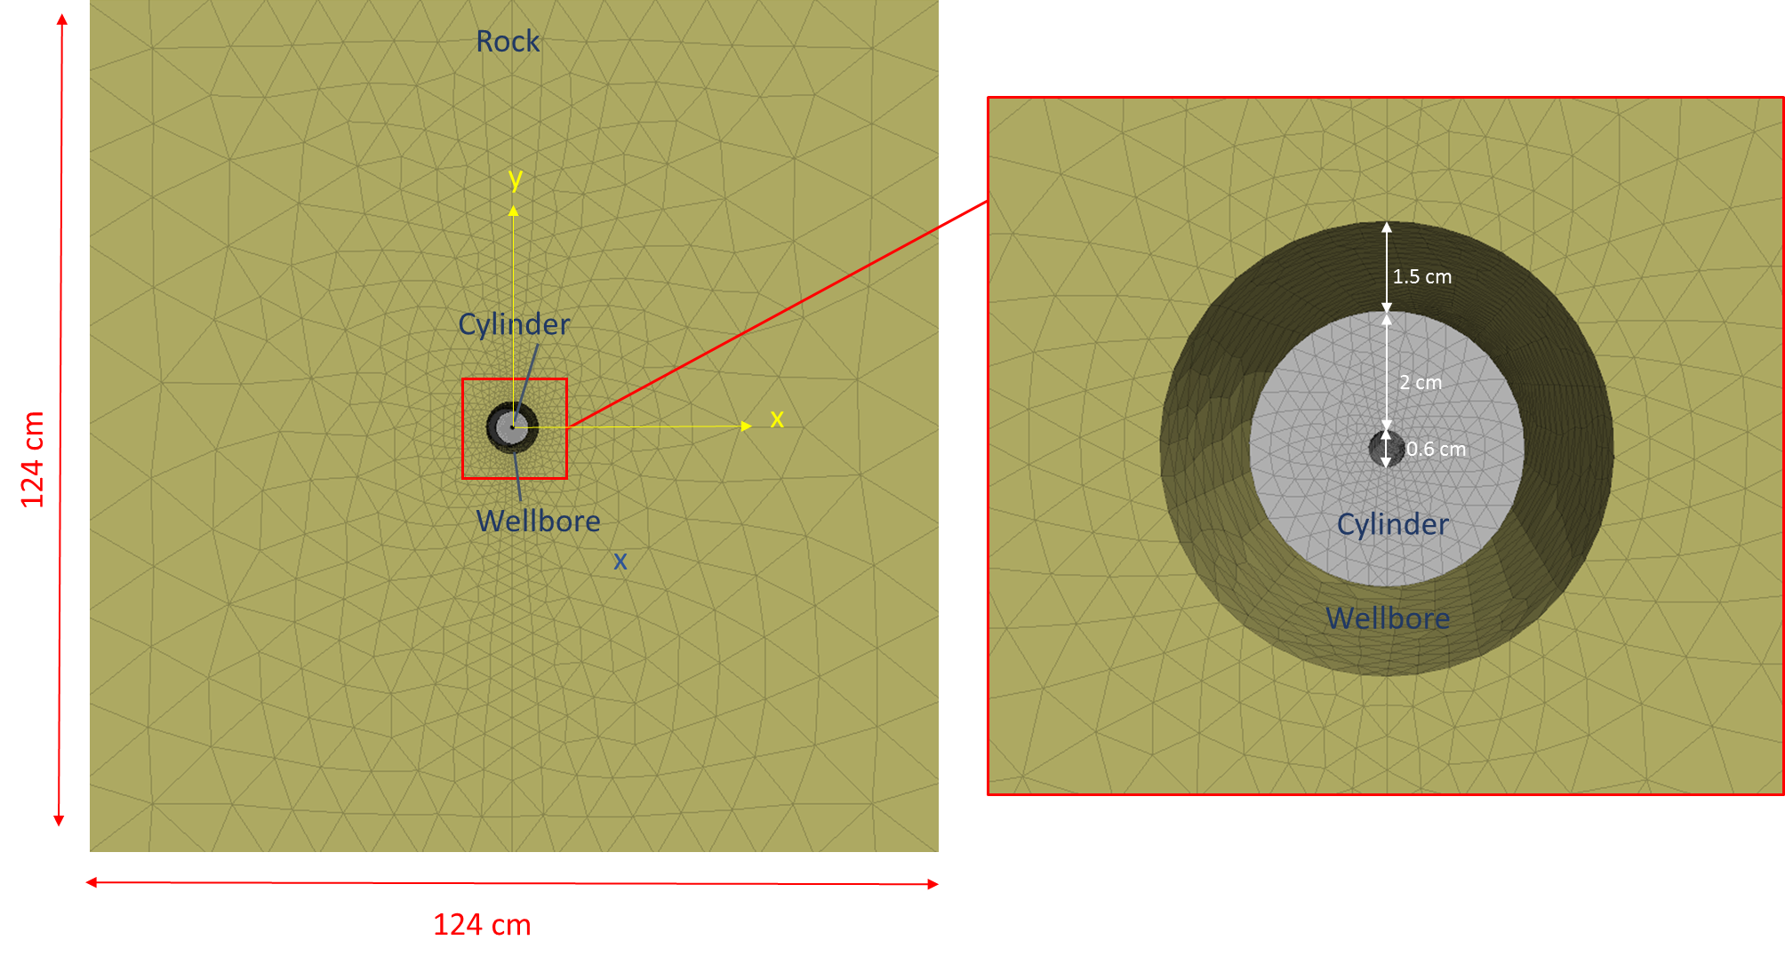
(3) The FORGE project setup – Case 9
The model consists of a cubic rock block with size of 124 cm × 124 cm × 124 cm
A 7.6 cm (3 inches) wellbore is located in the middle of the block
The packer is a hollow cylinder (cylindrical annulus, thickness of 2 mm)
The packer is attached to a cylinder
The cylindrical tube has an internal and external radius of 0.3 cm and 2.3 cm
The packer’s surface is at a distance of 3 mm from the wellbore wall.

Slide 47
(3) The FORGE project setup – Case 9
The vertical (x-z plane) cross-section of the model and the packer shape

Slide 48
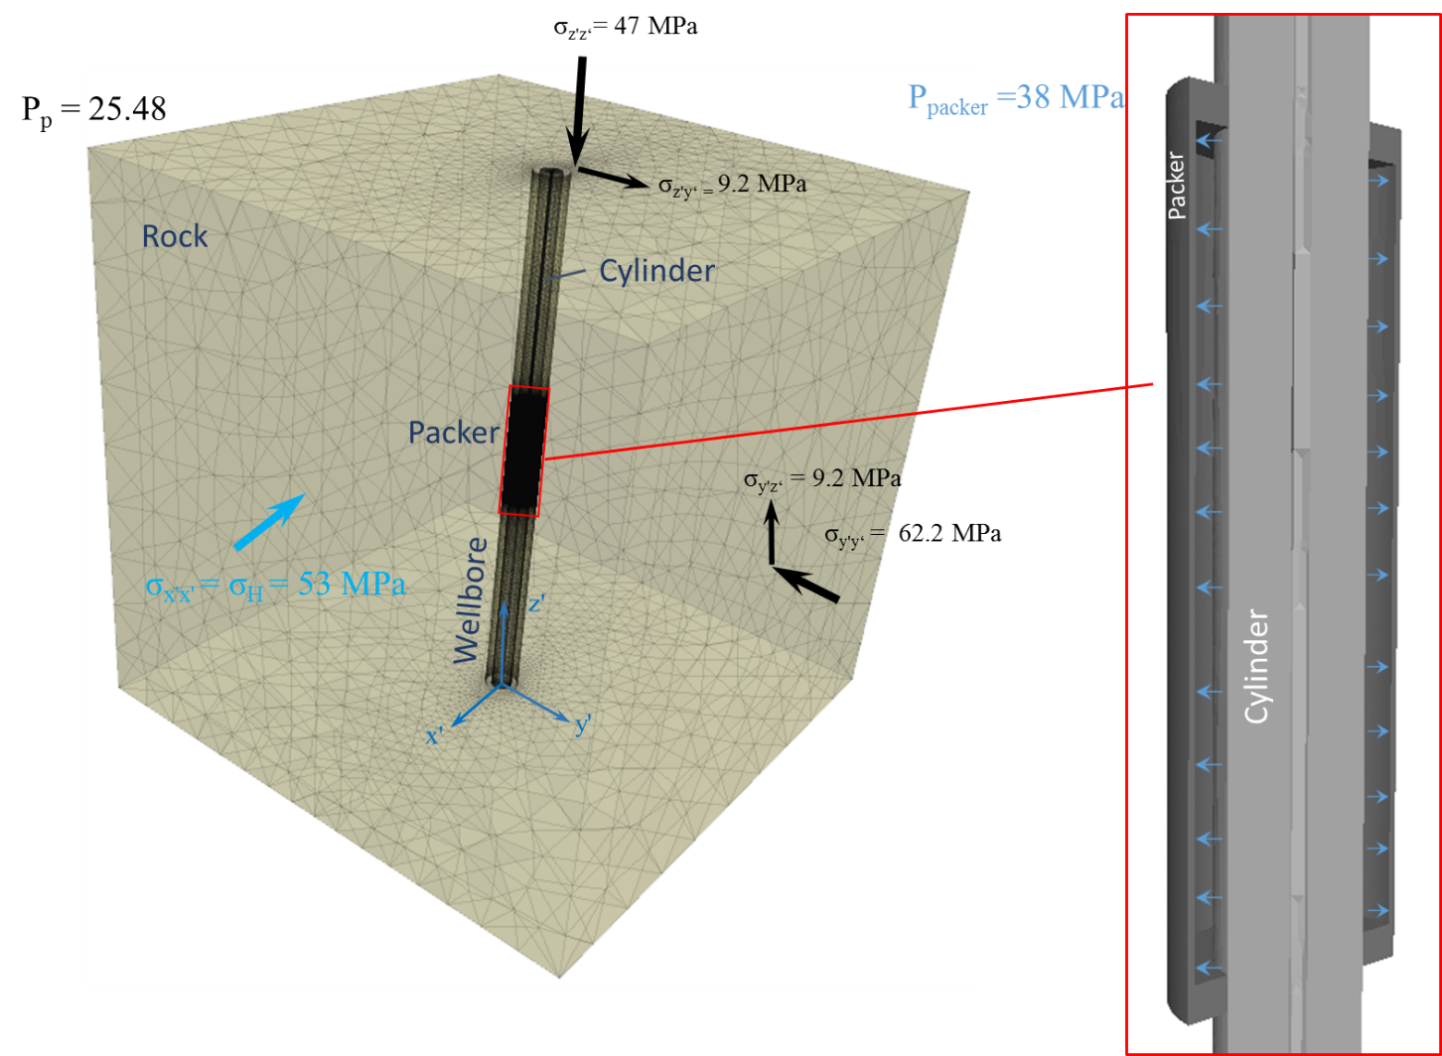
(3) The FORGE project setup – Case 9-BC and mechanical prop of the packer and the rock
The gradients of the maximum and minimum horizontal stresses, and overburden gradient are ∂σ_{H, max}/∂z =20.35 MPa/km (0.9 psi/ft), ∂σ_{H, min} /∂z =16.4 MPa/km (0.725 psi/ft), and ∂σ_{v}/∂z =25.56 MPa/km (1.3 psi/ft), respectively. The gradient of pore pressure is ∂P_{p} /∂z = 9.79 MPa/km (0.43 psi/ft).
Zhi and Ghassemi (2023, unpublished)
Rock | SI Unit | English Unit
E | 54.55 Gpa | 7910000 psi
v | 0.29
θ | 44 - 54 degrees
UCS | 91.03 MPa | 13200 psi
Zhi and Ghassemi (2023, unpublished)
 |  | Casing | Packer
Young's Modulus, E (GPa) |  | 210 | 26.34 (case I)- 210 (Case II)
Poisson's Ratio, ν |  | 0.3 | 0.3
Density (kg/m³) |  | 7850 | 7850
Based on the rock properties (Table 2) and initial condition, no failure occurred in the wellbore.

Slide 49
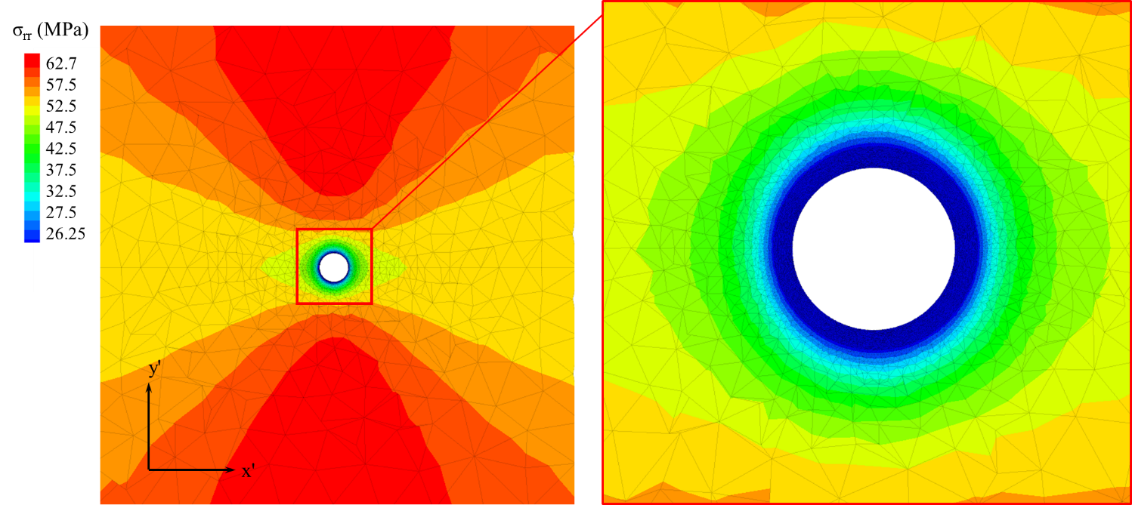
(3) The FORGE project setup – Case 9
The initial total and effective radial stress at the middle depth of the cross-section of the model.
Compression is assumed positive.
No failure is observed in the wellbore before pressurizing the packer to 38 MPa, and the wellbore remains stable.

Slide 50
(3) The FORGE project setup – Case 9
The initial total and effective tangential stress at the middle depth of the cross-section of the model.
Compression is assumed positive.
No failure is observed in the wellbore before pressurizing the packer to 38 MPa, and the wellbore remains stable.

Slide 51
(3) The FORGE project setup – Case 9
The z-direction normal stress at the cross section of the model (at the middle depth)
Compression is assumed positive.
No failure is observed in the wellbore before pressurizing the packer to 38 MPa, and the wellbore remains stable.

Slide 52
(3) The FORGE project setup – Case 9
After applying 38 MPa pressure in the packer, radial stress reaches ∼37 MPa on the wellbore wall in contact with the packer. In the upper and lower parts of the packer, the σ_{rr} reaches 110 MPa. The higher values of radial stress in some elements are not physically meaningful and are numerical artifacts.
No failure is observed in the wellbore after pressurizing the packer to 38 MPa.

Slide 53
(3) The FORGE project setup – Case 9
The cross-section of the model (at the middle depth) shows that the radial stress reaches 37 MPa on the wellbore wall and increases to the in-situ stress at farther distances from the wellbore. Compression is assumed positive.
No failure is observed in the wellbore after pressurizing the packer to 38 MPa.

Slide 54
(3) The FORGE project setup – Case 9
After applying 38 MPa pressure in the packer, tangential stress on the wellbore is between 47 and 66 MPa.In the upper and the lower parts of the packer, the σ_{θθ} reaches ∼120 MPa. The higher values of radial stress in some elements are not physically meaningful and are numerical artifacts.
No failure is observed in the wellbore after pressurizing the packer to 38 MPa.

Slide 55
(3) The FORGE project setup – Case 9
The cross-section of the model (at the middle depth) shows that the tangential stress reaches 66.5 MPa on some sections (θ = 0 and 180°) of the wellbore wall and decreases gradually to the in-situ stress at farther distances from the wellbore. It decreases to 47 MPa at some sections (θ = 90° and 270°) and increases at a farther distance from the wellbore.
Compression is assumed positive.
No failure is observed in the wellbore after pressurizing the packer to 38 MPa.

Slide 56
(3) The FORGE project setup – Case 9
After applying 38 MPa pressure in the packer, normal stresses (σ_{zz} )in the z-direction from 42 to 55 MPa on the wellbore
Compression is assumed positive.
No failure is observed in the wellbore after pressurizing the packer to 38 MPa.

Slide 57
(3) The FORGE project setup – Case 9
The cross-section of the model (at the middle depth) shows that σzz reaches 55.3 MPa on some sections (θ = 0 and 180°) of the wellbore wall and decreases gradually to the in-situ stress at farther distances from the wellbore. It decreases to 42 MPa at some sections (θ = 90° and 270°) and increases at a farther distance from the wellbore.
Compression is assumed positive.
No failure is observed in the wellbore after pressurizing the packer to 38 MPa.

Slide 58
(3) The FORGE project setup – Case 9
The profile of the effective radial and tangential stresses across θ = 0° from the wellbore wall to the boundary of the model at the middle depth. The σ_{θθ} reduces on the wellbore wall after applying the pressure in the packer. It decreases the initial in-situ stress at farther distances. In contrast, σ_{rr} increases on the wellbore wall due to the pressurized packer and reaches the in-situ stress at farther distances.
The profile of the effective σ_{θθ} and σ_{zz} across θ = 0 from the wellbore wall to the boundary of the model at the middle depth. The σ_{zz} change is negligible.

Slide 59
(3) The FORGE project setup – Case 9
The profile of the effective radial and tangential stresses across θ = 90° from the wellbore wall to the boundary of the model at the middle depth. The σ_{θθ} reduces on the wellbore wall after applying the pressure in the packer. It decreases the initial in-situ stress at farther distances. In contrast, σ_{rr} increases on the wellbore wall due to the pressurized packer, and reaches the in-situ stress at farther distances.
The profile of the effective σ_{θθ} and σ_{zz} across θ = 90° from the wellbore wall to the boundary of the model at the middle depth. The σ_{zz} change is negligible at the middle depth of the model.

Slide 60
(3) The FORGE project setup – Case 10
In this case, the rock block has a smaller domain of 22.8 cm ×22.8 cm.
Since stresses in the lab are smaller than in-situ stresses, we apply the stresses in a way that the differential stress remains identical to the in-situ stresses.
The boundary condition includes traction on all sides of the cube in a way that the differential stress applied on the well is identical to case 9.
From case 9, the differential stress is σ_{x'x'} - σ_{y'y'} = 53 – 47= 6MPa (870 psi).
It should be noted that we ignore the sheer components in the lab.
The next slides shows the results for differential stress of 9 MPa (σ_{x'x'} = 22.7 MPa and σ_{y'y‘} = 13.7 MPa).

Slide 61
(3) The FORGE project setup – Case 10
The model shows no tensile failure from pressure of 12.5 MPa. And the rock remains intact.
In cases 10, the pressurized (12.5 MPa) packer causes σ_{rr} increases to 7 MPa on the wellbore wall in the rock. It is almost uniform on the whole wellbore, and at the upper and lower end of the packer, it has higher values of 30 MPa. Compression is assumed positive.
In case 10, after applying 38 MPa pressure in the packer, tangential stress reaches up to 45 MPa on the wellbore wall in contact with the packer.
Compression is assumed positive.

Slide 62
Summary and Conclusions
In this study, we calculated the normal stress on the wellbore wall (or casing) and the packer stress and deformation caused by applying high pressure in the interior of the packer.
A 3D model has been constructed to simulate the packer expansion in a hole. After defining the mechanical properties of the rock and the packer, and applying boundary conditions, the following parameters are calculated:
induced normal stress on the wellbore(or casing)
the stress and deformation of the packer
The packer consists of one or a couple of donut shapes (torus) with a thickness of 1 mm which is pressurized (e.g., 38 MPa). In the following cases, we studied the response of a packer consisting of two donuts: (cases 1-4)
The packer is a hollow cylinder (cylindrical annulus, thickness of 2 mm) and fully elastic in some cases (5 and 6) and inelastic for both rock and the packer are defined in other cases (cases 7-8)
A similar boundary condition and rock properties as those of the FORGE project are defined for the rock in cases 9 and 10).
In donut shape packers, a high compressive normal stress of up to 500 MPa (depending on whether the packers attached or separated) on the casing is induced by the pressurized packer (38 MPa). In the packer itself, a tension up to 900 MPa in the contact area between the packer and the cylinder is created.
In elastic annulus shape packers, 38 MPa pressure inside the packer causes a large induced radial tensile stress (323 MPa) which is close to the steel tensile strength.

Slide 63
Summary and Conclusions
In inelastic annulus shape packers, a yield strength (200 MPa) for the packer and a Mohr-Coulomb failure criteria for the rock are defined. The results show that the failure occurred at a larger distance from the wellbore wall in the mid-depth of the packer than in the upper and lower area.
In inelastic cases, the pressurized (38 MPa) packer tensile stress (σ_{θθ}) reaches up to 10.5 MPa on the wellbore wall in the rock (after failure).
In case 9 (FORGE), a model with similar properties and initial conditions as those of the FORGE project was constructed. The model was considered to be at a depth of 2.6 km and was used to study the effect of 38 MPa pressure on a packer. In this case, the wellbore is stable and no failure (neither tensile nor shear) is observed in the wellbore due to applying 38 MPa pressure in the packer. This is consistent with the experimental observation.
After applying 38 MPa pressure in the packer, radial stress reaches 36 MPa on the wellbore wall in contact with the packer. In the upper and lower parts of the packer, the σ_{rr} reaches 110 MPa.
Applying 38 MPa pressure in the packer causes tangential stress on the wellbore reaches between 47 and 66 MPa. In the upper and the lower parts of the packer, the σ_{θθ} reaches ∼120 MPa.
In mid-depth of the wellbore, tangential stress reaches 66.5 MPa in some sections (θ = 0 and 180°) and 47 MPa in some sections (θ = 90° and 270°).
Case 10 includes the same simulation in the lab by applying the identical differential stress (6 MPa) as that of at depth of 2.6 km and a pressure of 12.5 MPa. In this case no failure (neither tensile nor shear) is observed in the model.

