Slide 1
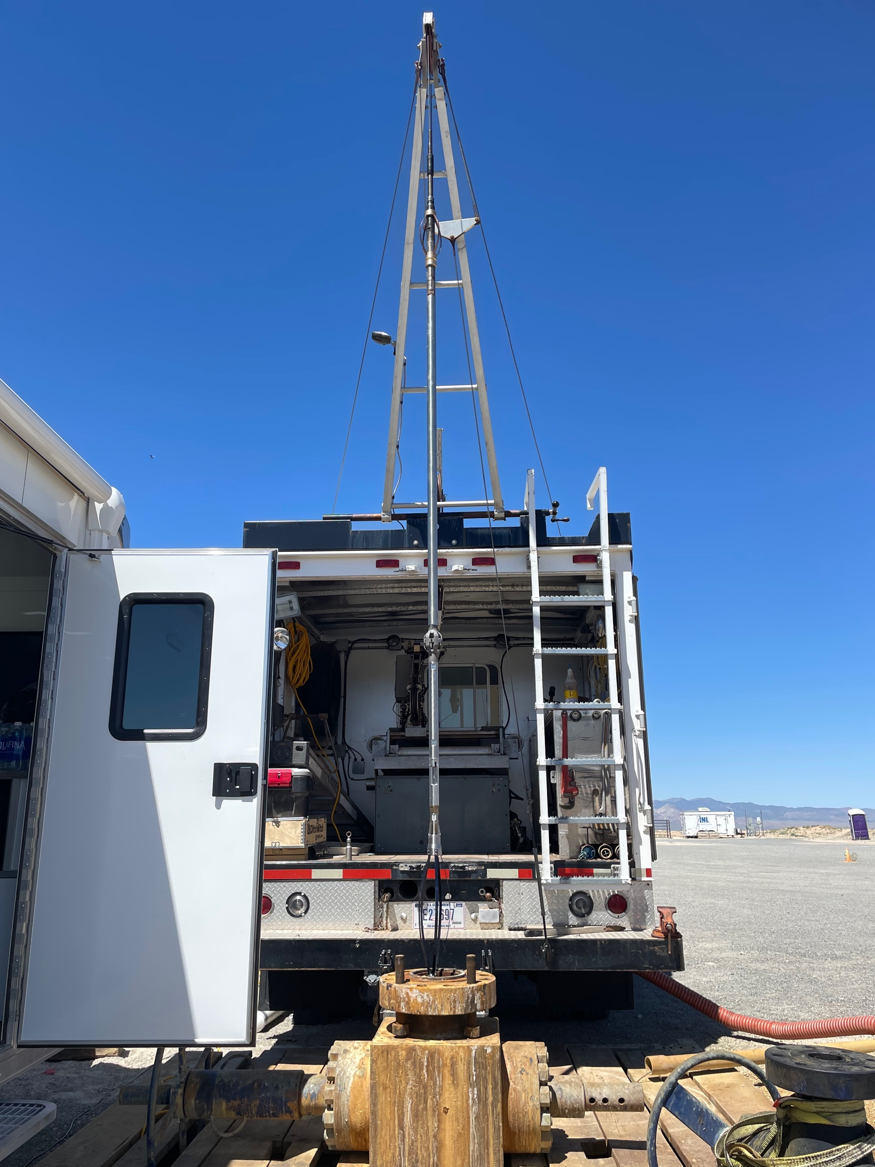
Chemical tool Logging Results
at 58-32
Prepared for GDR upload, 17 April 2025
Notes:
Quarterly report?

Slide 2
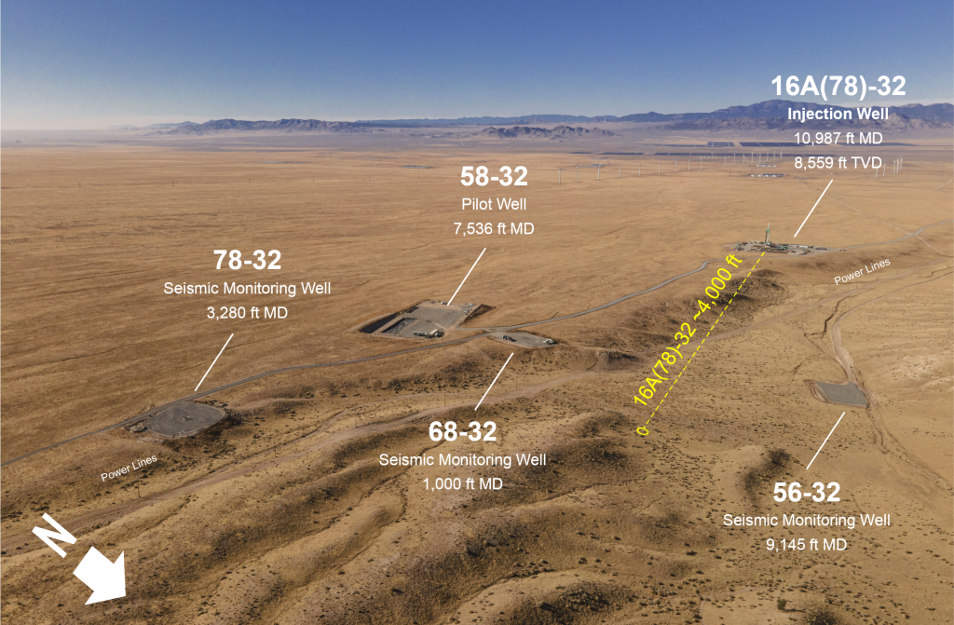
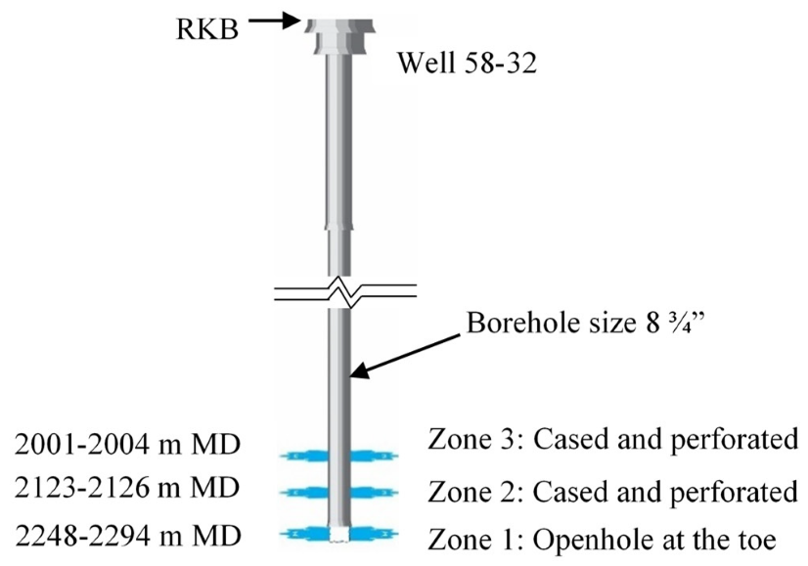
Field deployment at 58-32
Location of Well 58-32 in the Utah FORGE field
Deployment Plan
The well 58-32 deployment at Utah FORGE occurred on June 12-14, 2024, and was intended as a test run to assess the capabilities and limitations of the field-scale tool in preparation for the main deployment, which was at well 16B(78)-32.
Well 58-32 is a vertical pilot well of 7,536 ft depth with two cased and perforated zones (Zones 2 and 3) and an open hole section (Zone 1) with a 7-inch casing.
The logging was to be paused in five test locations above, below, and within the cased and perforated zones to gather stronger indicators of inflow.
Results
The logging was planned to stop short of entering Zone 1, as a component in the open hole section could potentially get stuck.
The first two tools encountered issues due to leaks in connections and a problem with the microcontroller board, thus they were unable to collect any data. The third tool was able to successfully log data in each test location during the trip in and out of the hole.
Schematics of Well 58-32
Deployment Plan of Well 58-32
Zone | Measured Depth (ft) | Planned Tool Depth MD (ft)
Above Zone 3 |  | 6368
3 (Cased and perforated) | 6565 – 6575 | 6568
Between Zone 2 and 3 |  | 6768
2 (Cased and perforated) | 6964 – 6974 | 6968
Between Zone 1 and 2 |  | 7168
1 (Openhole at the toe) | 7348 – 7525

Slide 3
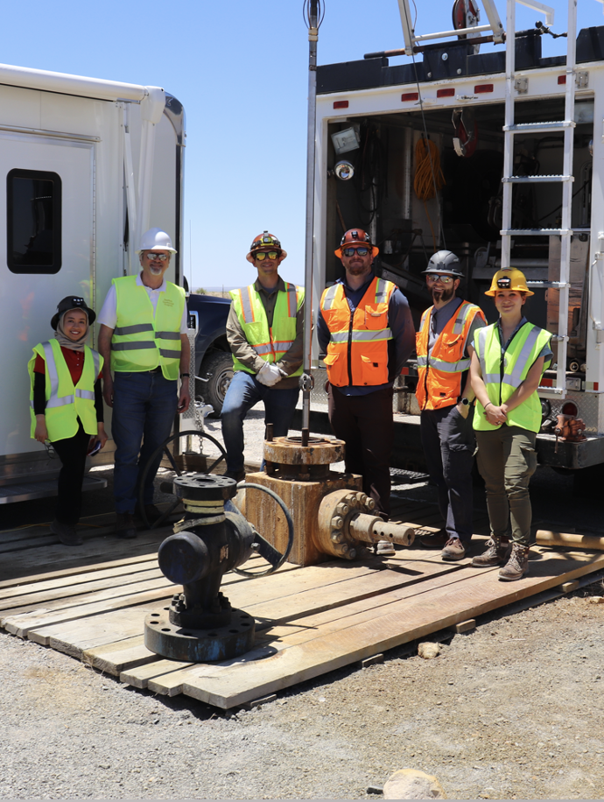
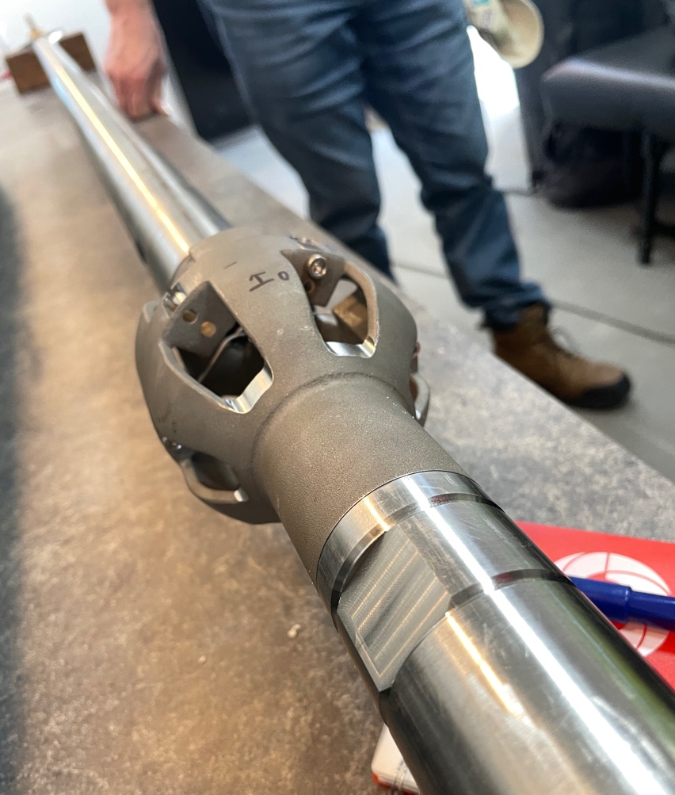
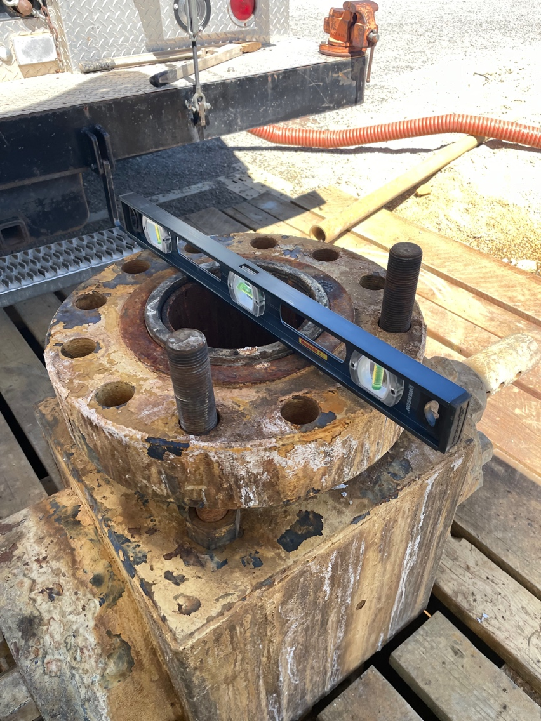
Chloride tool field test at 58-32
Chemical sensor ISEs and Housing as part of the wireline assembly
58-32 wellhead being prepared for deployment
Deployment crew from Sandia and Stanford.
Wireline tool assembly ready to trip in.
Full wireline assembly

Slide 4
Data Processing Steps for 58-32 Logging Results
Raw data
Cleaned and Corrected Data
Data with calculation results
GDR_58-32_POOH_1raw.csv
GDR_58-32_RIH_1raw.csv
GDR_58-32_POOH_2cleaned.csv
GDR_58-32_RIH_2cleaned.csv
Corrections:
Depth conversion
pressure data correction
GDR_58-32_POOH_3calc.csv
GDR_58-32_RIH_3calc.csv
Chloride concentration conversions:
Using Tool 1, Tool 2, and Tool 3 calibration curves, following the KCL line
With data above 10 mol/L clipped (‘_clip’)
Using Tool 1 and Tool 2 calibration curves ‘All’ line (‘_all’)

Slide 5
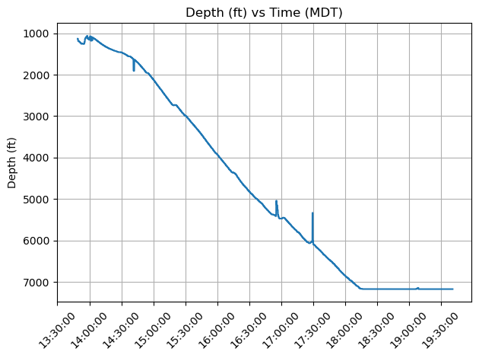
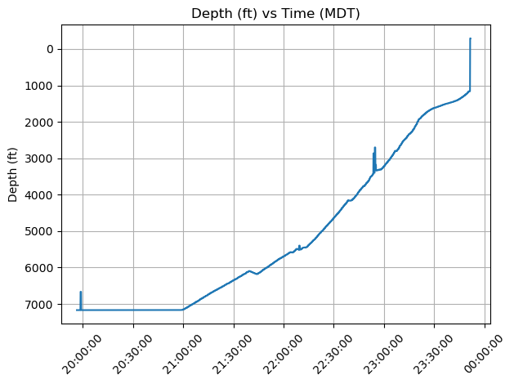
[Corrected Depth] vs Time, RIH and POOH
RIH
POOH

Slide 6
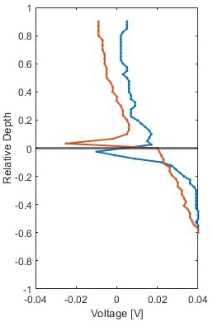
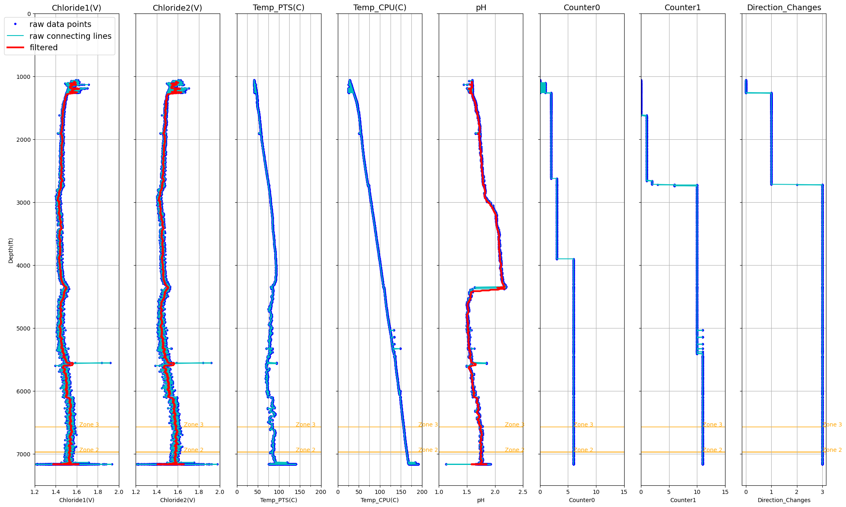
Flow indicators, RIH, full depth
Laboratory Dynamic Measurement
Single Feed Zone
Zone 3
6565 – 6575 ft
Zone 2
6964 – 6974 ft
Zone 1
7348 ft to TD
Logging TD

Slide 7
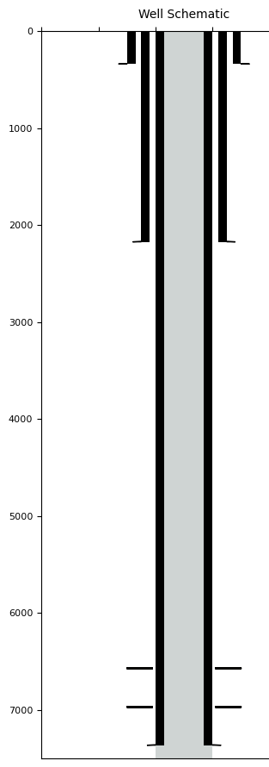
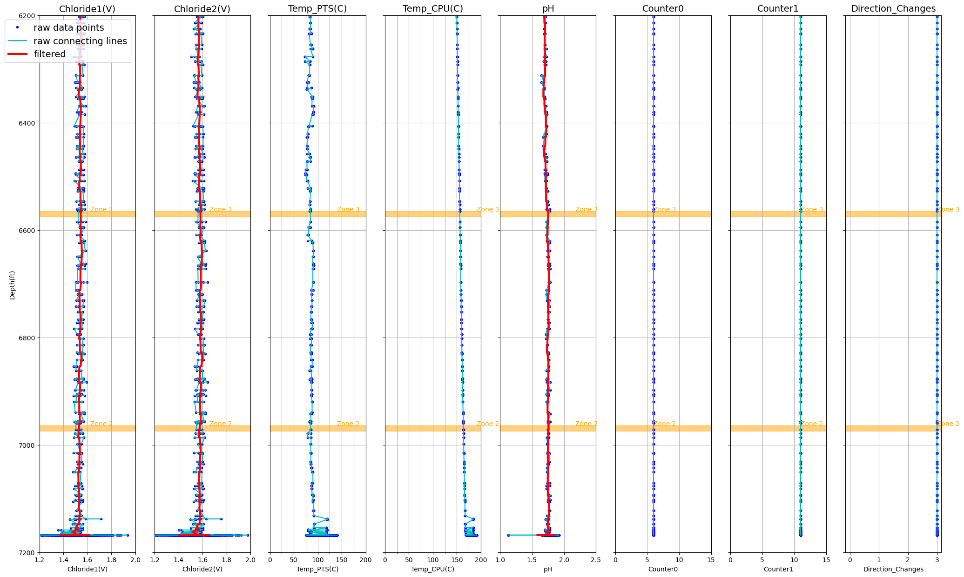
Flow indicators, RIH, zonal depth (6200 - 7200 ft)
Laboratory Dynamic Measurement
Single Feed Zone
Zone 3
6565 – 6575 ft
Zone 2
6964 – 6974 ft
Zone 1
7348 ft to TD
Logging TD

Slide 8
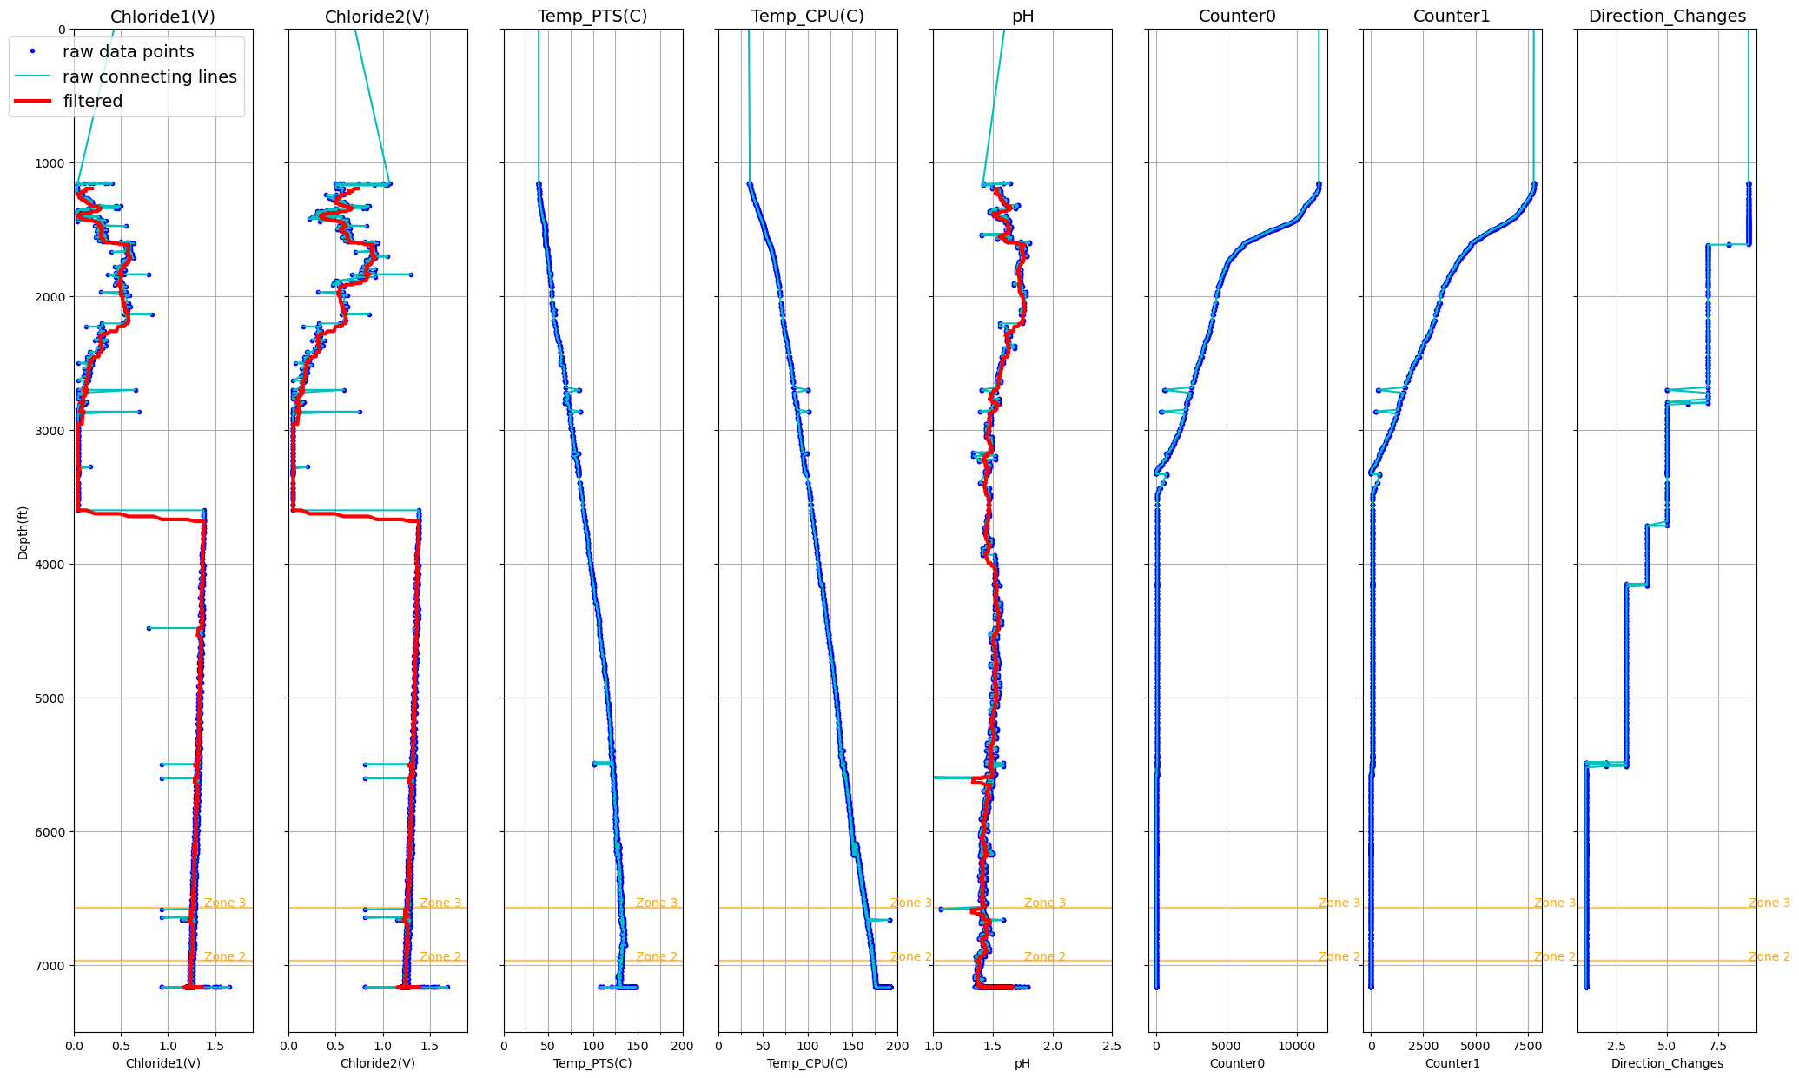
Flow indicators, POOH, full depth
Laboratory Dynamic Measurement
Single Feed Zone
Bad voltage data above this depth
Zone 3
6565 – 6575 ft
Zone 2
6964 – 6974 ft
Zone 1
7348 ft to TD
Logging TD

Slide 9
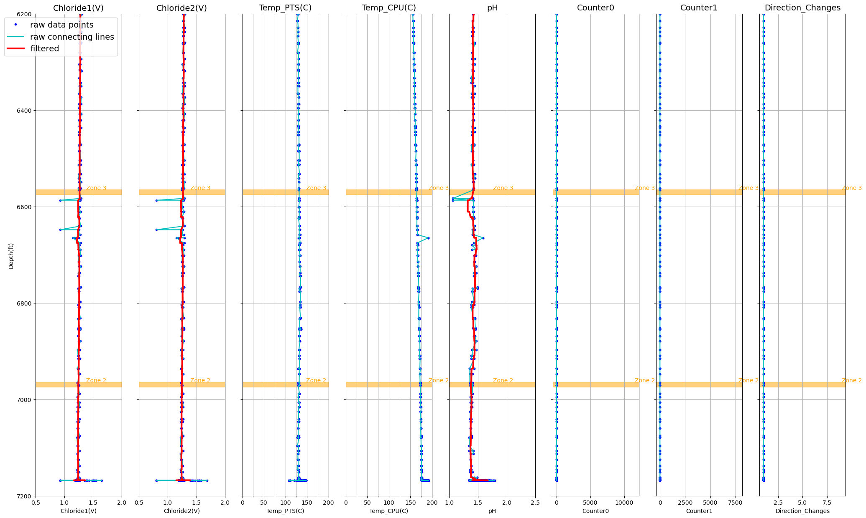
Flow indicators, POOH, zonal depth (6200 - 7200 ft)
Laboratory Dynamic Measurement
Single Feed Zone
Zone 3
6565 – 6575 ft
Zone 2
6964 – 6974 ft
Zone 1
7348 ft to TD
Logging TD

Slide 10
Chloride Concentration, RIH, full depth
Laboratory Dynamic Measurement
Single Feed Zone
Zone 3
6565 – 6575 ft
Zone 2
6964 – 6974 ft
Zone 1
7348 ft to TD
Logging TD

Slide 11
Flow indicators, RIH, zonal depth (6200 - 7200 ft)
Laboratory Dynamic Measurement
Single Feed Zone
Zone 3
6565 – 6575 ft
Zone 2
6964 – 6974 ft
Zone 1
7348 ft to TD
Logging TD

Slide 12
Field Tool Calibration Curves
Tool 3 was assembled in the field using available working components from Tools 1 and 2, and thus, it does not have a calibration curve prior to deployment. Post-deployment calibration on Tool 3 is inconclusive because the sensors have degraded since then.
To convert voltage into chloride concentration, we use calibration curves from different tools.
We also compare calibrations following the KCl curve (grey) vs All data curve (blue) for Tools 1 and 2
In the clipped version, data above 10 mol/L is truncated.

Slide 13
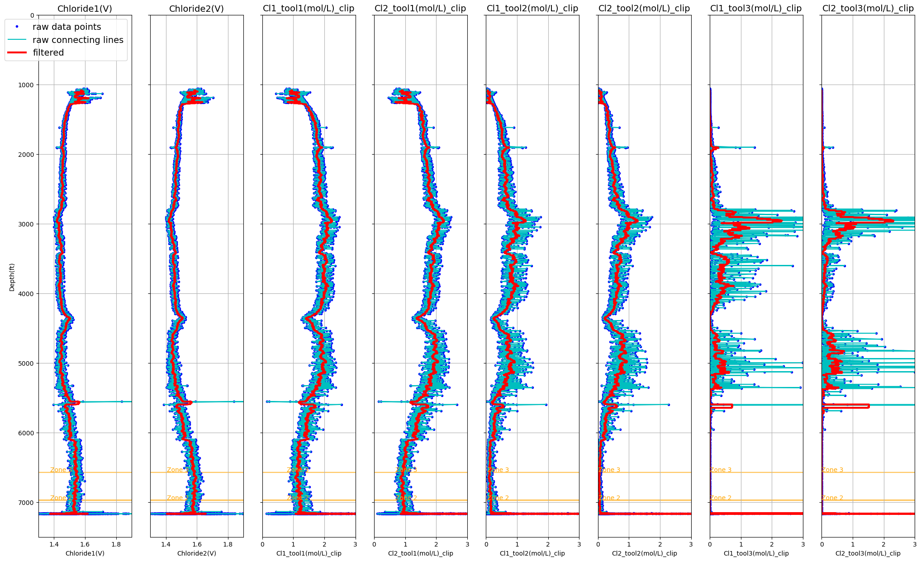
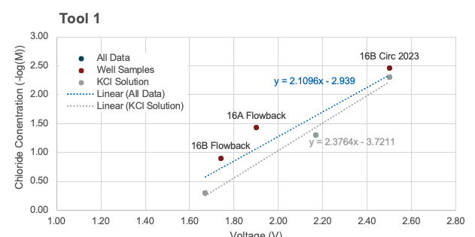
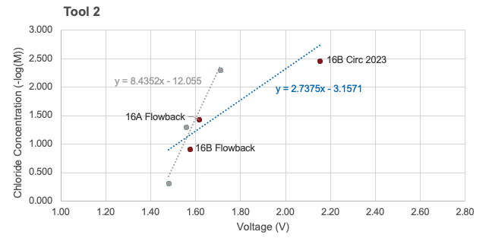
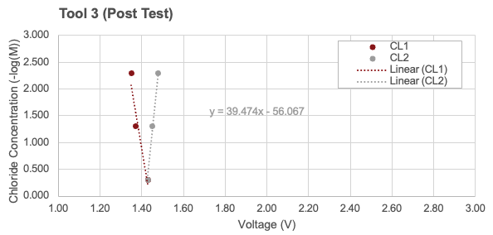
Chloride Concentration with KCl Calibration Line, RIH
Tool1, KCl line
Tool2, KCl line
Tool3, KCl line

Slide 14
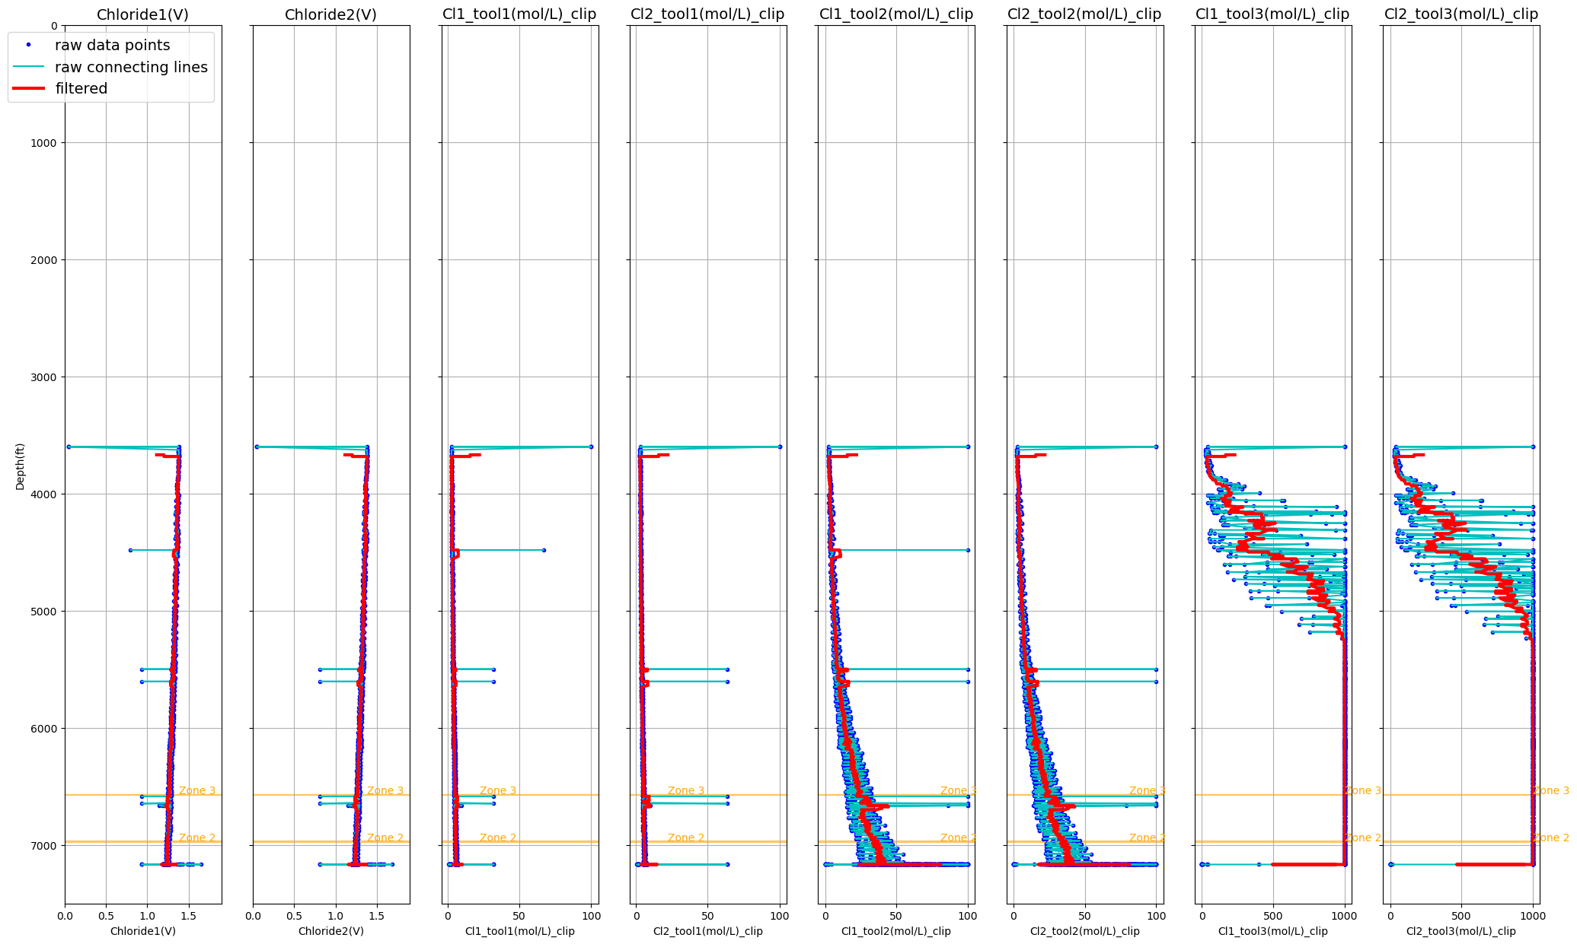
Chloride Concentration with KCl Calibration Line, POOH
Tool1, KCl line
Tool2, KCl line
Tool3, KCl line

Slide 15
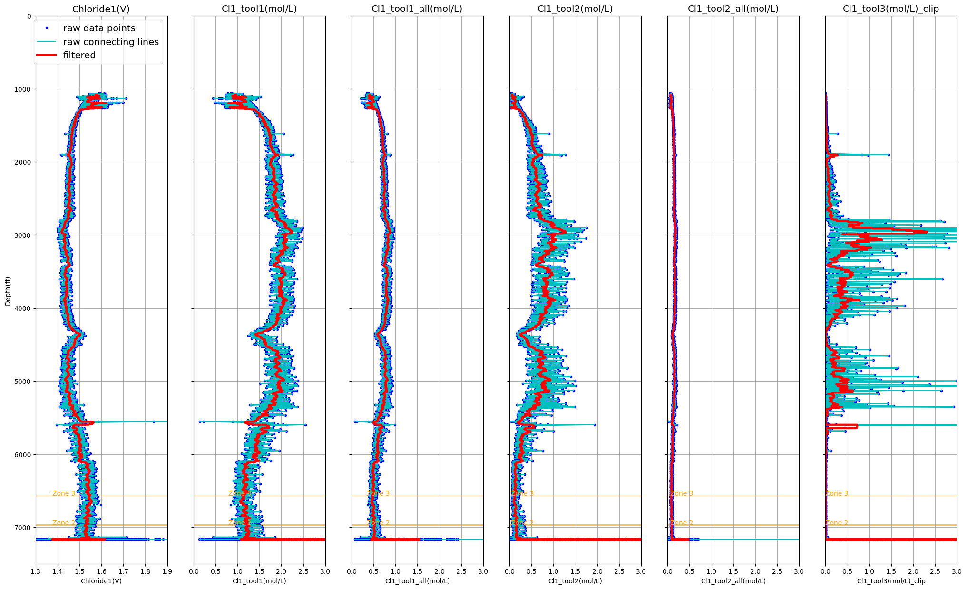
Chloride Concentration with All Calibration Line, RIH

Slide 16
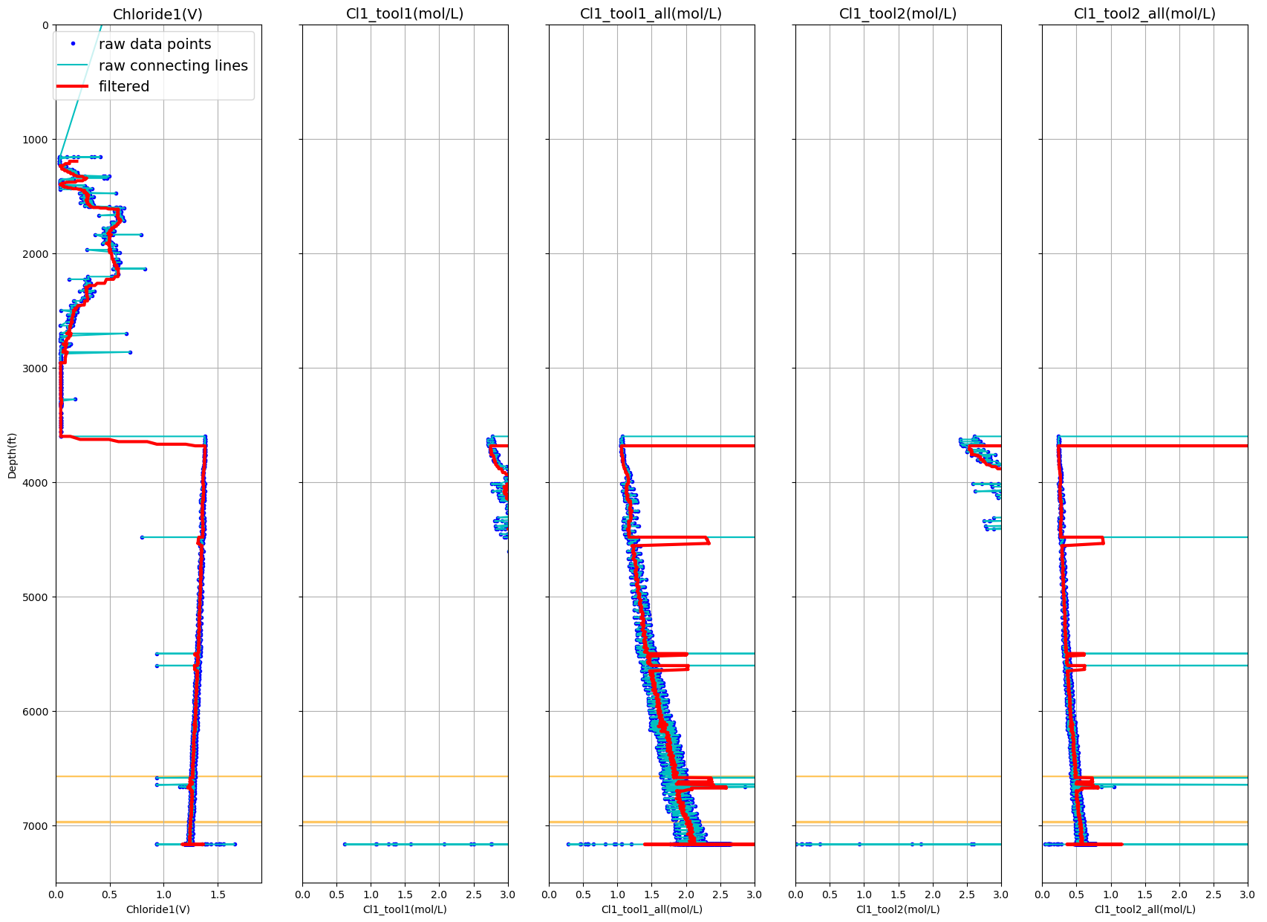
Chloride Concentration with All Calibration Line from Tool 1 and 2, POOH

