Slide 1
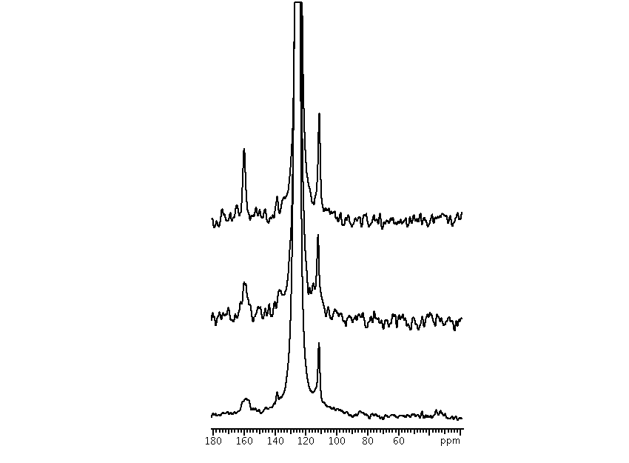
A
B
C
Notes:
Lb=40 gf=0.01, 15000 A- 99C, 1500 psi; B-127C, 1750 psi; C-154C, 2000psi;
Fig. 11 shows a ¹³C SP-MAS spectrum of 5% Hydraulic Fracking Fluid candidate (v/v) exposed to 10% ¹³C labeled scCO₂ at a temperature of 99 °C and a pressure of 103 bar (A), at 127 °C and 121 bar (B) and at 154 °C and 138 bar (C) using a sample spinning rate of 1.0 kHz. These spectra were acquired with ¹H high power decoupling using a total of 120, 120 and 1000 scans respectively with a recycle delay time of 5 s. The C chemical shifts were referenced using an external reference, adamatane (37.85 ppm).
Not sure of final figure number. Black and white figure could be substituted from PPT slide.

Slide 2
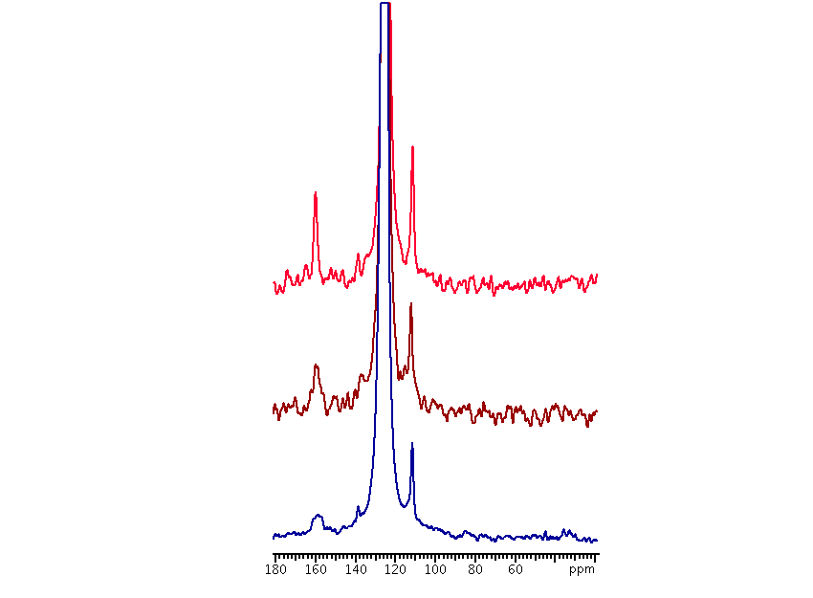
A
B
C
Notes:
Lb=40 gf=0.01, 15000 A- 99C, 1500 psi; B-127C, 1750 psi; C-154C, 2000psi;
Fig. 11 shows a ¹³C SP-MAS spectrum of 5% Hydraulic Fracking Fluid candidate (v/v) exposed to 10% ¹³C labeled scCO₂ at a temperature of 99 °C and a pressure of 103 bar (A), at 127 °C and 121 bar (B) and at 154 °C and 138 bar (C) using a sample spinning rate of 1.0 kHz. These spectra were acquired with ¹H high power decoupling using a total of 120, 120 and 1000 scans respectively with a recycle delay time of 5 s. The C chemical shifts were referenced using an external reference, adamatane (37.85 ppm).
Not sure of final figure number. Black and white figure could be substituted from PPT slide.

