Slide 1
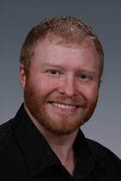
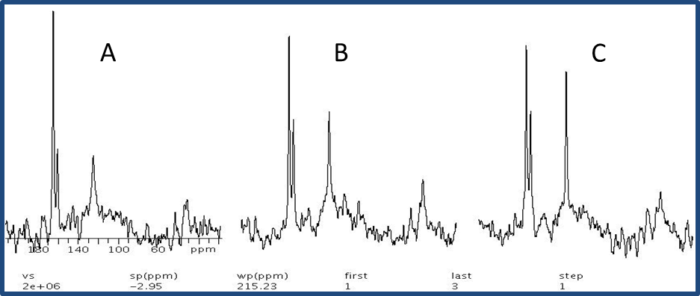
Accomplishments, Results and Progress
Task 2: Reactive-Polymer Fracturing
Real-time monitoring of fluid chemistry
Unique High-Pressure Rotor capability for
Magic Angle Spinning ¹³C NMR (MAS-NMR) developed by Dr. David Hoyt at EMSL
Unparalleled real-time analysis of kinetics and speciation of H₂O/CO₂ fluid with polymer under geothermal conditions
Dr. D.
Heldebrant
Dr. D.
Hoyt
In situ time-resolved ¹³C NMR spectra of 1% aqueous polymer.
Temperature 100 ºC
Pressure = 120 bar H₂O/CO₂
Initial
5 h
10 h
Notes:
Polymer chemistry is proprietary information

Slide 2
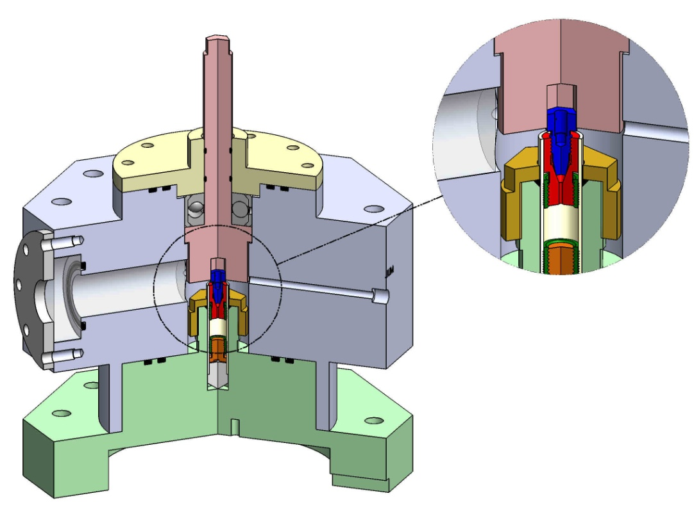
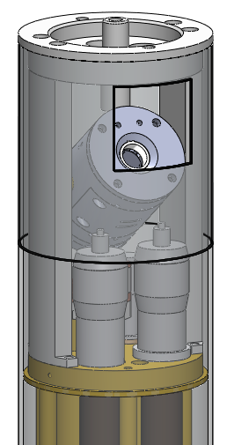
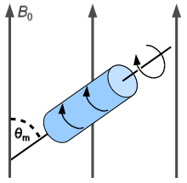
Accomplishments, Results and Progress
Task 2: Reactive-Polymer Fracturing
Current cell performance limited to 120 bar and 150 ˚C
Current data is higher than any other in situ measurement capability
but still short of geothermal conditions
Projected cell performance requirements are 300 bar, 300 ˚C
Dr. D. Hoyt
High pressure sample loading/ reaction chamber
Sample MAS NMR probe

