Slide 1
2014 Results from Newberry Volcano EGS Demonstration
Trenton T. Cladouhos, Susan Petty, Michael W. Swyer, Matthew E. Uddenberg, and Yini Nordin
Stanford Geothermal Workshop
January 27, 2015

Slide 2
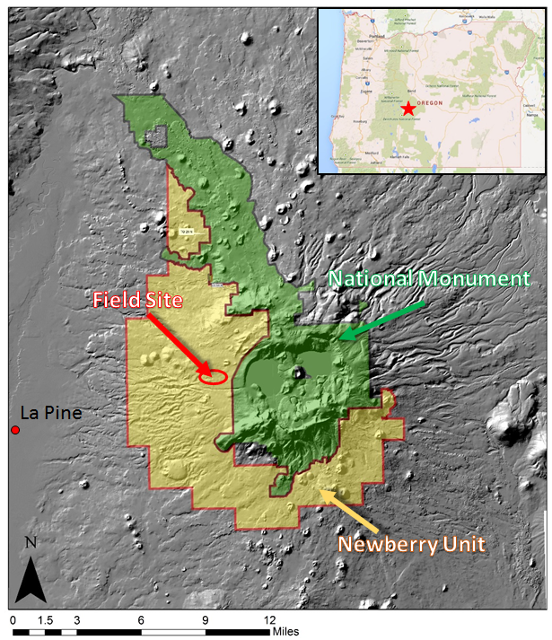
Newberry Volcano EGS Demonstration
Geothermal well drilled in 2008
55-29
10,060 feet, 3067 m deep
620⁰F, 330⁰C
No hydrothermal system
DOE ARRA grant awarded in 2009
Three phases
50% cost share
DOE funding ends Sept 2015
Notes:
20 km away ~7 km across Caldera, 4000 ft of relief, Paulina Peak just under 8000 ft, Pre-caldera peak may have been 10,000 ft

Slide 3
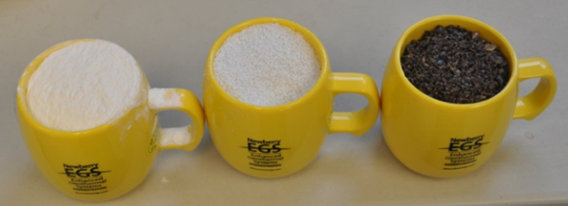
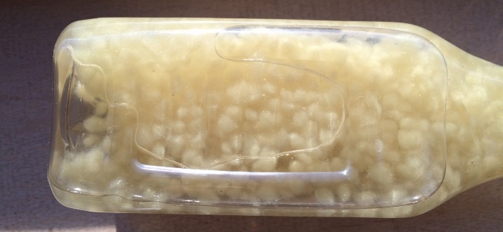
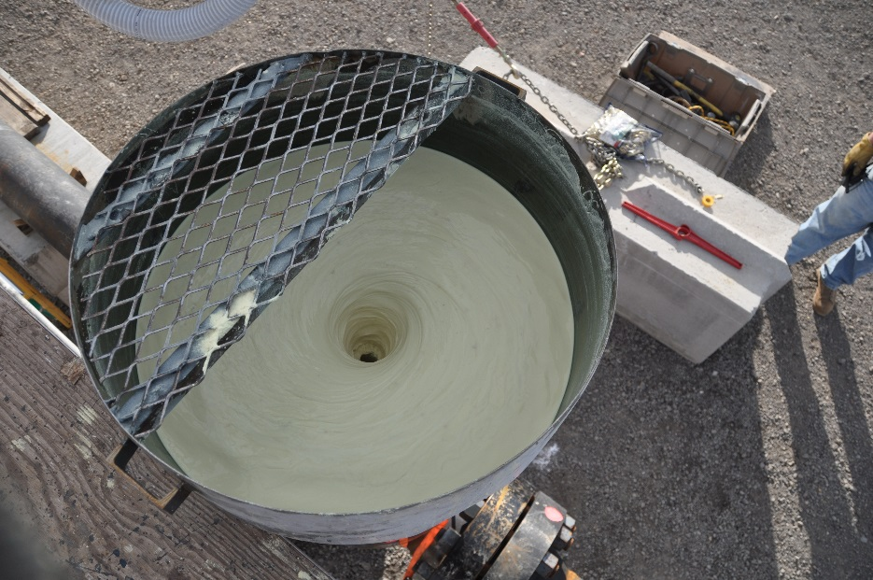
AltaRock TZIM Technology
Challenge: Low flow per EGS well Need >75 l/s, >1200 gpm
Solution: Multiple zone stimulation through thermally-degradable zonal isolation materials (TZIM)
Non-mechanical zonal isolation
No rig required during treatment
Non-hazardous breakdown products
A suite of materials developed that degrade with time and temperature
Lab tested from 74°C-315 ° C
Notes:
I added the diverter degradation results from Daniel’s Stanford paper. The key here is to show that we have a variety of materials that will degrade at different temperatures. Every stimulation we design will be unique and targeted to fit the characteristic of the reservoir.

Slide 4
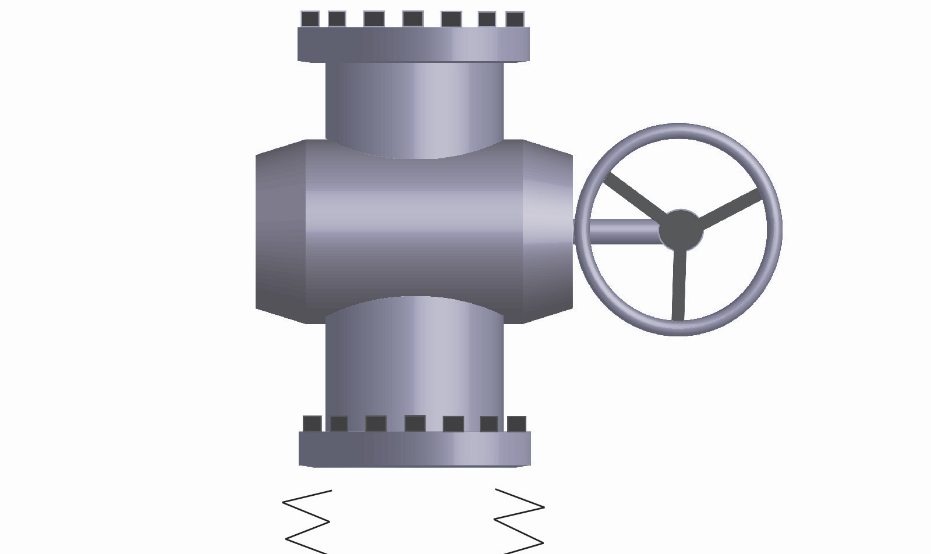
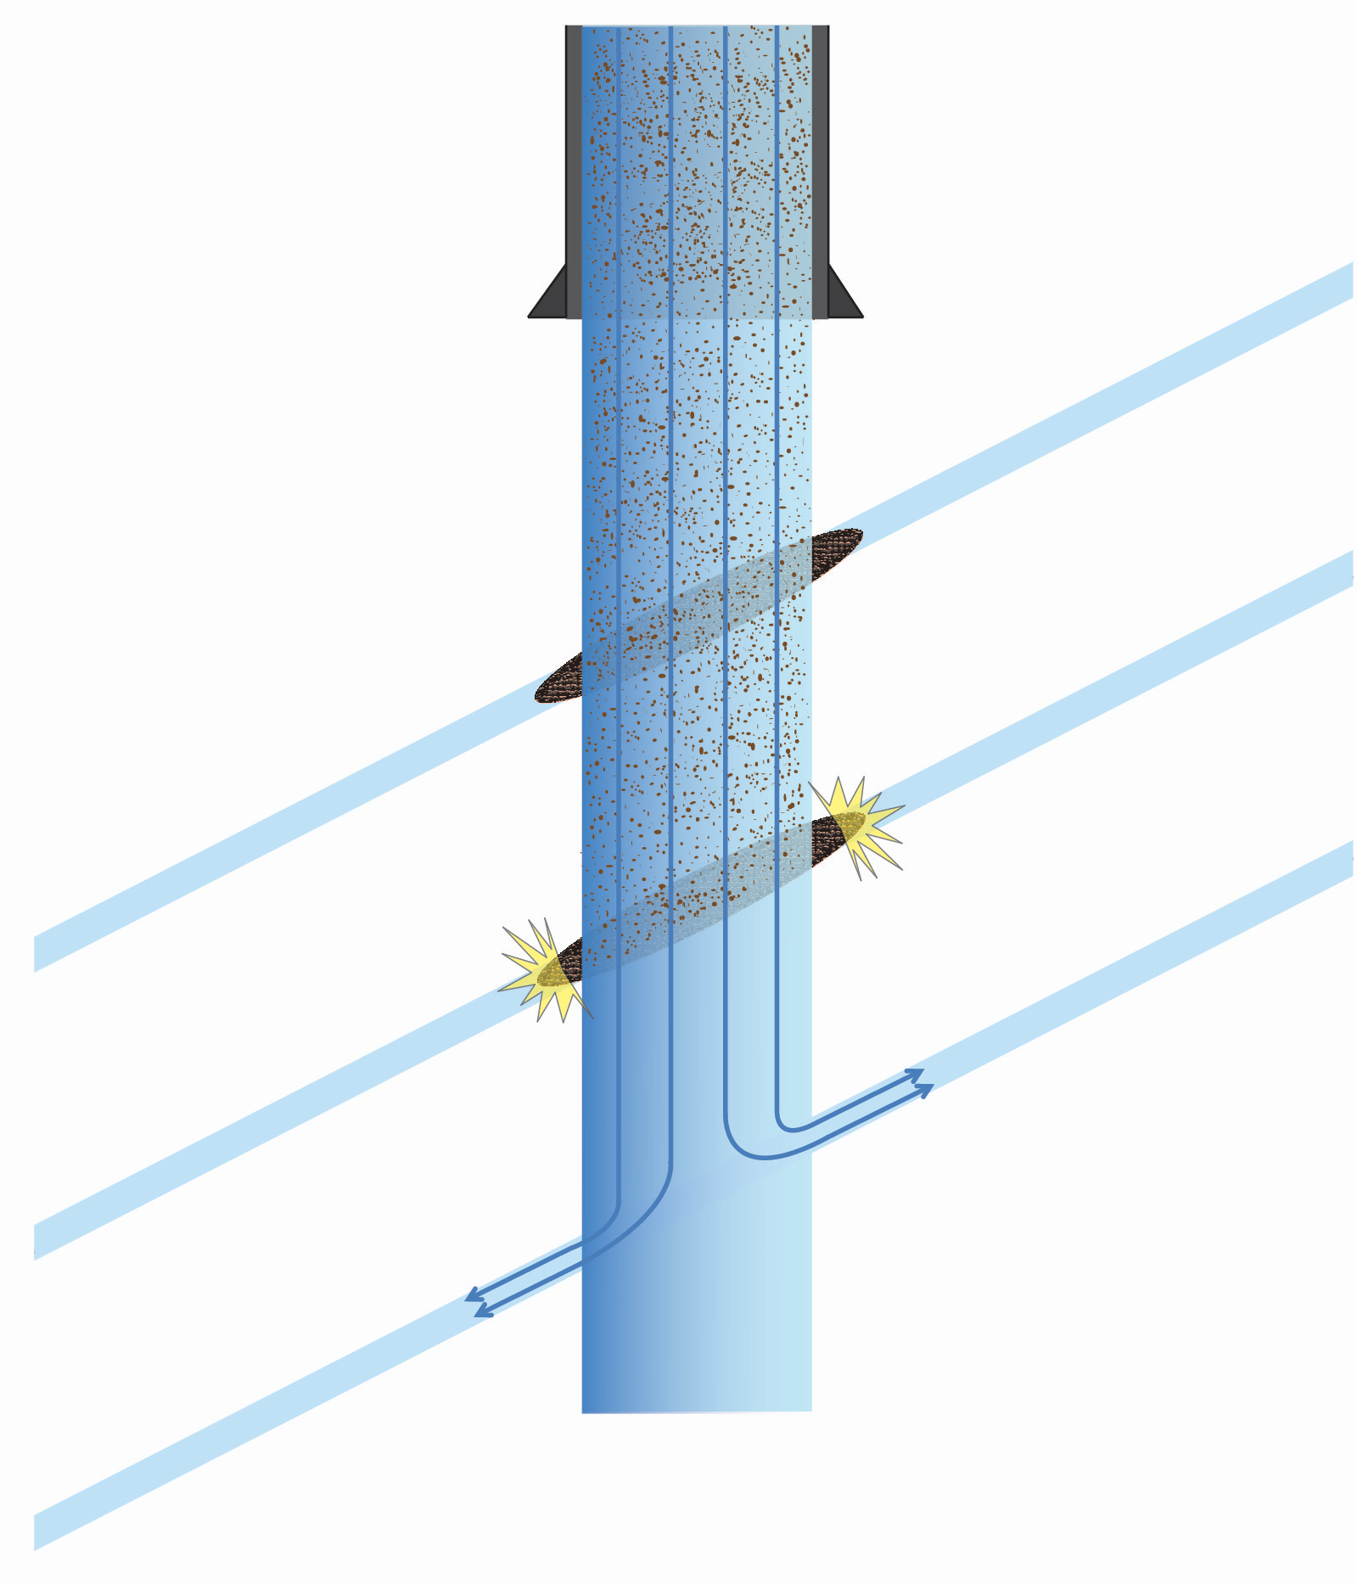
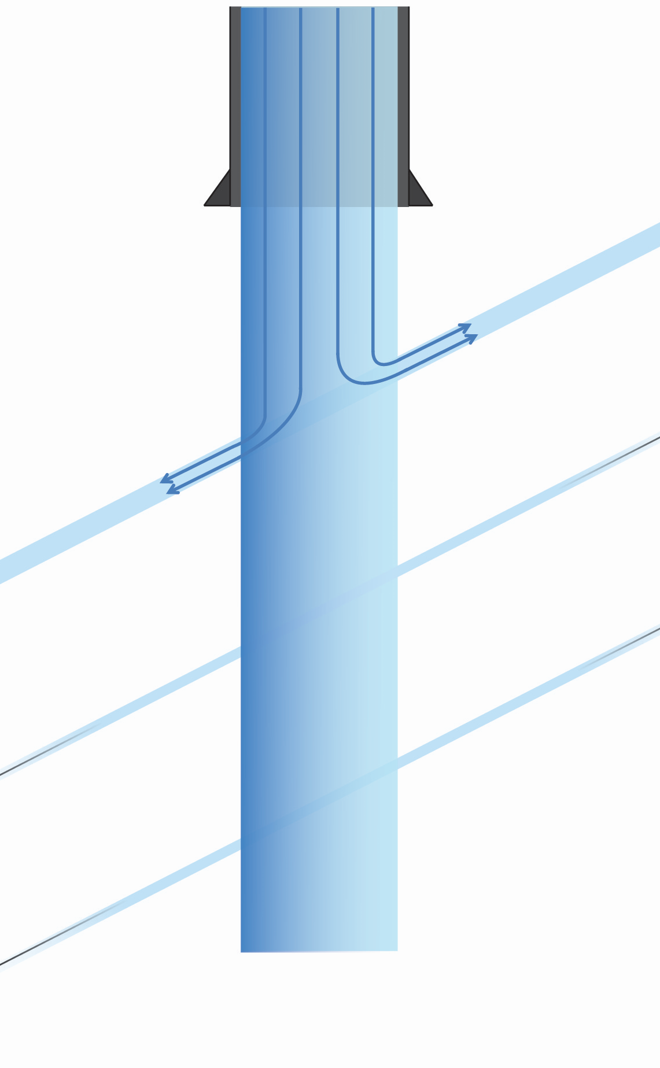
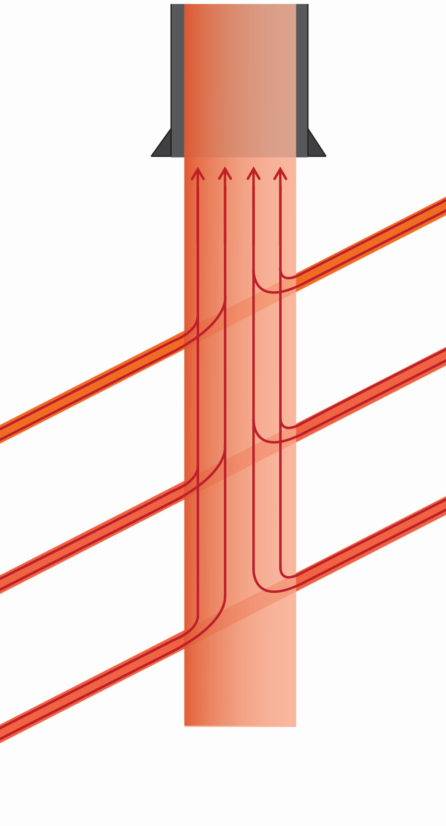
Multizone Stimulation and TZIMs
Stage 1
Stage 2&3
Heat-up and flow back
Cold Water
Cold Water & TZIM
Hot Water

Slide 5
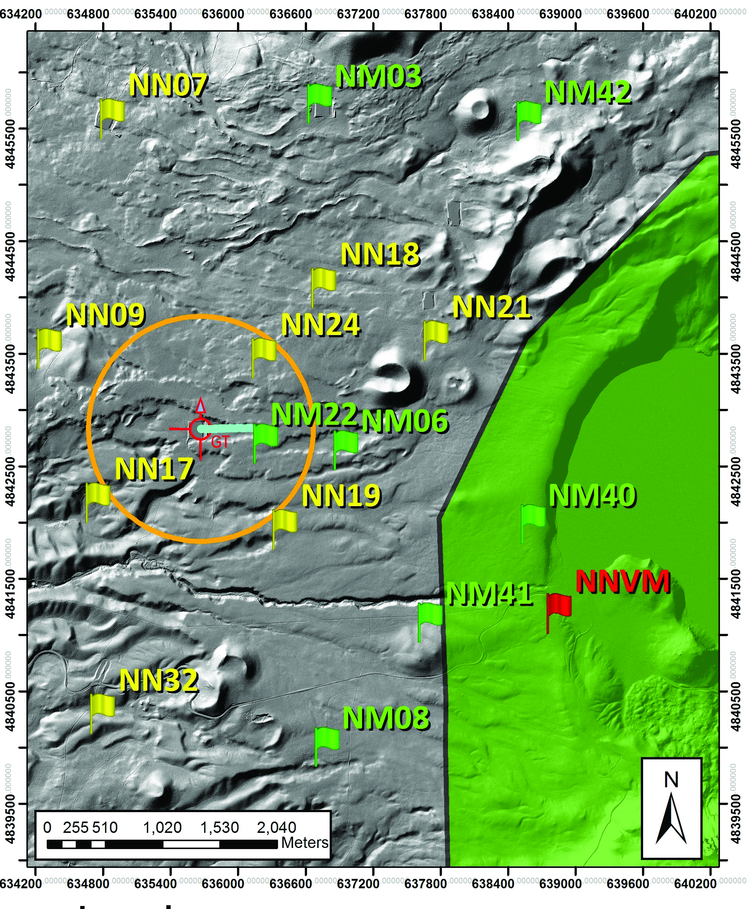
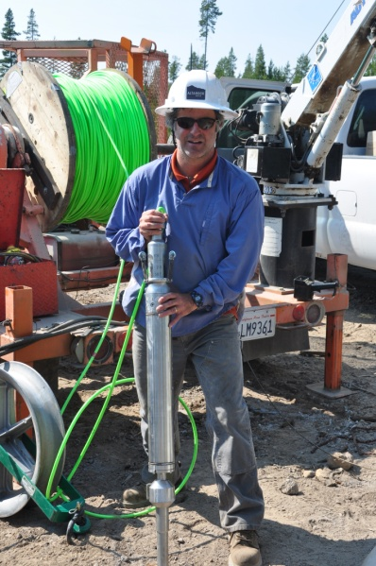
Mapping Newberry EGS with Microseismic Array
15-station seismic array (installed 2012)
8 borehole (250 m deep) geophones
7 surface geophones
Real-time telemetry
Strong motion sensor in nearest building (ISMP)
1 km
2 Hz, 3 component
geophones

Slide 6
Rig Operations 2014
2012 stimulation problems
Leaks in 13 3/8” casing at 1800ft (PAS) and 2250ft
Blockage in open hole at 6888ft
2014 Repairs
Installed 9 5/8” tieback
Installed perforated liner
9 5/8” tie-back
New Liner

Slide 7
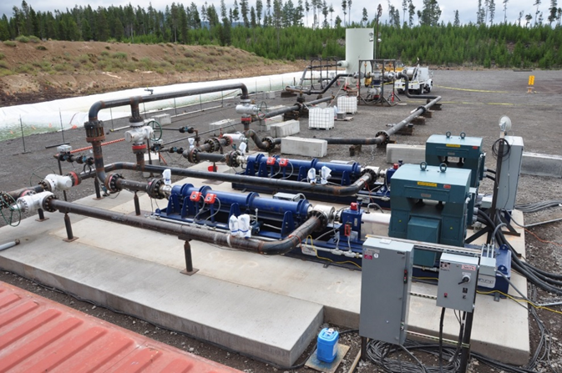
Electric Centrifugal Stimulation Pumps

Slide 8
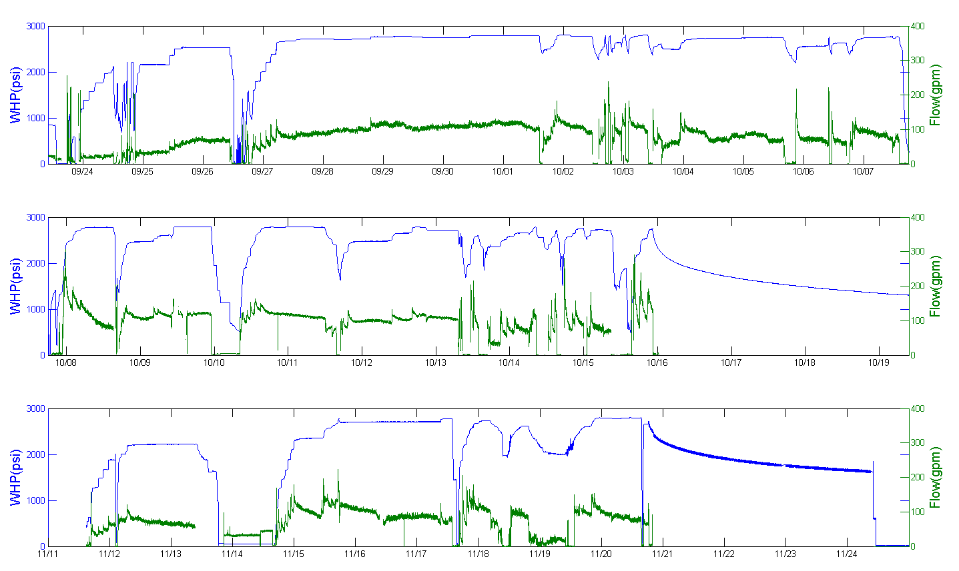
Wellhead pressure and flow rate during stimulation
Round 1 (Sept 23- Oct 15)
srt
Max WHP stim
srt
srt
14 days
f&I PTS
srt
TZIM
heat up /fall-off
flow back
8 stim days
Round 2 (Nov 11-20)
Max WHP
stim
srt
TZIM &
tracer
inj PTS
srt
heat up / fall-off
flow back
8 stim days
srt = step-rate test

Slide 9
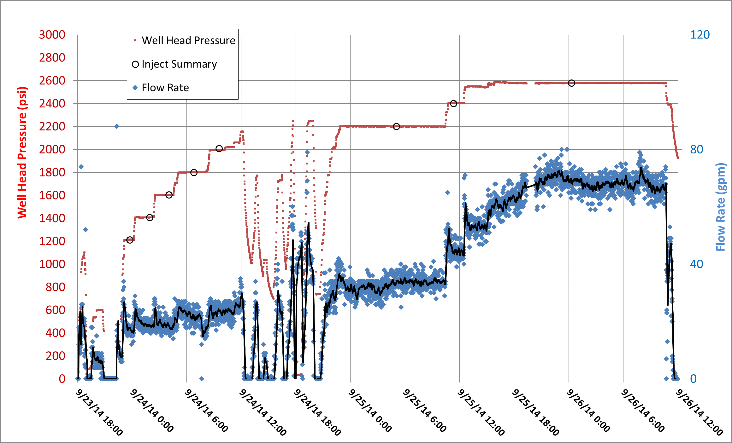
Stimulation Start
Stimulation initiated
(aseismic)

Slide 10
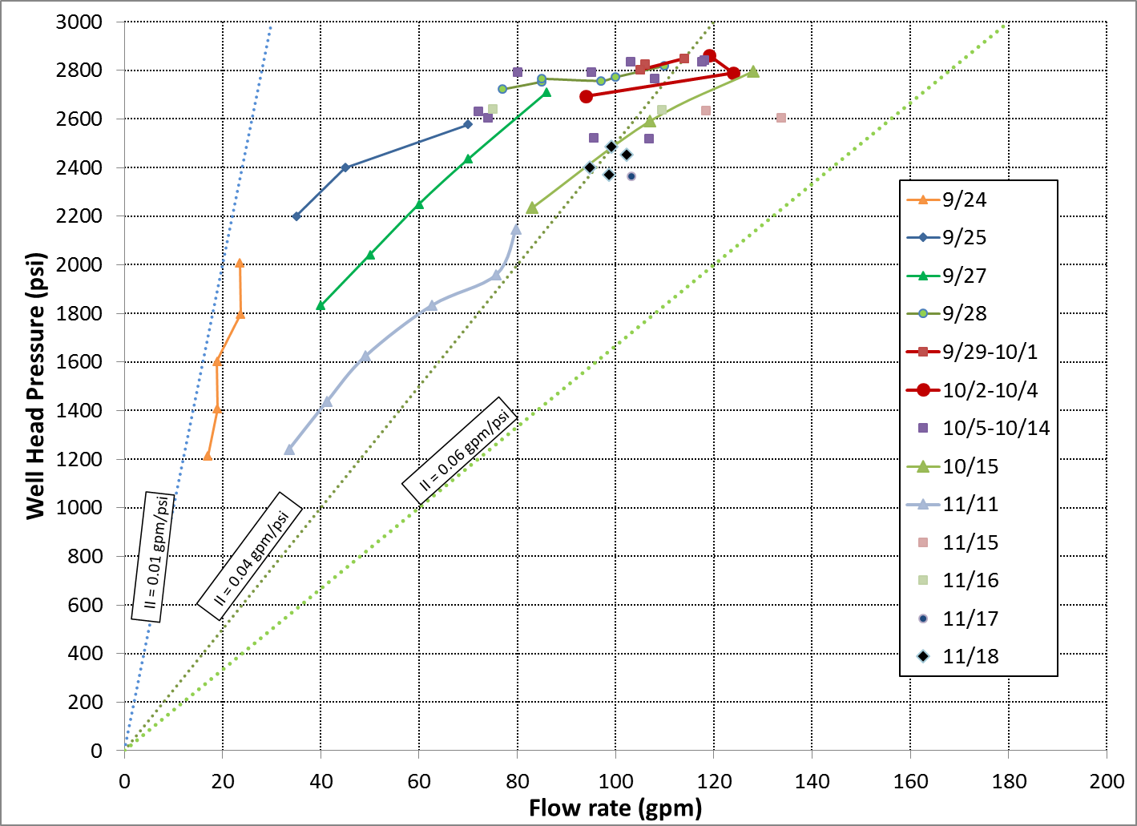
Injectivity Index
Max WHP
initial
final

Slide 11
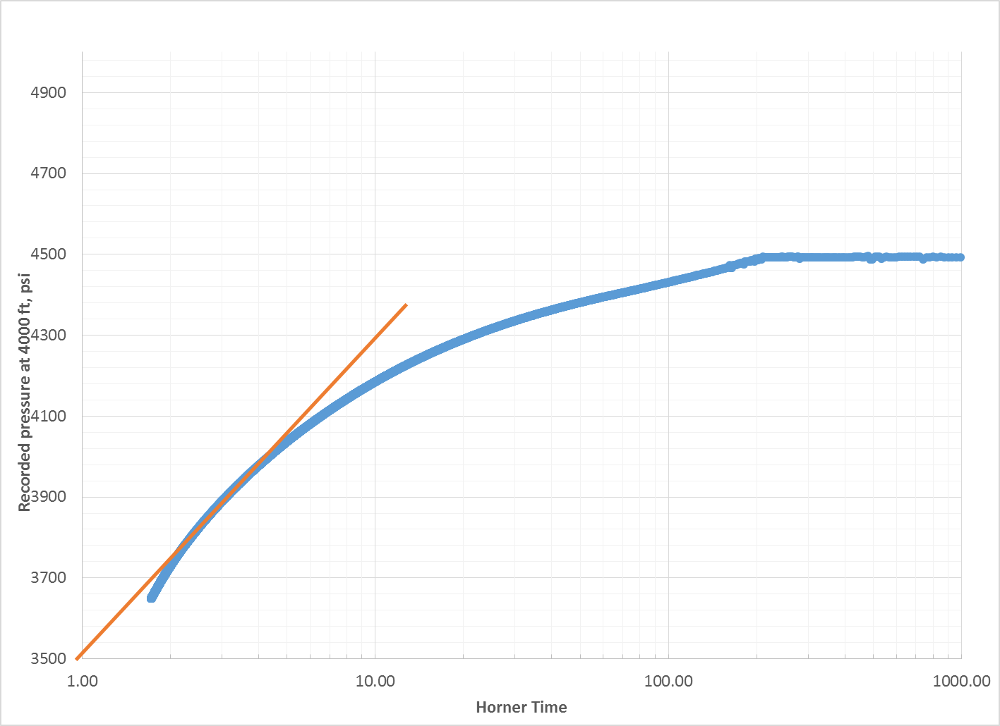
Pressure Fall-off Test
Injection shut-off on 10/15/14.
Pressure fall off monitored down hole for 12 hours.
Data analyzed with Horner plot.
Transmissivity calculated to be (957 md-ft).
*Assuming 200m reservoir height as presented in Cladouhos et al. 2011
Pre-stim permeability (modeled) | 0.01 md 10⁻¹⁷ m²
Fall-off analysis permeability* | 1.46 md (10⁻¹⁵ m²)
Skin factor | -6.19

Slide 12
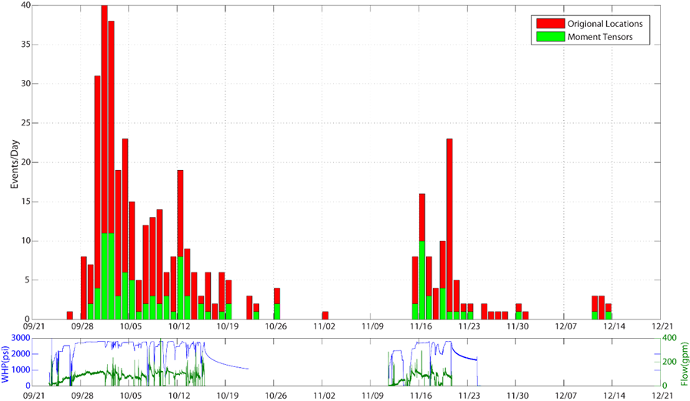
Seismicity Rate

Slide 13
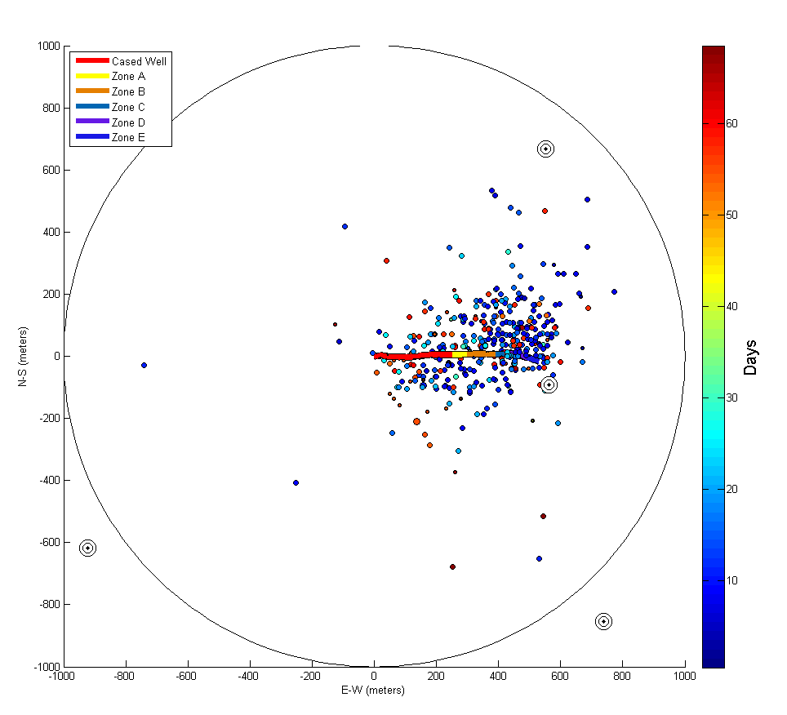
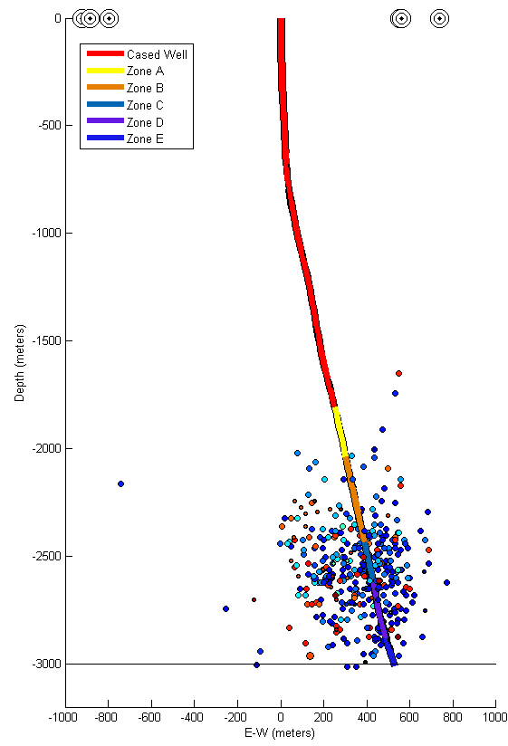
400 Micro-Seismic Event Locations (hand-picked)
1 km
Map View North View

Slide 14
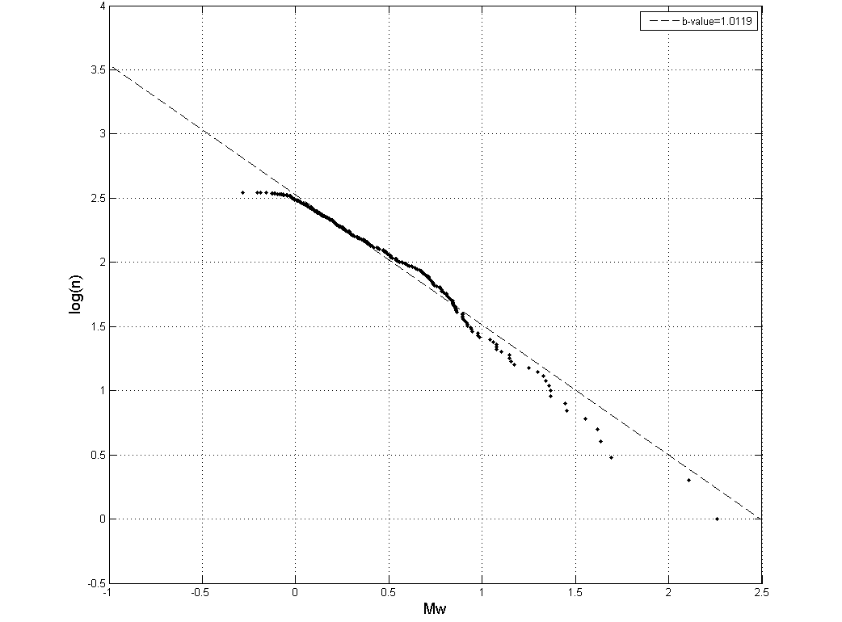
Micro-Seismic event size distribution
b-value 1.01
Log (N)
Mw 0.0
Mw 2.3

Slide 15
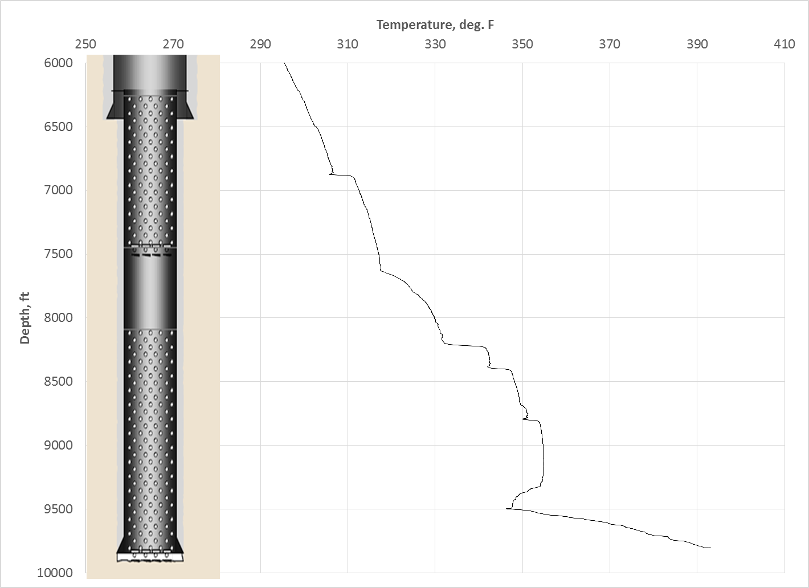
Flowing Temperature Survey, October 15
Logged on 10/15 with outflow rate of ~100 gpm (6.3 l/s)
6878-6929
7477
8200-8240
8145
8393-8415
8791-8835
9320-9500

Slide 16
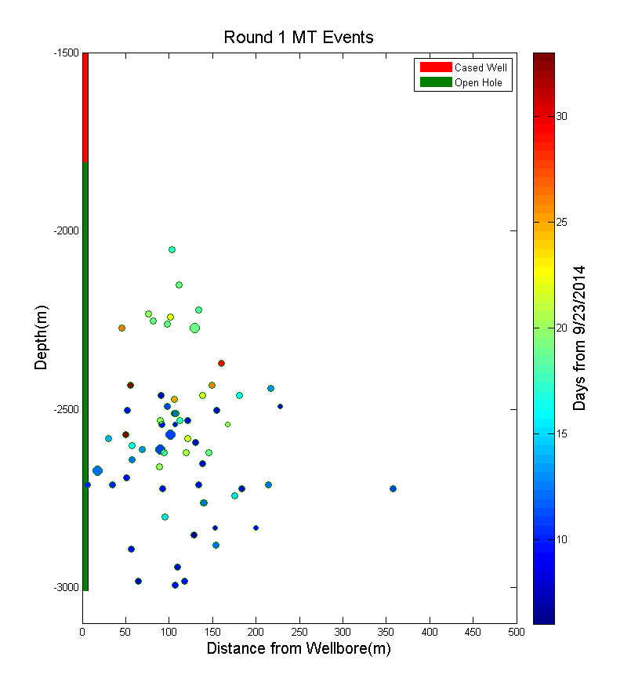
Progression of seismicity from well
MD potential exit depths
6863’
8390’
8800’
error bars
9624’
9950’

Slide 17
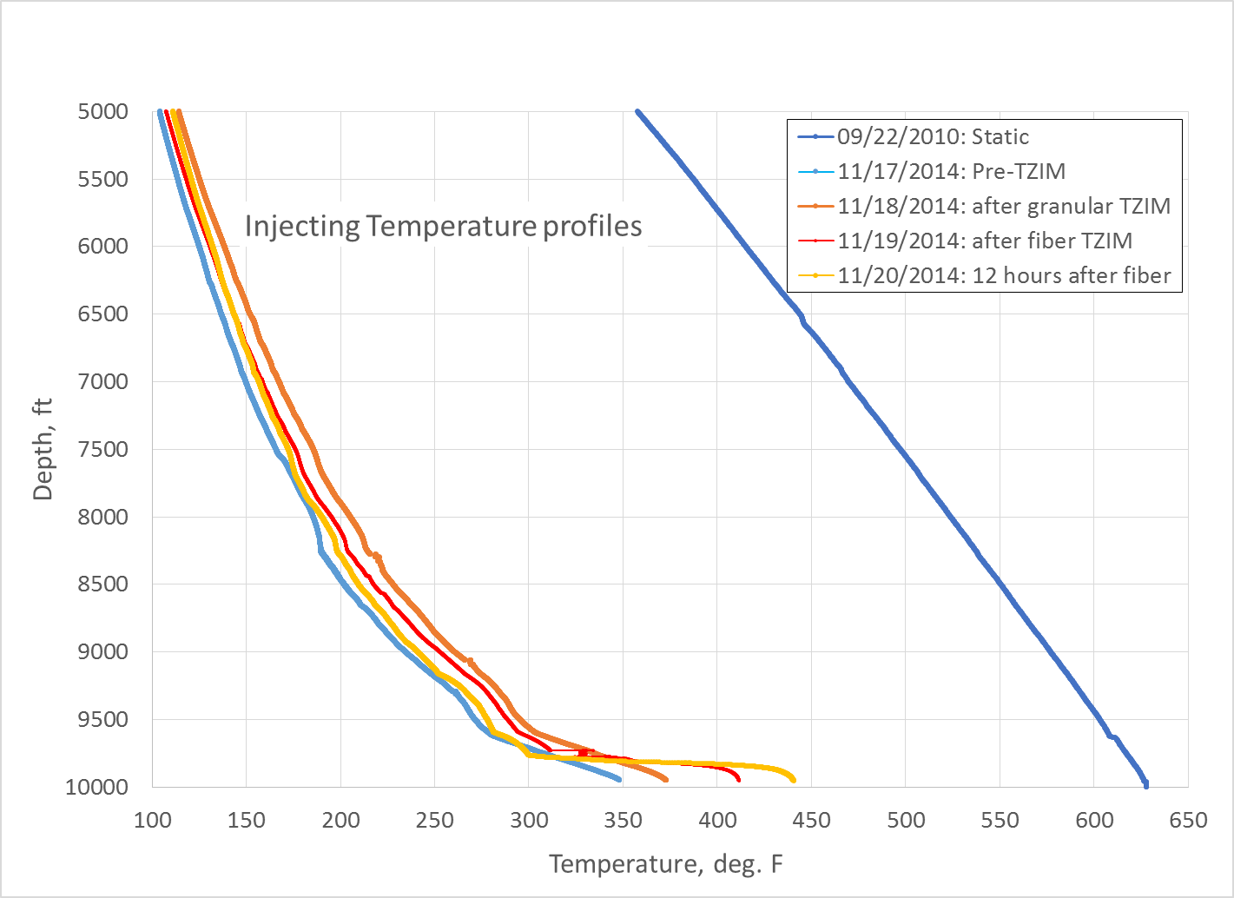
PTS Logging to document TZIM effect

Slide 18
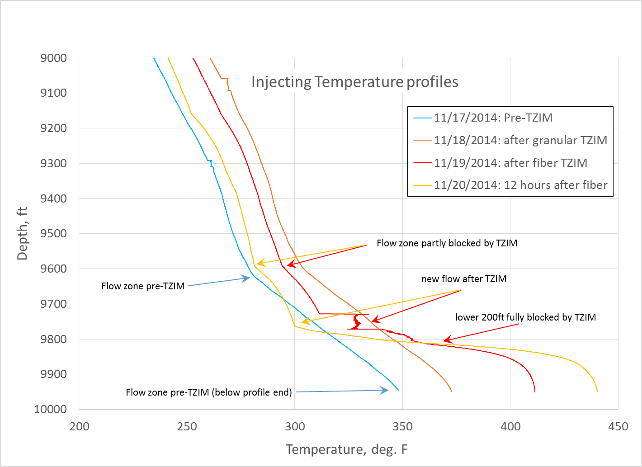
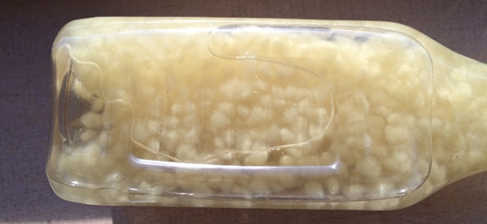
Evidence for TZIM Blocking

Slide 19
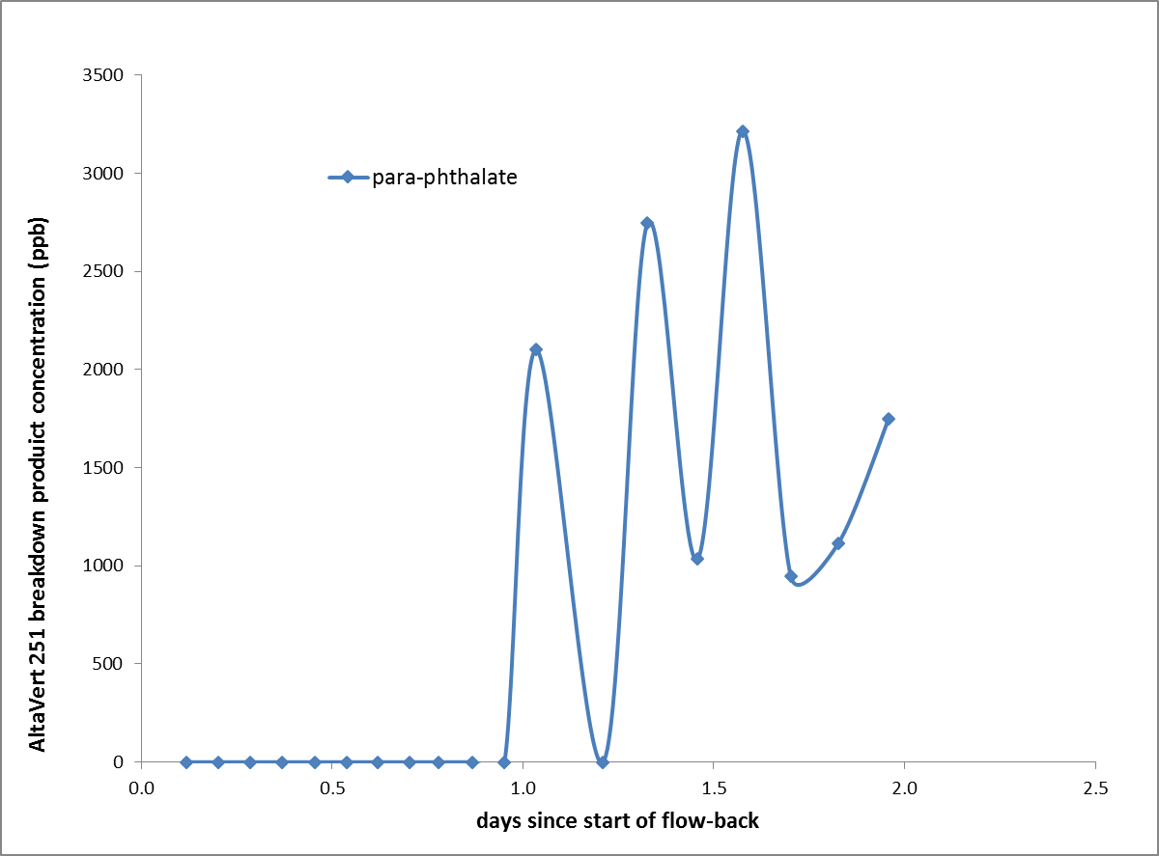
Nov. 24-25 flowback: TZIM degradation product
AltaVert 251 degrades
at >200 C / 400 F
Fully in less than a week
Partial degradation
Results from Peter Rose, EGI

Slide 20
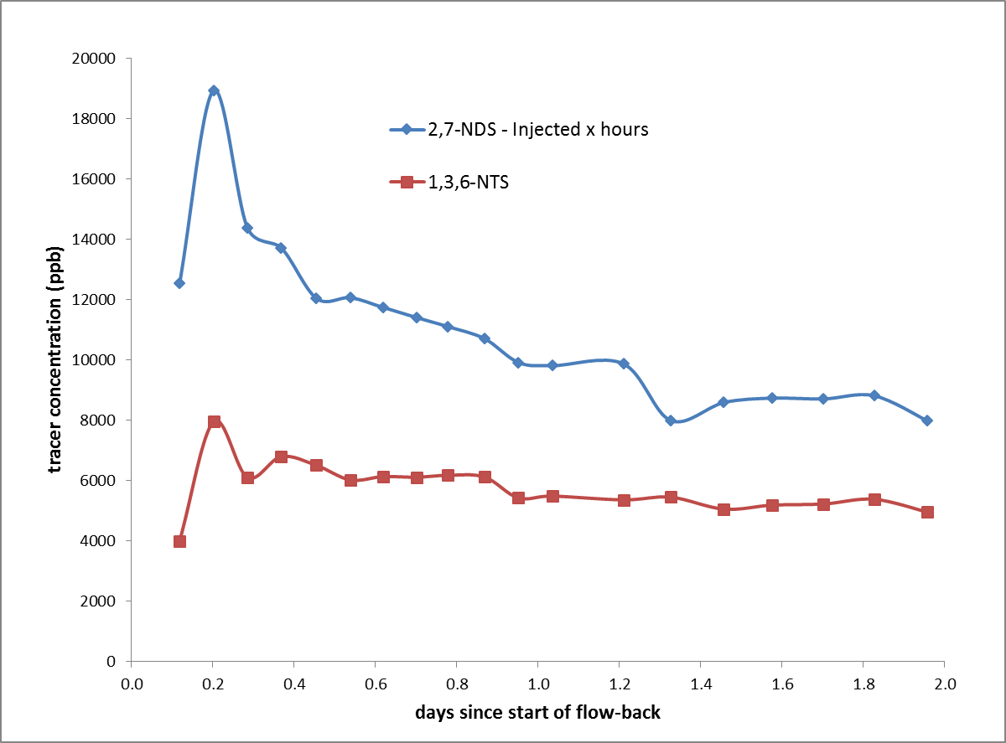
Nov. 24-25 flowback: Tracer Returns
2,7 NDS
Injected prior to fiber TZIM
153,000 gallons injected after
18.1% mass recovered
Tracer return model pending
1,3,6 NTS
Injected prior to granular TZIM
206,000 gallons inject after
9.1% mass recovered
116,000
gallons
flowed
Results from Peter Rose, EGI

Slide 21
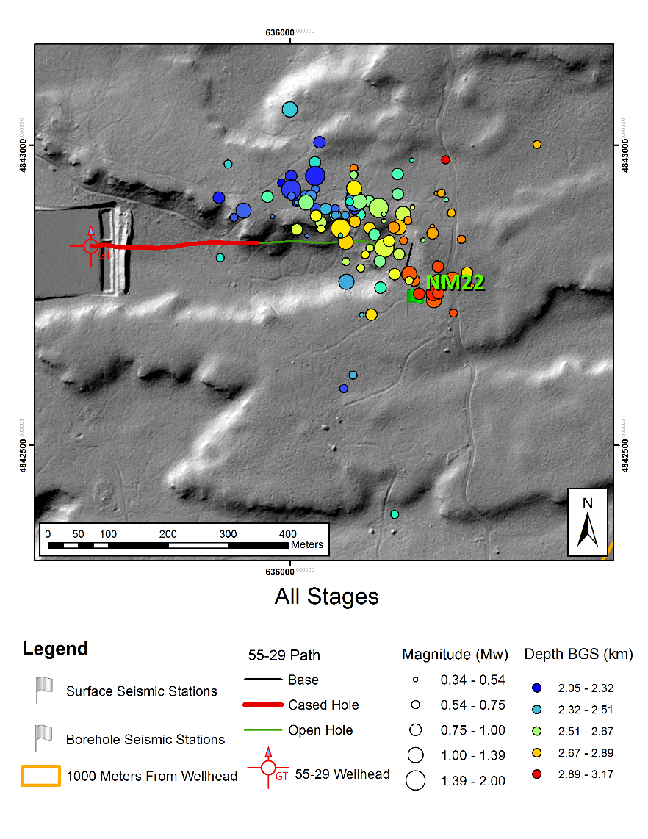
Potential Production Well Targets
Work in Progress
Based on 100 best-located seismic events
Production well will be stimulated (single and dual)
cased
open
Results from Foulger Consulting

Slide 22
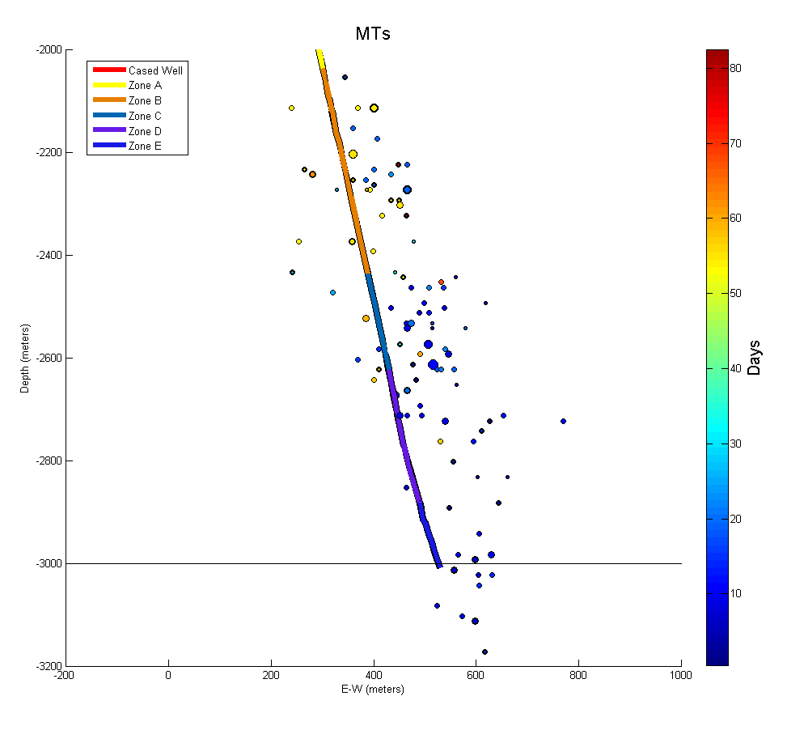

Slide 23
200 m
8°
Over
300 m
20°
15°
Under
200 m

Slide 24
55A-29 Well Target Options
South-side, Deep
PROS
Targets depths with most flow in 55-29
Targets hottest rock
Targets Deep MEQs
Simpler well course
CONS
Does not target majority of 2014 MEQs
Deeper = higher drilling cost
North-side, Shallow
PROS
Targets volume with most 2014 MEQs
Targets Deep Shallow MEQs
CONS
Requires S-curve drill path
Targets cooler rock
Stim. of 55A will likely grow up (?)

Slide 25
Thanks!
Follow us!
blog.newberrygeothermal.org
Facebook - NewberryEGS
This material is based upon work supported by the Department of Energy under Award Number DE-EE0002777.
Disclaimer: This report was prepared as an account of work sponsored by an agency of the United States Government. Neither the United States Government nor any agency thereof, nor any of their employees, makes any warranty, express or implied, or assumes any legal liability or responsibility for the accuracy, completeness, or usefulness of any information, apparatus, product, or process disclosed, or represents that its use would not infringe privately owned rights. Reference herein to any specific commercial product, process, or service by trade name, trademark, manufacturer, or otherwise does not necessarily constitute or imply its endorsement, recommendation, or favoring by the United States Government or any agency thereof. The views and opinions of authors expressed herein do not necessarily state or reflect those of the United States Government or any agency thereof.

Slide 26
Acknowledgement
Funded by the DOE via Recovery Act DE-EE0002777/004

Slide 27
Geology of 9500ft flow zone
Micro-
crystalline
Granodiorite
Subvolcanic Basalt
Epidote veinlets, metasomatic alteration
Microcrystalline Granodiorite
Chlorite alteration of mafics
Subvolcanic Basalt

Slide 28
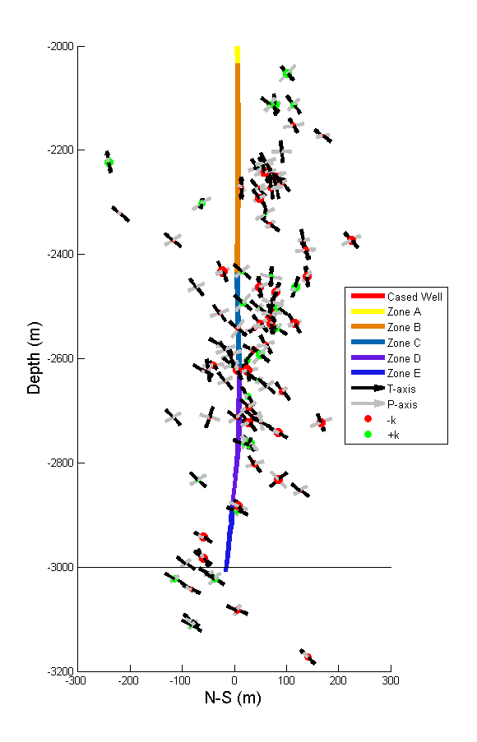
2000
Potential Production Well targets
Cross-section looking west
P&T axes from moment tensor solutions
2200
2400
cased
open
2600
Depth (m)
2800
3000
3200
-200
0
200
South - North (m)

Slide 29
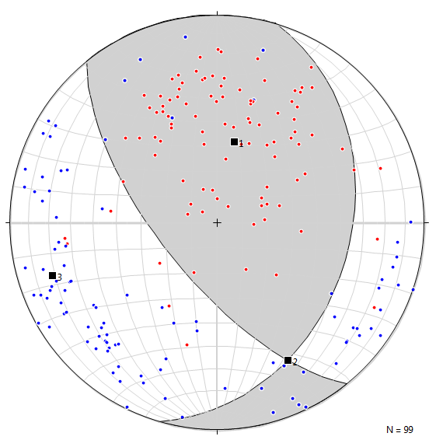
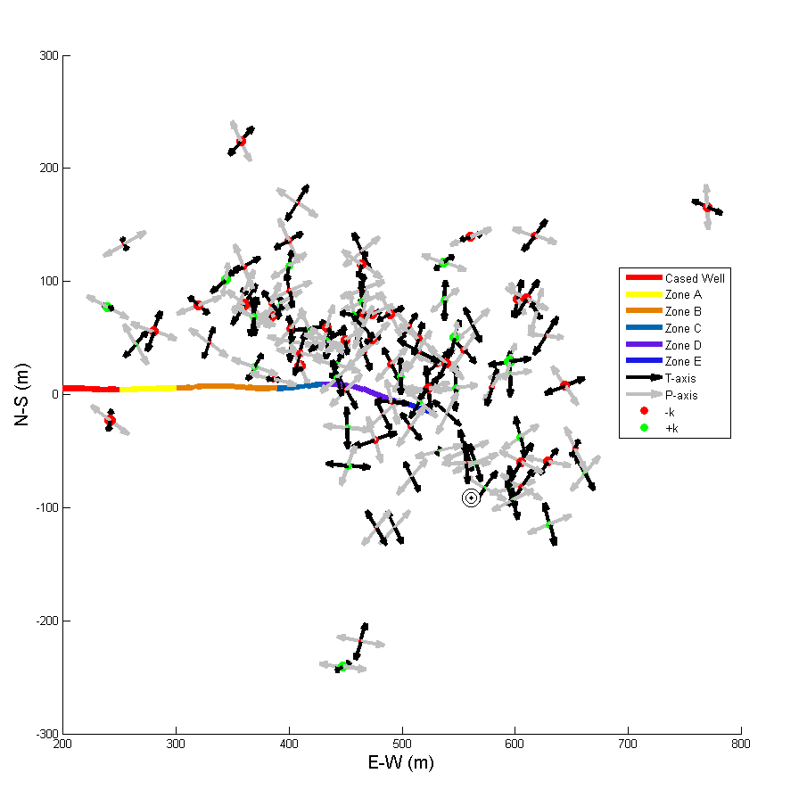
All P&T Axes
Axis Trend Plunge
1. σ3 012.2 57.4
2. σ2 152.8 26.3
3. σ1 252.0 17.9
T-axes from BHTV breakouts
P-axis if strike-slip regime
P-axis if normal regime

Slide 31
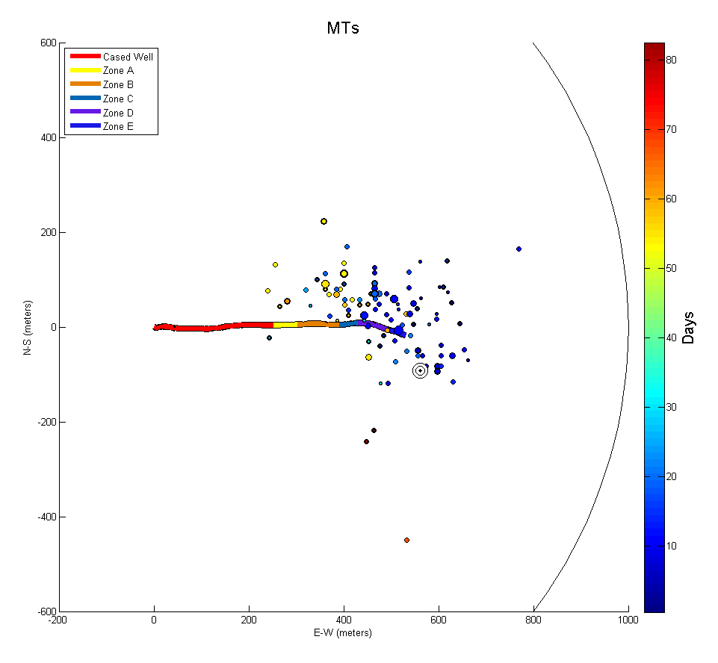
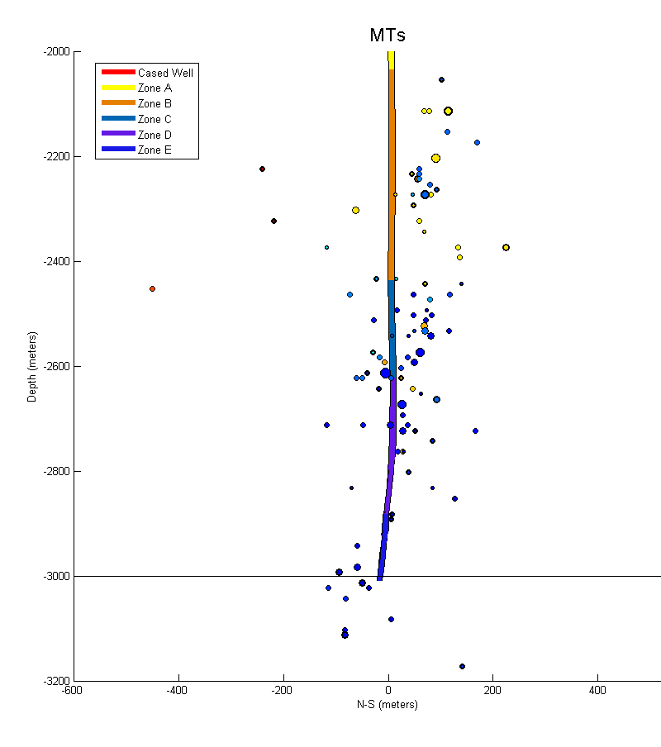
2015: Plan, Drill and Stimulate Production Well
Injection well
300 m
Production well
Injection well
Production
well
Map View
Best MEQ locations (N=100)
West view cross section
Best MEQ locations (N=100)

Slide 32
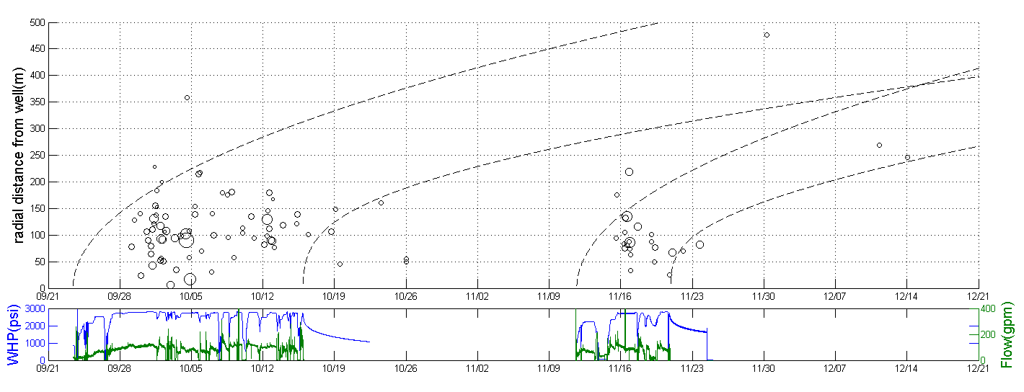

Slide 33
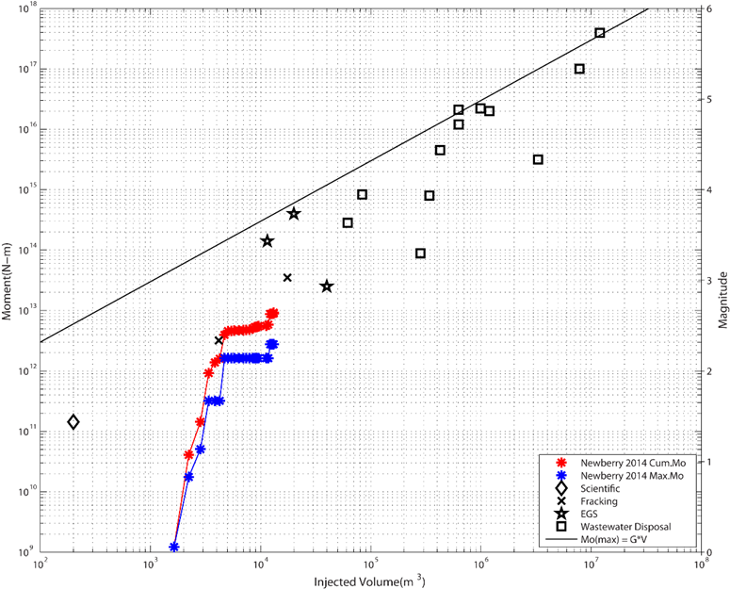
Injected Volume vs. Earthquake Magnitude
(McGarr 2014)
Prague, OK
RatonB
RMA
M 5
M 4
M_{o} = G Vinj
Basel
M 3
Soultz
M 2
10,000 m³
63,000 bbl
2.6 mgallons
8.1 acre-ft

Slide 34
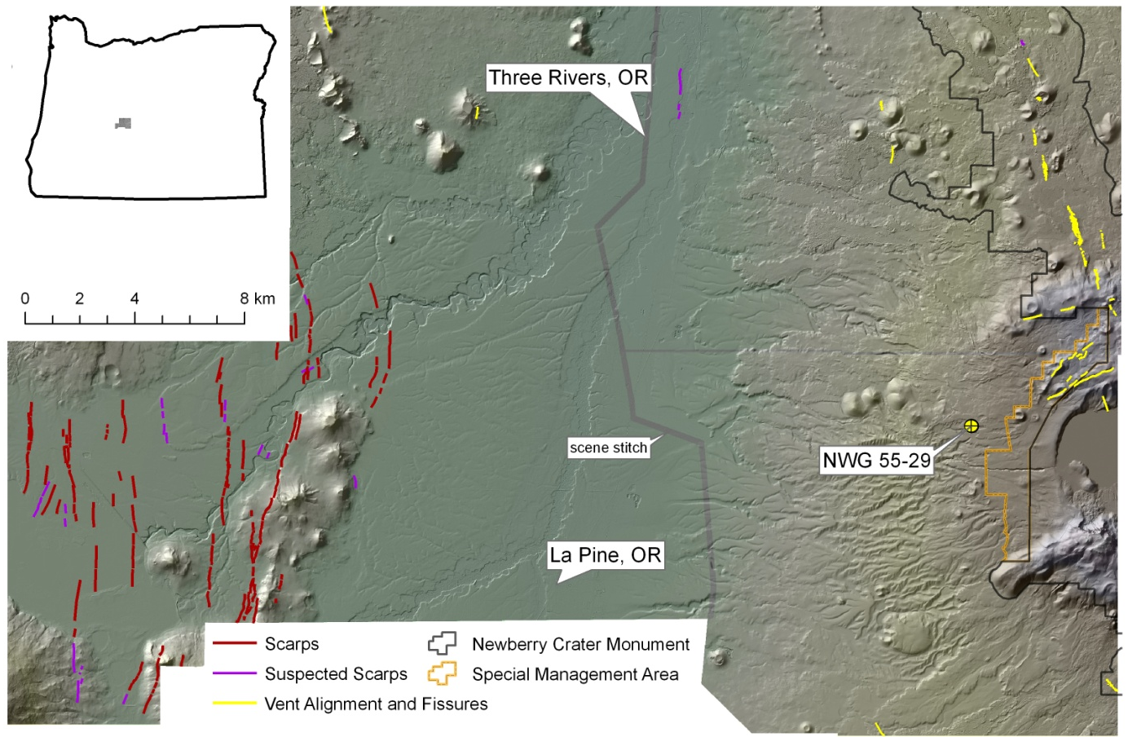
Oregon LiDAR Consortium: Deschutes and Newberry, summer 2010
Vents and
Fissures
Extension Direction (consistent with
Regional focal mechanism inversions)
E-W S_{hmin}
Ring
Fractures
Scarps

Slide 35
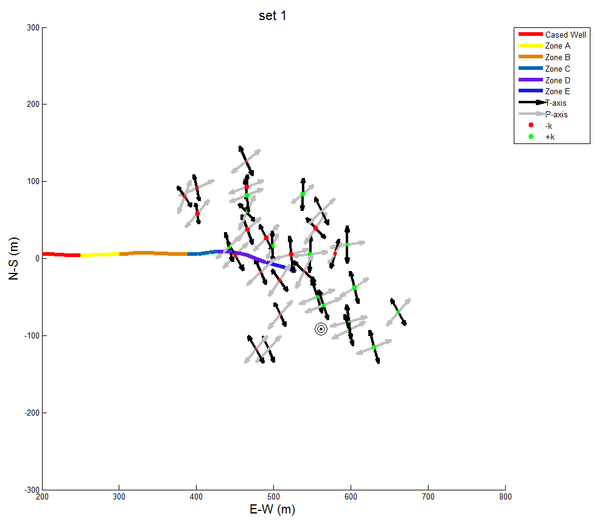
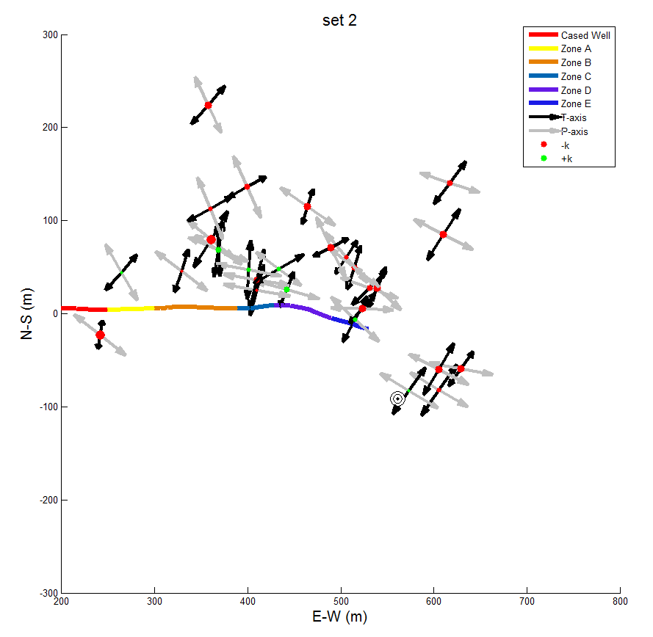
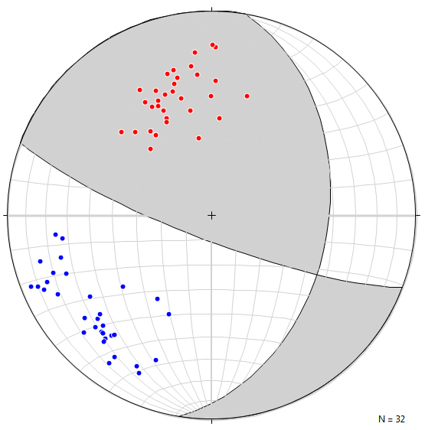
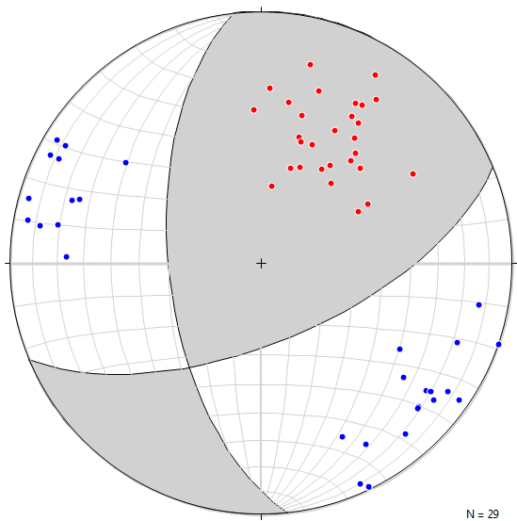
Set 1
Set 2

Slide 37
Borehole Televiewer Log: Newberry Well 55-29
2-Way Travel Time Amplitude
Fast Slow Low High
2-Way Travel Time Amplitude
Fast Slow Low High
F
L
B
B
Measured Depth, ft
F
N E S W N
N E S W N
N E S W N
N E S W N

Slide 38
Stress Model
density logs
injection test
BH breakouts
rock strength
Stress Orientations from BHTV
Profiles of Stress Magnitudes

Slide 39
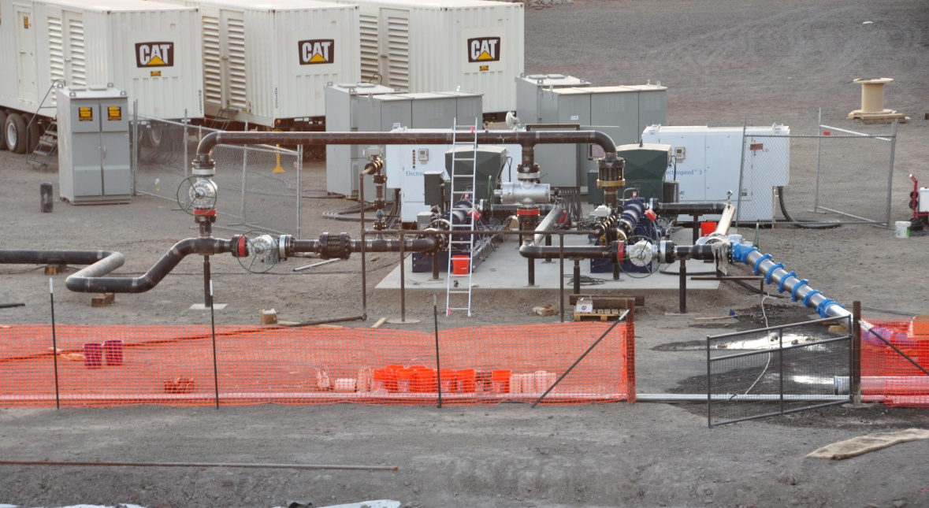
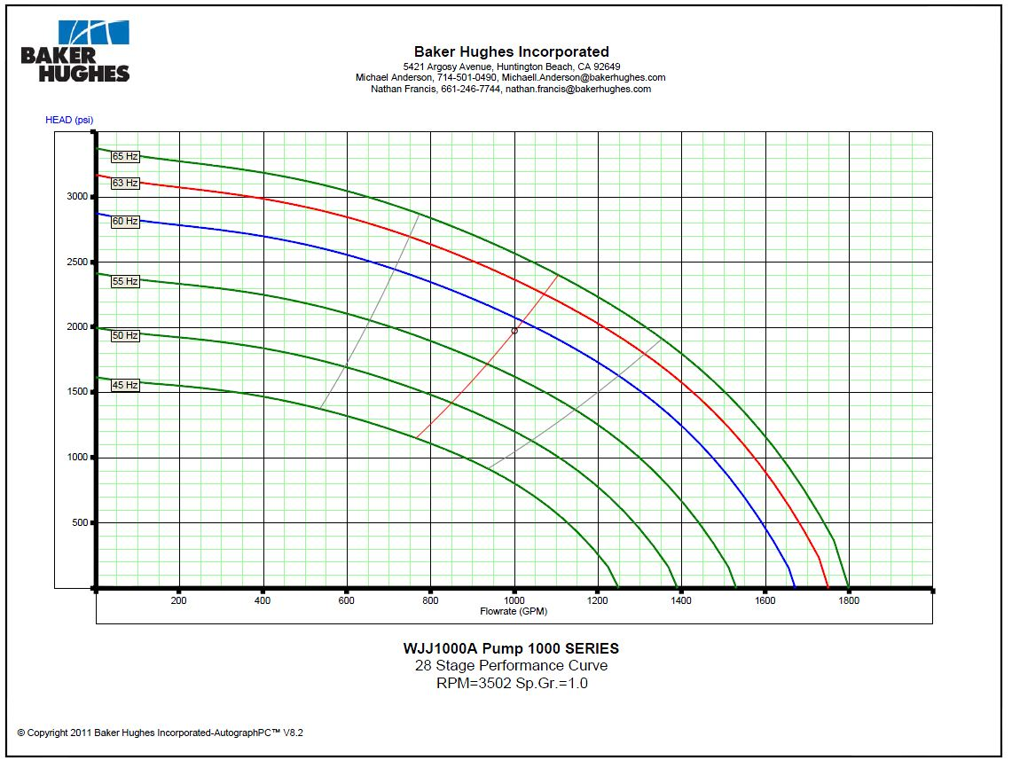
Innovation: Centrifugal Stimulation pumps
Challenge: Stimulation pump reliability, suitability, and high rental cost
Solution: Centrifugal, electric pumps
Two 14 stage centrifugal pumps connected by 10 inch pipes & four valves
HP (Newberry) Mode: in series with bypass line to allow sufficient flow to keep pumps cool when injecting to very low permeability wells
LP Mode: in parallel for 1450 psi (100 bar) and 1600 gpm (100 l/s)
2850 psi – 195 bar
800 gpm – 50 l/s
Pump curves for HP Mode

Slide 40
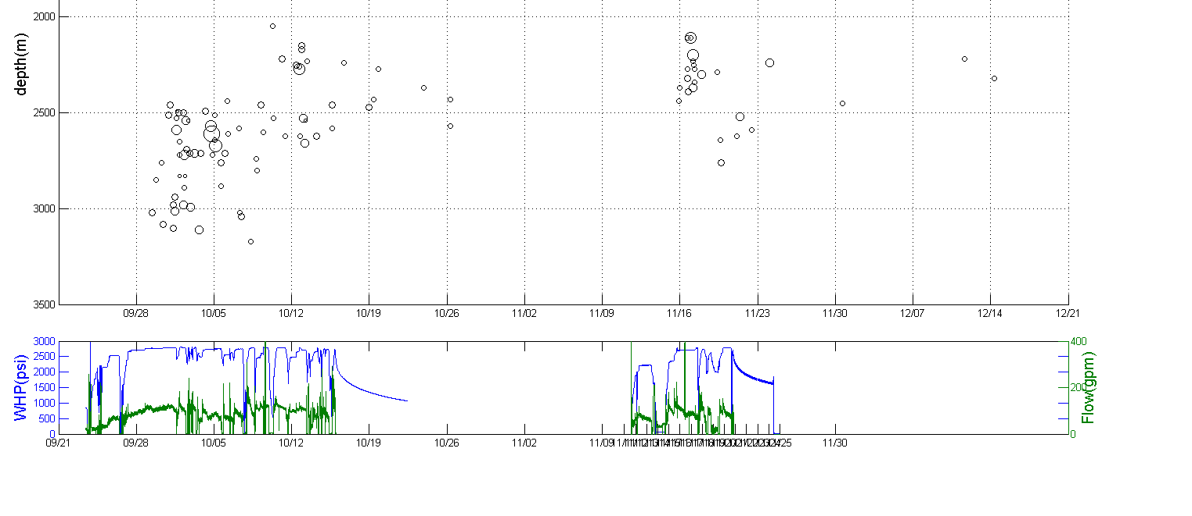

Slide 41
