Slide 1
Numerical Modeling for Hydraulic Fracture Prediction on Fused Silica Surrogate Cylindrical Samples
Varun Gupta

Slide 2
Goal: To predict overpressures required to fracture an homogeneous pure (surrogate) material with known mechanical properties to compare these values to experimental overpressures obtained in our lab-scale stimulation system.
Geometry and Material Properties
3.2 mm
Material: Fused Quartz
Assumptions:
Linear Elastic material behavior is assumed with the following properties:
Young’s Modulus = 74 Gpa
Poisson’s Ratio = 0.17
Fracture Toughness = 0.65-0.70 MPa m^{0.5}
Thermo-mechanical effects are not considered
25.4 mm
50.8 mm
16 mm

Slide 3
Numerical Model: Loading and BCs
Modeled as an axisymmetric problem
Constant confining pressure of 5000 psi is applied
Internal pressure is applied incrementally
Quantity of interest: Fracture parameters near the corner
Objective is to determine the internal pressure which leads to fracture
P_{int} =
6000-9000 psi
P_{ext} = 5000 psi
Fixed

Slide 4
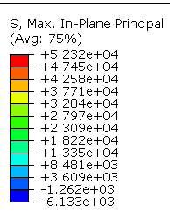
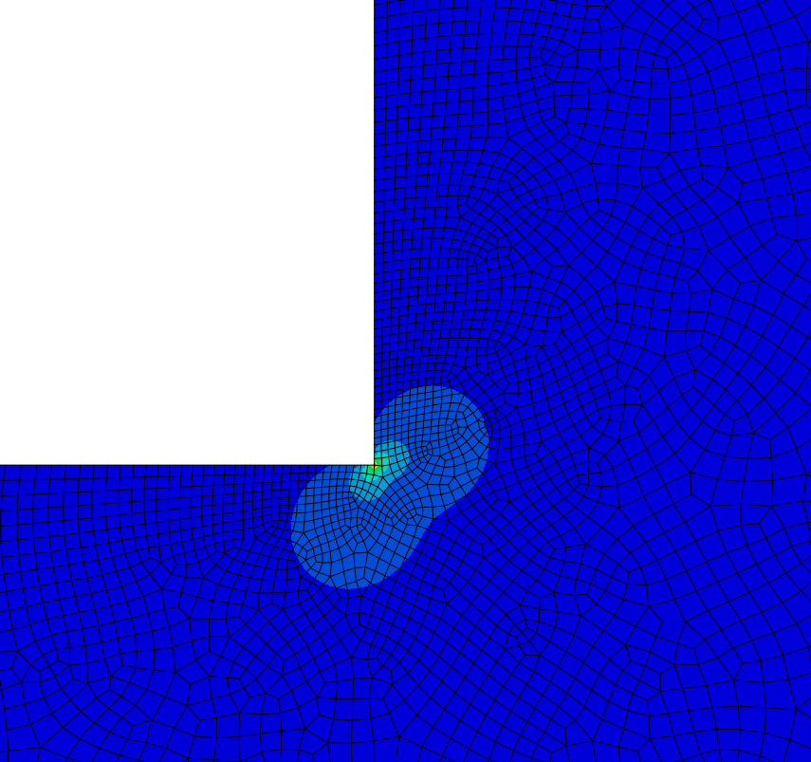
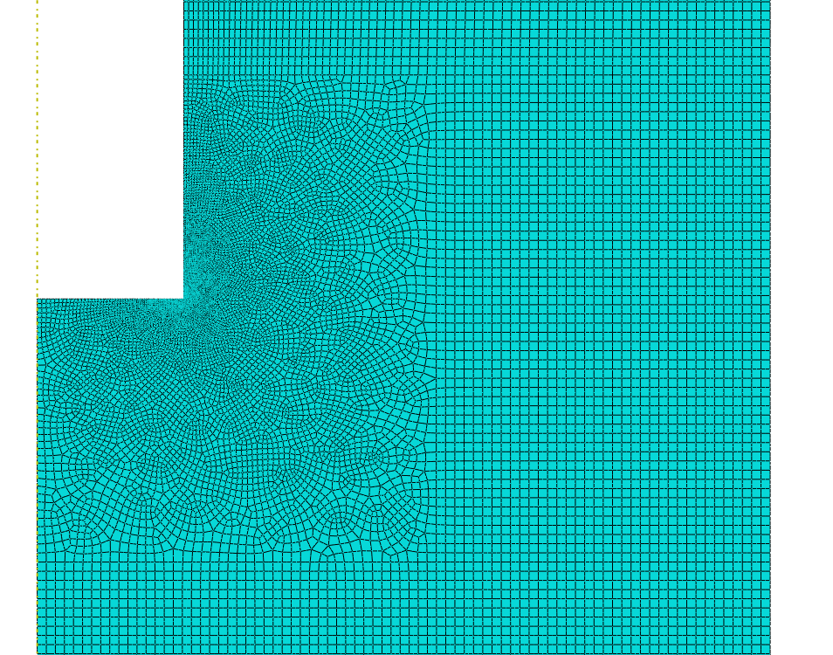
Mesh Details and Stress distribution
Number of elements: 44915
Number of nodes: 136066
Quadratic quadrilateral elements are used
Localized refinement performed close to the corner
Maximum in-plane principal stress at
P_{int} = 9000 psi

Slide 5
Direction of crack extension
θ
Maximum energy release rate is attained at an angle of 45°, which is the angle of crack initiation

Slide 6
Stress Intensity Factor vs Internal Pressure
Given the fracture toughness of KIC = 0.7 Mpa m^{0.5} , at 5000 psi confining pressure the fracture is predicted at P_{int} ~ 8500 psi, i.e., overpressure = 3500psi

Slide 7
Effect of Different Confining Pressure
Confining pressure does not seem to have a significant role in the fracturing overpressure.

Slide 8
Smoothed corner
R 0.1mm
Smoothing the corner out averts failure until much higher load
For example, introducing 0.1 mm fillet radius increases the fracture
overpressure to ~10,600 psi

